Slide 1
Text Mining
Chong Ho Yu, Ph.D., D. Phil.

Slide 2

What is text mining?
Also known as text analytic.
A process of extracting useful information from document collections through the identification and exploration of interesting patterns (Feldman & Sanger, 2007).

Slide 3
What is text mining?
While data mining is often used to analyze structured data, which is a small percentage of existing data sources, text mining is the ideal tool for tapping into under-utilized, unstructured data.
Difference: numeric data vs. textual data
Same principles
  Extraction (mining)
  Exploration
  Pattern seeking
You! yes, you created textual data everyday! Whenever you send emails and post messages on your FaceBook or blog, these become data! And we have tons of back data (historical archives)

Slide 4
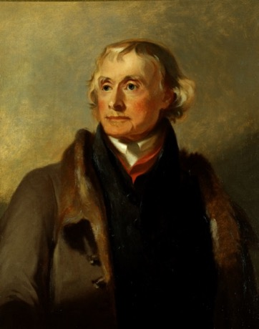
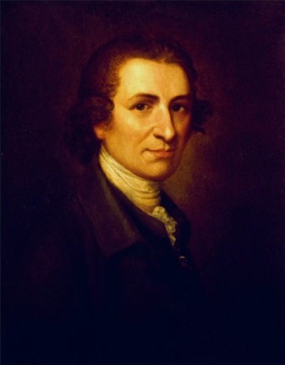
Question 1
Some scholars argue that America is not a Christian nation in the sense that the Christian belief is not the foundational ideology shared by our founding fathers.
Indeed several founding fathers and influential figures are deists, such as Thomas Jefferson and Thomas Paine.
What research methodology can you use to respond to this question?

Slide 5
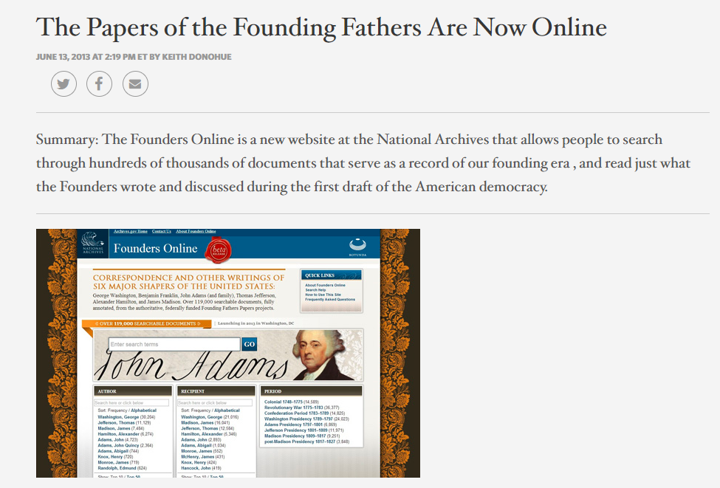

Slide 6

Question 2
How is American idols related to text mining?
May 2010 show
23 million viewers
Who will be the winner?

Slide 7
Text mining predicted winner
MTV.com: “American idol’ Finale: Lee DeWyze upsets Crystal Bowersox”
But text miners saw it coming without polling data.
They monitored social media and conducted sentiment analysis (will be discussed later)

Slide 8
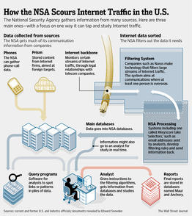
Question 3
How is anti-terrorism
related to text mining?
NSA veteran William Benny estimates that NSA had collected between 15 and 20 trillion transactions in 11 years.

Slide 9
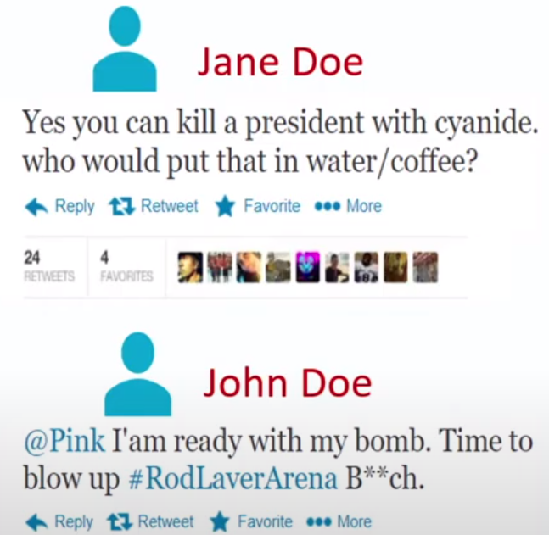
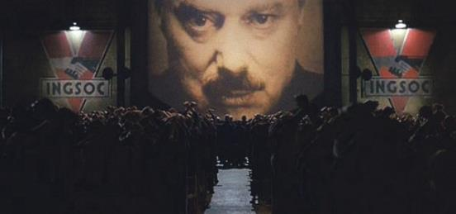
Question 3
If someone posts threatening messages on social media, the text mining algorithm of the law enforcement can detect it.
The next day the FBI will knock on his door.
Big brother is watching you!
Notes:
Source: Hate speech classification of social media posts using text analysis and machine learning. 2020 SAS Global Forum.

Slide 10

How is anti-terrorism related to text mining?
DoD funded ASU researchers to study the messages posted by Islamists.
They concluded that verses extremists cite from the Quran do not emphasize conquest of infidels.

Slide 11
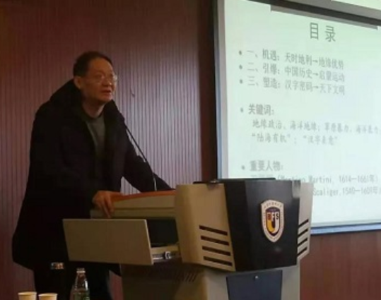
Question 4
In 2019 a Chinese-British scholar asserted that the Western civilization is a “branch” of the Chinese culture because from 17th to 18th centuries European thinker were deeply influenced by Confucianism and Taoism.

Slide 12
Question 4
Content analysis
If Confucianism and Taoism were very influential in Europe during the 17th and 18th century, European writers should mention those concepts very often.
Google scanned many classic texts into digital archives.
https://books.google.com/ngrams

Slide 13
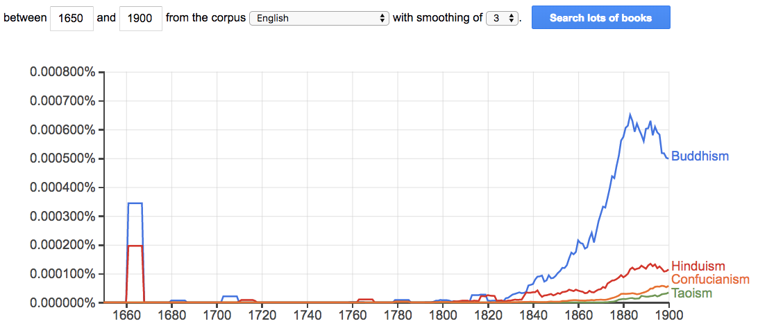
Google Books Ngram Viewer
English books

Slide 14
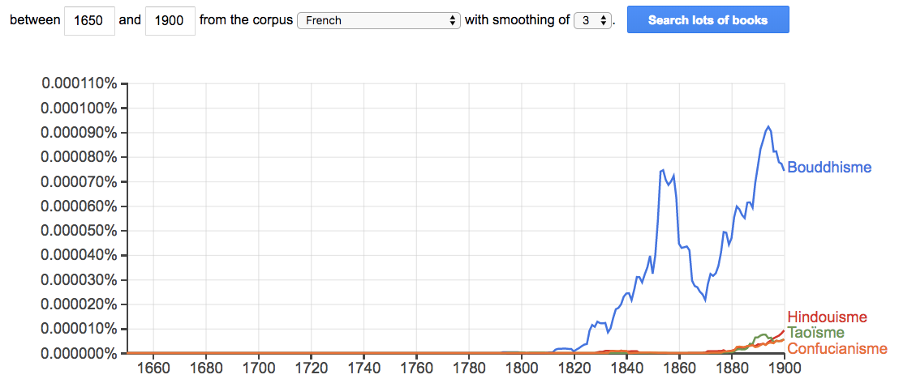
Google Books Ngram Viewer
French books

Slide 15
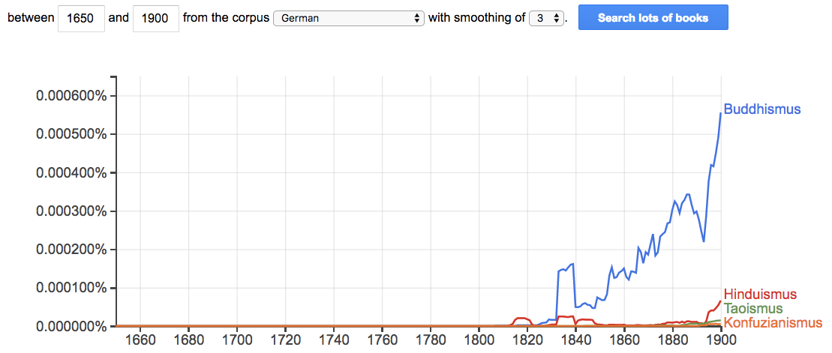
Google Books Ngram Viewer
German books

Slide 16
Google Books Ngram Viewer
Caution: When someone performed a content analysis pertaining to the history of Internet abbreviations, such as “lol” and “wt*,” it was found that these terms reached their peak usage around 1660.
It is resulted from errors in optical character recognition (OCR).

Slide 17
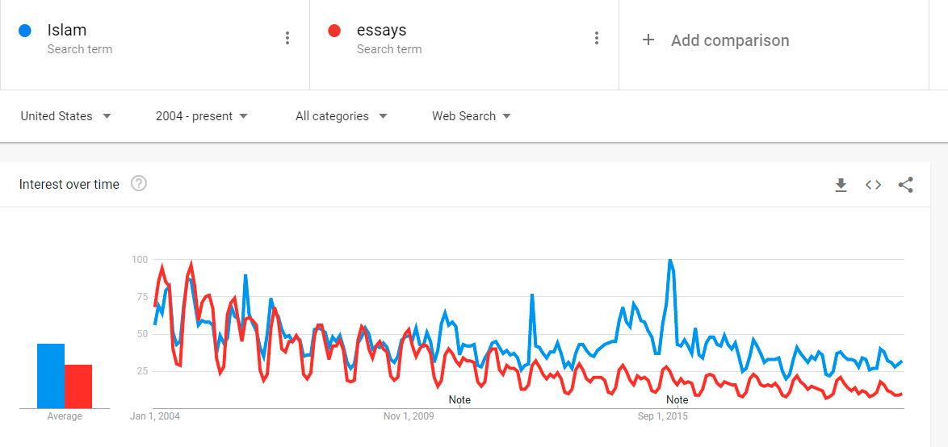
Google Trends: Content analysis
The searches for “Islam” and “essays” appear to be seasonal and are correlated. Why?

Slide 18
Google Trends: Content analysis
The searches for “Islam” and “essays” appear to be seasonal and are correlated. Why?

Slide 19
Google Trends: Content analysis
“The prominent dynamic in searches for ‘Islam’ is the same as that in searches for ‘essays'. US internet search for some topics is dominated by the academic calendar and the demands placed on high school and college students in common courses.”
Goist, M., & Monroe, B. (2020). Taking data seriously in the design of data science projects. In Luigi Curini & Robert Franzese (Eds.), The SAGE handbook of research methods in political science and international relations (pp.79-103). Sage. DOI: https://dx.doi.org/10.4135/9781526486387

Slide 20
The forerunners of TM
TM is not entirely new.
Qualitative researchers have been doing content analysis and grounded theory by hand.
Yu, C. H. & Marcus-Mendoza, S. (1993). Attitudes of correctional staff. In B. R. Fletcher, L. D. Shaver, & D. G. Moon (Eds.), Women prisoners: A forgotten population (pp.111-118). Westport, Connecticut: Praeger.
Yu, C. H., Jannasch-Pennell, A., & DiGangi, S. (2011). Compatibility between text mining and qualitative research in the perspectives of grounded theory, content analysis, and reliability. Qualitative Report, 16, 730-744. [link]

Slide 21


Qualitative method
Classify how correctional officers perceive the objective of imprisonment by reading their responses to open-ended questions.
  Retribution
  Deterrence
  Rehabilitation/restoration
This is tedious to read through the documents! Today we have AI!

Slide 22
Another forerunner
Hypothesis generation by Swanson process.
Based on the idea of concept linking, Swanson (1986) carefully scrutinized the medical literature and identified relationships between some apparently unrelated events, namely, consumption of fish oils, reduction in blood viscosity, and Raynaud’s disease.

Slide 23
Hypothesis generation
His hypothesis that there was a connection between the consumption of fish oils and the effects of Raynaud’s syndrome was eventually validated by experimental studies (DiGiacomo., Kremer, & Shah, 1989).
Using the same methodology, the links between stress, migraines, and magnesium were also postulated and verified.

Slide 24

Don R. Swanson
Swanson had no formal training in the biomedical field!
He received a BS in Physics at Caltech, a Ph.D. in Theoretical Physics from UC Berkeley.
Worked as a physicist at various lab.
Become a professor and Dean of Graduate School of Library Science at the U. of Chicago.
The key of his success is concept linking.

Slide 25

Artificial intelligence
TM enhances grounded theory and concept linking by automation.
TM utilizes the technology of natural language processing, a subfield of artificial intelligence (AI) & computational linguistics.
Why do we need natural language processing in data mining?
The software app must be smart enough to understand the context.

Slide 26
Artificial intelligence
Well, I don’t work at NSA. I don’t have AI software. What I have is the opposite of artificial intelligence: genuine stupidity.
Can I still do something about text mining?

Slide 27
Natural Language Processing
They don’t mean the same thing
I book a ticket to Paris.
Hanna read Dr. Yu’s boring book.
Peter is a senior at Azusa Pacific University.
Alex received a senior discount at TJX (soon).
Paul is a senior manager at TJX.
Age and sex are included in the demographic data.
Jesse Helms proposed an amendment to ban sex education.

Slide 28

Human languages are contextual
Interactionist approach to parsing
  Semantics and syntax both influence processing as one reads a sentence
  The spy saw the man with the binoculars
  The bird saw the man with the binoculars
  The man saw the bird with the binoculars

Slide 29
Ungraded Pop quiz: Which of the following statements is true?
How we interpret a sentence depends on its meaning and context.
How we interpret a sentence depends on its grammatical structure.
How we interpret a sentence depends on the processing speed of our working memory.
Both A and B

Slide 30
Ambiguous and multiple meanings
Soviet Virgin Lands Short of Goal Again
It could mean the landings of Virgin Airline operated in Russia could not meet expectations (bumpy landing)

Slide 31
Can AI understand?
Soviet Virgin Lands Short of Goal Again
In 1953 the Virgin Lands campaign was launched in an attempt to boost the Soviet Union’s agricultural production by utilizing unused lands.

Slide 32
Can AI understand?
The poor living conditions caused many workers to leave the Virgin Lands.
Very little infrastructure existed in the Virgin Land provinces. When harvesting began there were minimal storage facilities for the crops. A large amount of the crop left in the fields to rot.

Slide 33
What does it mean?
British Left Waffles on Falkland Island
It could mean: British people are so nice that they left a lot of food on the island when they left.

Slide 34
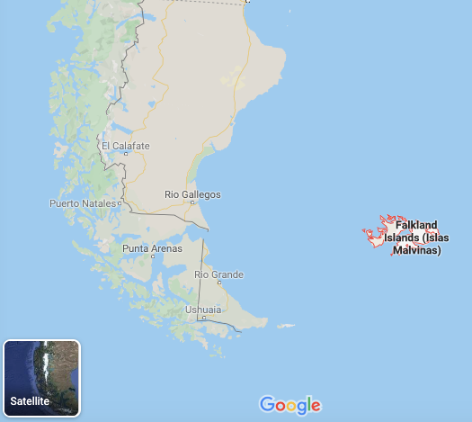
Can AI understand?
British Left Waffles on Falkland Island
British Left Waffles on Falklands” was an actual news headline in the UK’s Guardian newspaper when the UK and Argentina fought a war over the ownership of the Falkland Islands in 1982.

Slide 35
Can AI understand?
British Left Waffles on Falkland Island
The UK political parties in England argued how to respond to the crisis.
In British English, an indecisive state is referred to as “waffling.”

Slide 36
Can AI figure out what these mean?
The student failed the professor
Eye drops off shelf
Farmer Bill Dies in House
Police begin campaign to run down jaywalkers
Teacher strikes idle kids
Iraqi head seeks arms
Kicking baby considered to be healthy
President Reagan wins on budget, but more lies ahead
Two sisters reunite after eighteen years at checkout counter
Ousted Ambassador to Ukraine Testifies in House

Slide 37
Steps
Pre-processing and extraction: Obtain meaningful terms and phrases.
  Tokenization
  Stop-word removal
  Stemming
  Lemmatization
Categorization: Classifying terms and phrases into concepts or themes.
Concept linking: Identifying the relationships between concepts

Slide 38
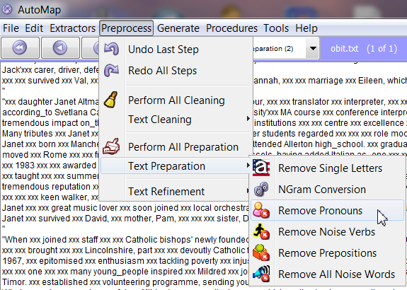
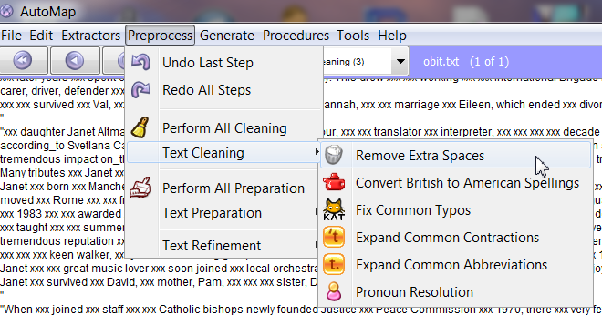
Some software apps (e.g. AutoMap [freeware]) require too much manual pre-processing inputs
Windows only http://www.casos.cs.cmu.edu/projects/automap/

Slide 39
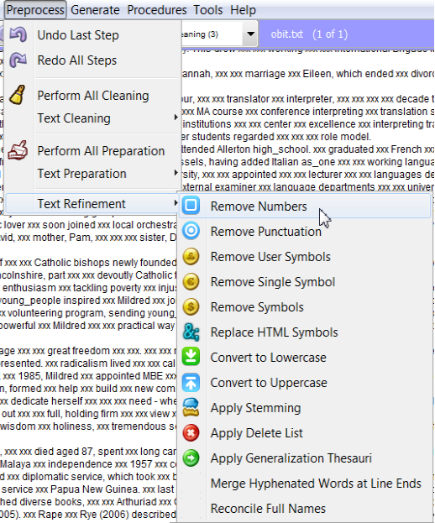
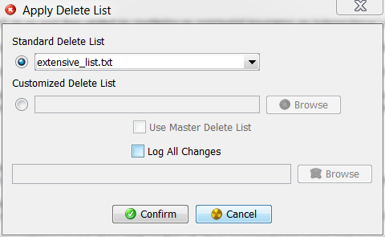
Too much manual pre-processing inputs

Slide 40
Tokenization
Pre-processing should be automatic
Separating the punctuation from the words yet the results are still meaningful.
For example, there are periods inside a string of IP address, such as “129.2.13.105,” but if all periods are removed, then the string “129213105” would become meaningless

Slide 41
Garden path sentences
Garden path sentences
  Sentences that begin by appearing to mean one thing, but then end up meaning something else
Temporary ambiguity
  When the initial words are ambiguous, but the meaning is made clear by the end of the sentence
After the musician played the piano was wheeled off the stage.
Is the musician on the wheel chair?
After the musician played, the piano was wheeled off the stage (The comma is crucial).

Slide 42
Stop-word removal
Remove trivial words, such as “a,” “an,” “the,” “is,” “am,” “are,” “however,” “although,” “but,” etc.,
This process necessitates AI, otherwise, on some occasions important information might be lost.
  “To be or not to be”
  “If it is to be, it is up to me.”
  “Brazil traveler to USA need a visa.”

Slide 43
Solution: BERT
BERT (Bidirectional Encoder Representations from Transformers) was invented by Google researchers of AI Language in 2018-2019.
The traditional AI system “read” the sentence sequentially (e.g. from left to right).
In BERT the reading is bi-directional (read the whole sentence at once) in order to determine the role of surrounding words (left and right), including common words, in the sentence.
Transformer, developed by Google in 2017, is a mechanism that learns the contextual relations between words.

Slide 44
BERT & Transformer
Before Transformer, the state-of-the –art model is seq2seq, which was also developed by Google.
Transformer is 61 times more efficient (less compute than seq2seq2.
Open AI spent $12 million to train its GPT-3 language model.
Google spent $6912 to train BERT.
Notes:
Source: https://venturebeat.com/2020/07/15/mit-researchers-warn-that-deep-learning-is-approaching-computational-limits/?fbclid=IwAR3jjwWwVe7qPHPznddAokplj5nzOkXdPuZA3ouOo7bJgGUV1fLHBNR-OyM

Slide 45

BERT
In the sentence “2019 Brazil traveler to USA need a visa,” how the word “to” and other words related is important for understanding the meaning.
Older NLP misinterpreted the first sentence as the visa requirement of US citizens traveling to Brazil.

Slide 46

BERT
With BERT Google NLP is able to learn that the very common word “to” matters a lot.

Slide 47
Stemming and Lemmatization
Stemming: remove prefix and suffix e.g. “computer”, “computational”, and “computing” can be reduced to the same stem, “compute”
Lemmatization: use a set of rules to reduce the inflectional forms of a word to its root form e.g. “boys” can be changed to “boy” and “children” becomes “child”

Slide 48
Software modules
We will compare the results of several text mining approaches, including:
  JMP Pro: Text Explorer
  IBM SPSS Modeler: Sentiment analysis
  IBM SPSS Modeler: Text Mining: No pre-built category
  IBM SPSS Modeler : Customer survey category

Slide 49
Example 1
The data source, which encompasses responses to an open-ended survey item collected from a US Southwestern university, was used for extracting common threads.
“If you had the ability to design your ideal online learning environment--What would you like to see? How would it look and feel? What features would it have?”
Effective sample size: 3,193

Slide 50
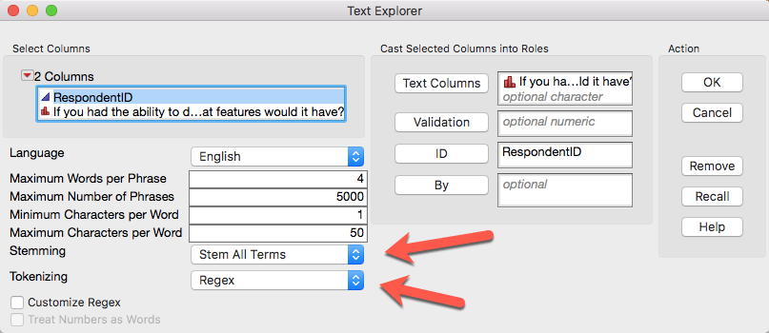
Text Explorer in JMP
Analyze → text explorer

Slide 51
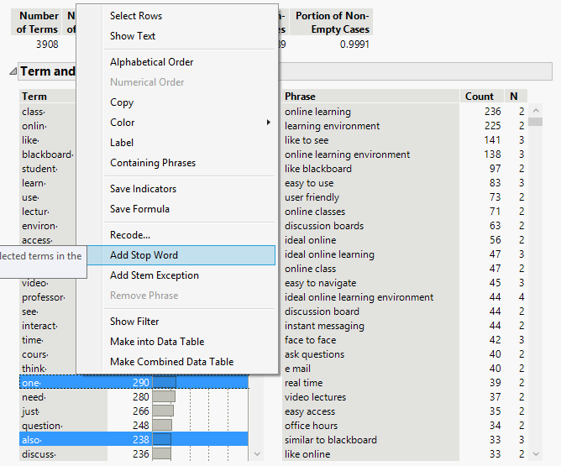
Text Explorer in JMP
Phrases are good.
Terms: Stop-word removal isn’t good.

Slide 52
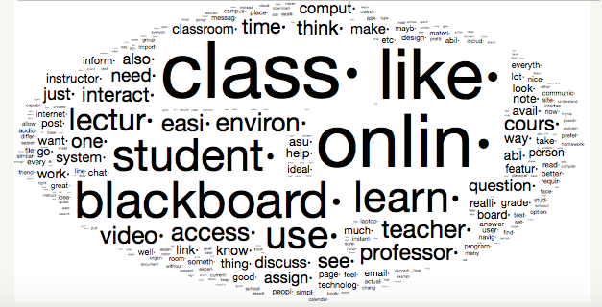
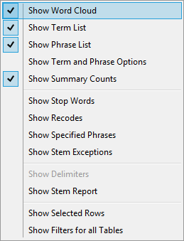

Word Cloud
Fun to look at but may not be helpful to research

Slide 53
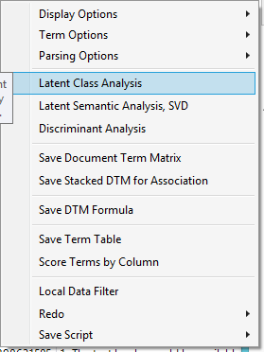
Latent class analysis
LCA is a form of cluster analysis for textual data.
The goal is to group similar concepts (or terms) together.

Slide 54
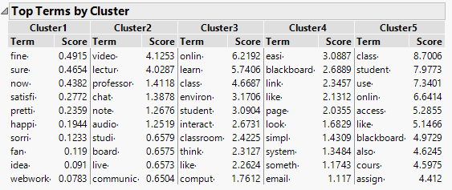
Latent class analysis

Slide 55
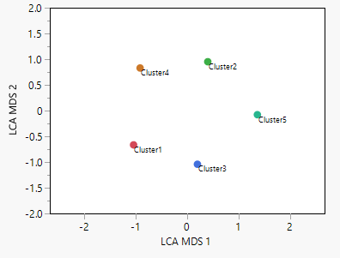
LCA and MDS
Cluster analysis and Multi-dimensional scaling (MDS) can work hand in hand.
The graph shows five distinct clusters of terms.

Slide 56
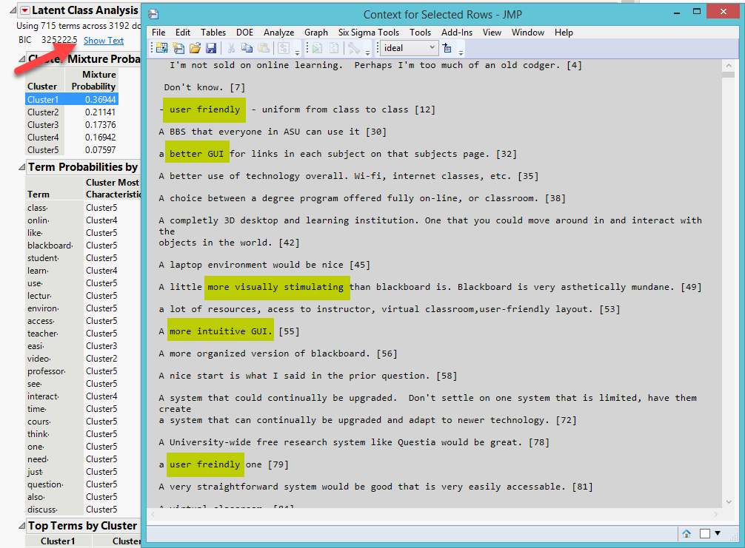

Slide 57
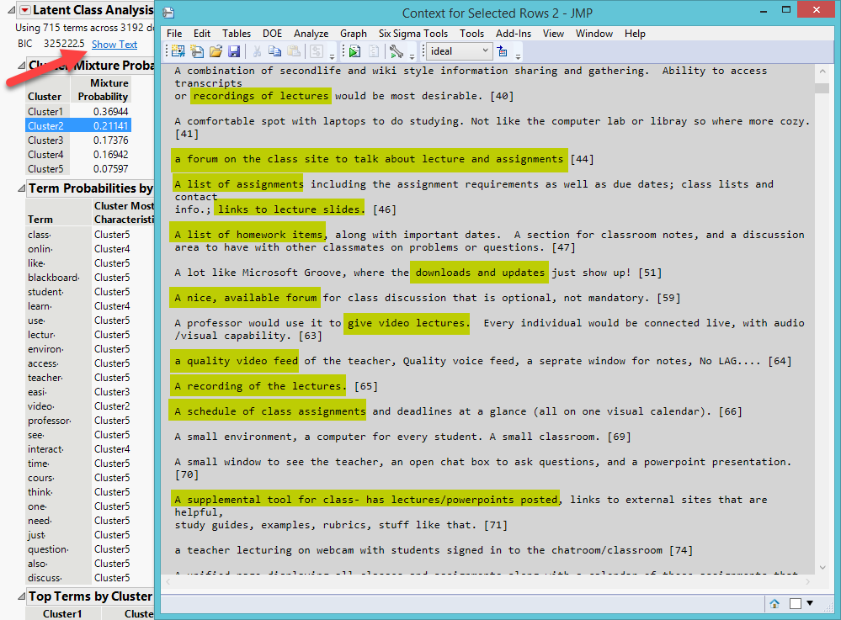

Slide 58
Name the cluster
Concept 1: User friendliness or user interface
Concept 2: Accessibility to course-related resources
Concept 3, 4, 5…etc.

Slide 59
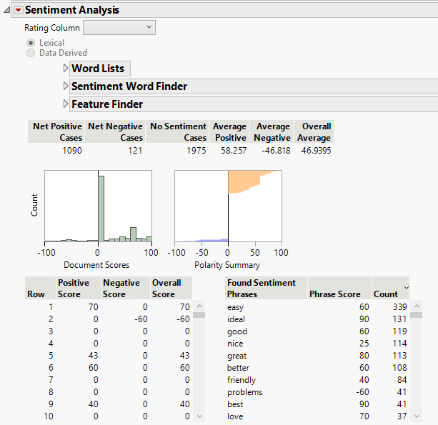
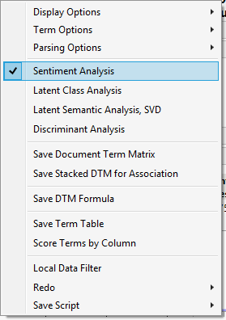
Sentiment analysis

Slide 60
Example 2 of Text Explorer
Interpretation student evaluation is subjective. If there are diverse opinions, text mining can be used.
Data source: Open-ended comments by students of all classes taught by the same faculty in the last 3 years.

Slide 61
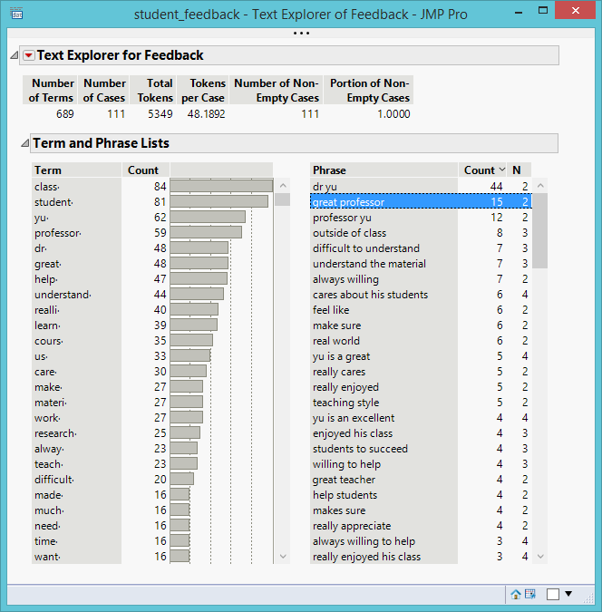
Example 2: JMP Text Explorer

Slide 62
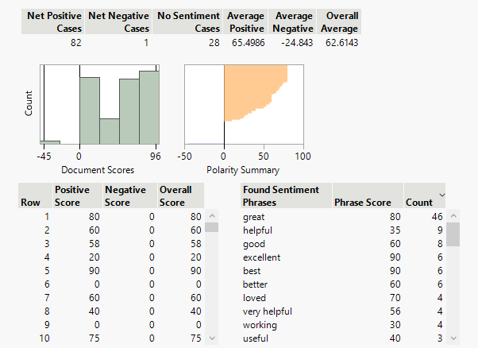
Sentiment analysis

Slide 63
Sentiment analysis
Also known as opinion mining
Sentiment means an attitude or judgment based on one’s feeling e.g. “I don’t like the computer lab”
Opinion is a view or appraisal about a particular matter e.g. “I think the computers at the lab are outdated”
Used interchangeably

Slide 64
Challenges to SA
In some cases classifying sentiment as positive, negative, or neutral is straight-forward while in some situations it is tricky.
  Sarcasm
  Negation
  Valence-shifting
  Irrealis

Slide 65

Sarcasm
When the writer made sarcastic expressions, it could fool a regular text mining software package
Consider this passage: “The professor is very great! I didn’t study at all. I closed my eyes throughout the whole semester and still got an A!”

Slide 66

Sarcastic or serious?
“And then I see the disinfectant, where it knocks it out in a minute. One minute. And is there a way we can do something like that, by injection inside or almost a cleaning. Because you see it gets in the lungs and it does a tremendous number on the lungs. So it would be interesting to check that. So, that, you're going to have to use medical doctors with. But it sounds -- it sounds interesting to me.”

Slide 67
Solution: CNN
Convolutional Neural Networks (CNN)
Model local features to learn global features
Detecting contradictions
  “I love the pain of breakup.”
  “I work so hard to be so poor.”
  “Truly, you have a dizzying intellect. (Wesley, The Princess Bride)

Slide 68
Negation
The positive polarity is reversed by a negative word.
“No one thinks it is good.” In this case, although “good” is a positive word, the phrase “no one” alters its connotation.
“Parking on a hill with no curb.”

Slide 69
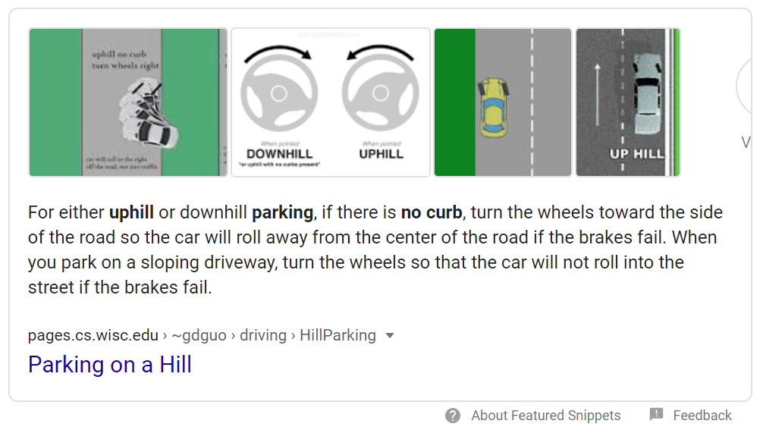
Solution: BERT
In the past Google ignore “no” but now…

Slide 70
Value-shifting
In some cases a single word in a sentence shifts the meaning.
This is a missed opportunity”
“The medicine kills cancer cells”

Slide 71
Irrealis
When a conditional sentence implies a counterfactual scenario, it might be difficult to tell whether it is positive or negative
“It would be better if the Wi-Fi network is faster.” The student might be satisfied with the existing connection speed but he is looking for more bandwidth. It might also be the case that he could not stand the slowness of the current Wi-Fi network.

Slide 72
Assignment 10
Use the data set “young adults deconversion”
Use the last data column for text explorer and stem all terms.
Create a word cloud
Perform sentimental analysis.
What is the ratio of positive and negative sentiments?

Slide 73
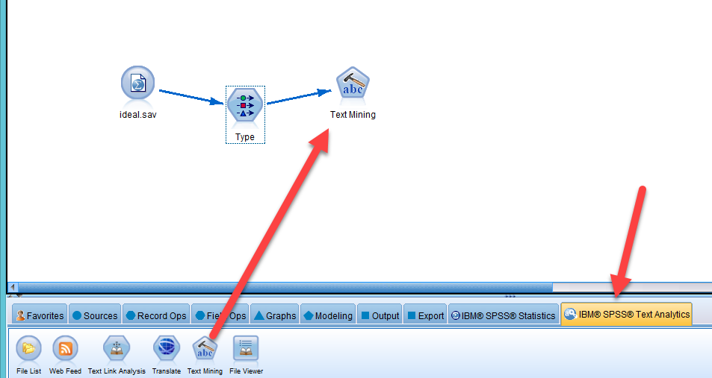
IBM SPSS Modeler:
Text Analytics
Windows only

Slide 74
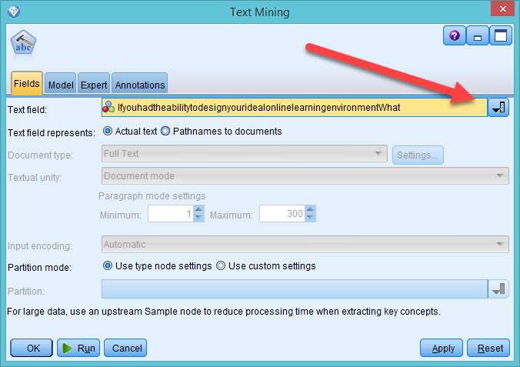
IBM SPSS Modeler:
Text Analytics
Choose the text field to analyze

Slide 75
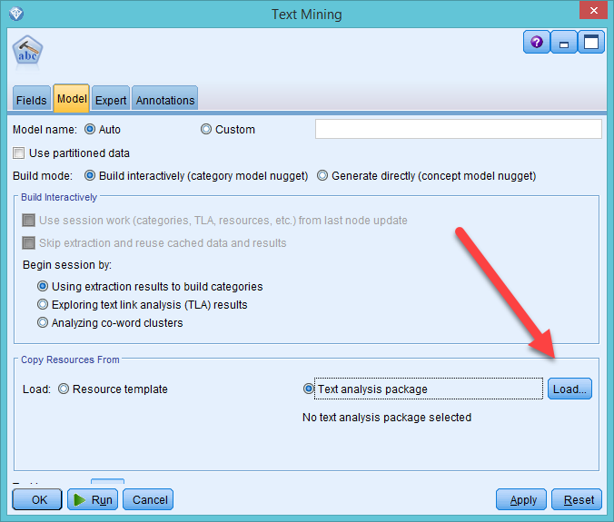
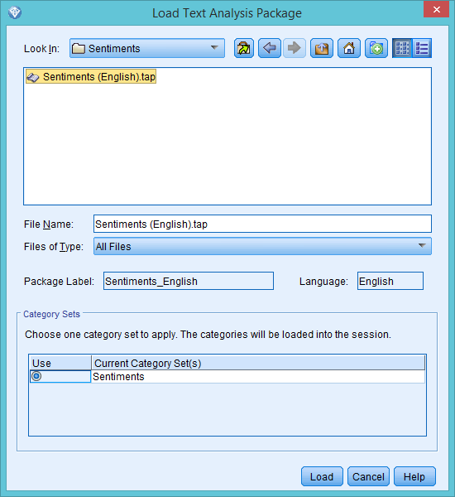
IBM SPSS Modeler:
Text Analytics
Load a pre-set package → English → Sentiment

Slide 76
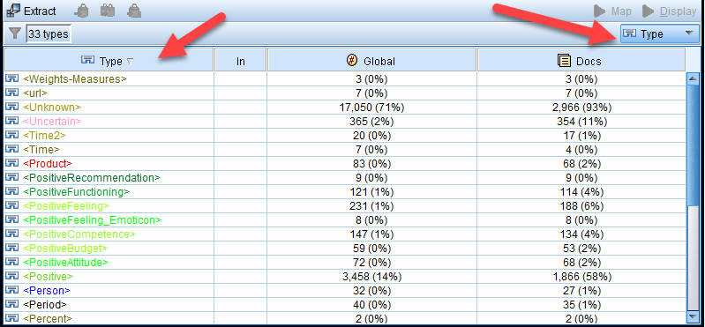
IBM SPSS Modeler:
Text Analytics
Choose Type and Sort
Look for sentiment: Positive and negative

Slide 77
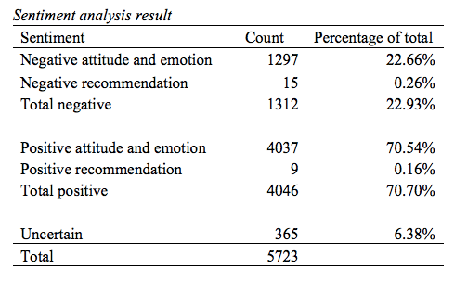

Slide 78
Example of positive recommendation
“The features that Blackboard has are very nice, the only difference is that the email program does not always work very well when sending messages to classmates through the roster, so I would try to improve that.”

Slide 79
Example of negative recommendation
“Classes categorized either by day/time, or by subject. It would be neat if they were in chronological order because that's how I go about my week. Color coding or a ranking system for announcements that teachers put out to class-- i.e. is it about today's cancelled lecture or is it a review for the test? And if there IS a cancelled class, it should show up as the first thing I see, or it should send me an e-mail so I KNOW it's cancelled before I get there.”

Slide 80
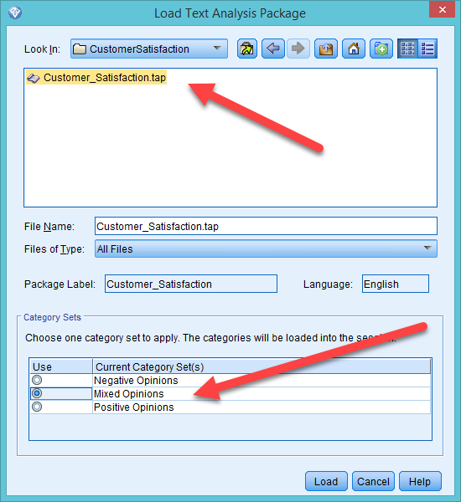
IBM SPSS Modeler
The software app is made for business, and thus it has a pre-built text mining package for customer satisfaction.
Let’s treat students as customers.

Slide 81
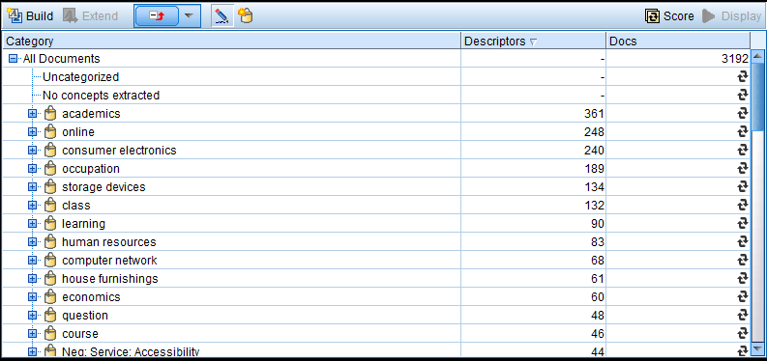
IBM SPSS Modeler:
Build the categories (concepts) based on the recurring terms and phrases.

Slide 82
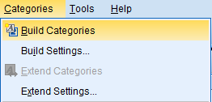
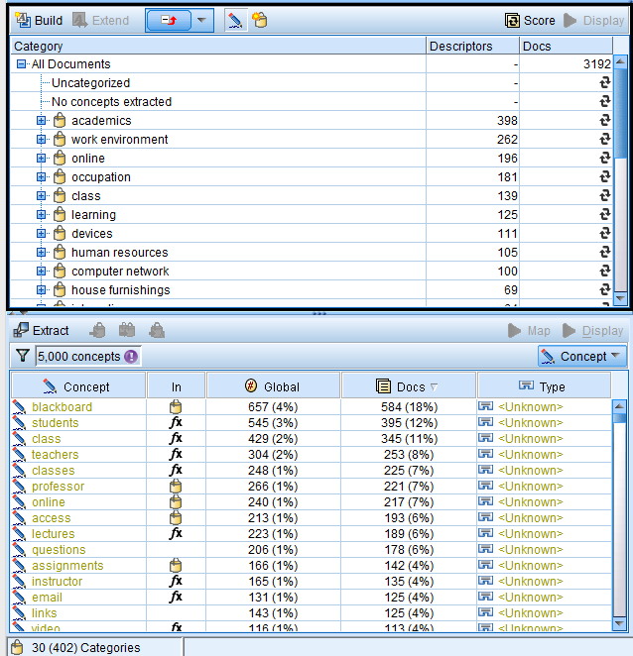
Categorization
Modeler counts the frequency of terms and phrases.
Based on the words it builds categories.

Slide 83
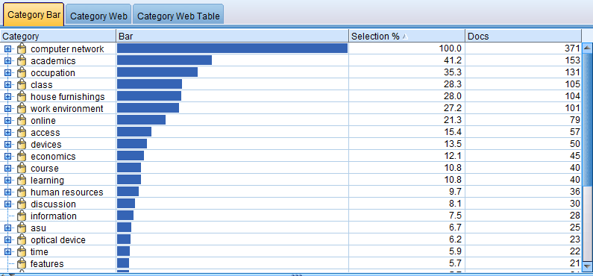
Category Bar by frequency
Hit Display to show the table and the map.

Slide 84
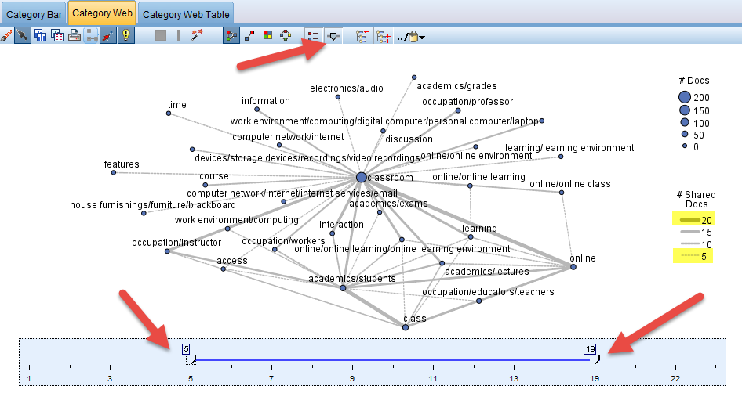
Category Web:
Show how themes are related.
Set the range of the frequency to avoid over-plotting.

Slide 85
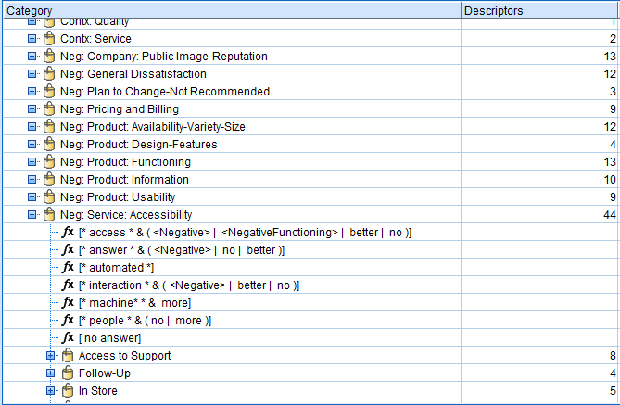
Pre-built categorization: Customer Survey
When a pre-built category package (e.g. customer survey) is used, the result is different.
Text analysis looks for “usability”, “functioning”, “accessibility”…etc.
You can mine the text without using any pre-built package.

Slide 86
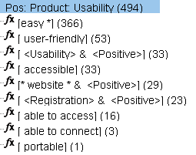
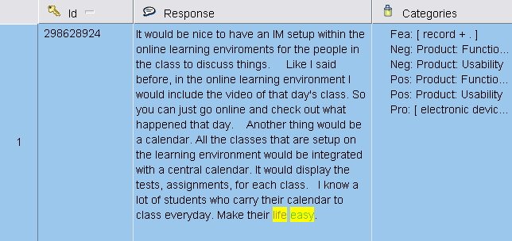
Example of sub-categories
The researcher can drill down the category to view the sub-categories.
The original responses are highlighted for the researcher to cross-examine.

Slide 87
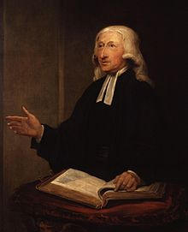
Question
What are the central theme of John Wesley's Methodist movement?
Some people said that he had no intention to start a new denomination, and thus his sermons were not opposed to the Church of England.
How could we find out?

Slide 88
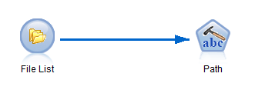
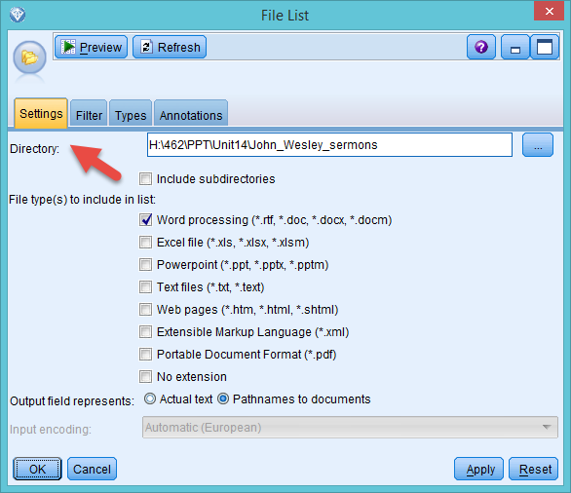
Mine documents
You can save documents (e.g. Word, PDF…etc,) in a folder and make Modeler to scan all files on the list.

Slide 89
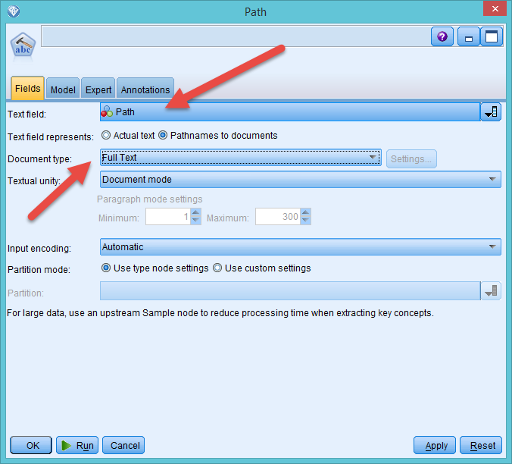
Mine documents

Slide 90
Similar question
One of the most famous sermons written by Johnathan Edwards (1703-1758) is "Sinners in the Hands of an Angry God”
The message is simple: if you don’t believe in Jesus, you will go to Hell.
Is fear of divine punishment the central theme during the First Great Awakening?
Text mining of all his sermons: http://www.jonathan-edwards.org/

Slide 91
Example 3:
Psychology of religion
Yu, C. H. (2015). Are positive trait attributions for the deceased caused by fear of supernatural punishments?: A triangulated study by content analysis and text mining. Journal of Psychology and Christianity, 34, 3-18.
This project is a replicated and enhanced study of Jesse Bering’s research on perceptions of dead agents.
Utilizing the framework of cognitive psychology and evolutionary psychology, Bering hypothesized that humans have a natural tendency to perceive that cognitive systems continue to function after death, and this disposition might be the psychological foundation of religion.

Slide 92

Context
Bering and his associates conducted a content analysis by extracting trait attributions from 496 obituaries published in the New York Times. The trait attributions were classified according to the categories in the Evaluation of Other Questionnaire (EOOQ).

Slide 93
Context
Bering found that in those obituaries pro-social and morality-related attributes of the dead people appeared more frequently than other types of qualities, such as achievements.
Along with the findings form other similar studies, Bering and his colleagues asserted that this behavioral pattern might result from adaptions during the evolutionary process.

Slide 94

Specifically, if dead agents were believed to be aware of what the living people said and did, it could strengthen our moral framework.

Slide 95
Limitation of Bering’s study
Bering’s study has certain limitations. It is important to point out that 41% Americans attend church on a regular basis, and Christianity has major impacts on every aspect of people’s life.
A Gallup poll shows that 92% Americans believe in the existence of God. Thus, the wording patterns found in New York Times obituaries and the idea of afterlife among the Americans could be a cultural product, instead of a natural tendency.

Slide 96
Purpose
Another sample is needed in order to further examine Bering’s notion. In contrast to the US, in the UK churchgoers are 10% of the entire population, and 44% of UK citizens believe in God.
UK is more secular than the US. If the perception of active dead agents is really natural or a-cultural, then the trait attributions found in the US sample should also be observed in the UK.
In this project 400 obituaries were sourced from two UK newspapers, namely, Guardian and Independent.

Slide 97
Methodology
Replicate the study using content analysis based on EOOQ and data-driven categories in MAXQDA
Triangulate data analysis using SPSS Text Analytics
Content analysis relies on human on coders whereas text mining is automated by natural language processing and computational linguistics.
Coded variables were exported to JMP for quantitative analysis

Slide 98
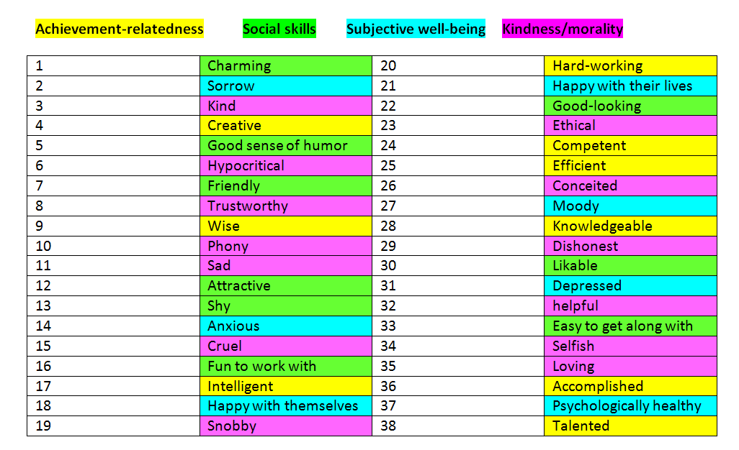
EOOQ
It is extremely rare to see negative attributes, such as “hypocritical” and “selfish” in those obituaries, and thus these categories are not useful.

Slide 99

New categories driven by the data
Some new categories were created by the coders.

Slide 100

MAXQDA
Human coders:
  More accurate than machine coding
  Subject to fatigue and bias
  Take forever with big data
Classify the passage by dragging and dropping

Slide 101

Content analysis results
The most frequent recurring traits are achievement-related.

Slide 102

Code relation chart in MAXQDA
Symmetrical data matrix; R1=C1, R2 = C2 (as what you saw in MDS)
The frequency of co-occurrence is depicted by the size and the color of the square.
Accomplished tends to co-occur with inspiring, justice, bravery, talented, leadership, helpful, hard-working, and intelligent.

Slide 103

SPSS results

Slide 104

SPSS Category web
Click Display
Similar to Code relation chart in MAXQDA
Thicker line → stronger relationship (more co-occurrence)

Slide 105
Conclusion
The study is triangulated by content analysis (human coders with MAXQDA) and text mining (SPSS text mining algorithms).
In the UK sample achievement-oriented traits occurred more often than pro-social and morality-related traits. This finding suggests that the alleged perception of dead agents may be more cultural than natural.

Slide 106
Recommendations
Some authors (e.g. Bennett, Dumais, & Horvitz, 2005) suggest ensemble methods, such as using multiple text mining tools and assigning reliability index to each of the results.
Next, the researcher can select the best text classifier or combining all results to generate a meta-result.

Slide 107
Recommendations
The text miner should have some preconception of what they are looking for (e.g. customer satisfaction? Technical support issues? Student expectation?).
In this sense, only one set of categorization is considered proper and comparison across different text mining results may be not necessary.

Slide 108
Recommendations
Triangulation between results coded by humans and concepts extracted by text mining is good for a small project.
When there are too many documents, sample a subset for human coders for comparison or use text mining only.

