Slide 1
Introduction to big data
Chong Ho (Alex) Yu

Slide 2
Introduction to big data
Chong Ho (Alex) Yu

Slide 3
Why big data analytics (BDA)?
What is BDA? Be patience. I will define it later. Let’s address the issues of hypothesis testing first.
Shortcoming 1 of HT: Does not address treatment effectiveness or answer your question
  What people are doing now: starting with a single hypothesis and then computing the p value based on one sample: P(D|H)
  BDA is data-driven, not hypothesis-driven. Let the data speak for themselves!
  Given the pattern of the data, what is the best explanation out of many alternate theories (inference to the best explanation): P(H|D)

Slide 4
Why big data analytics (BDA)?
In A Picture is Worth a Thousand p Values, Loftus observed that many journal editors do not accept the results reported in mere graphical form. Test statistics must be provided for the consideration of publication. Loftus asserted that hypothesis testing ignores two important issues:
  What is the pattern of population means over conditions?
  What are the magnitudes (effect size or predictive power) of various variability measures?
P(D|H) is prone to confirmation bias. In BDA you consider alternate explanations to answer your research question by using ensemble methods.

Slide 5

Why big data analytics (BDA)?
Shortcoming 2 of HT: Easy to reject the null
  BDG has built-in features to avoid over-fitting (falsely declare the effect)
  Usually the data are collected in naturalistic settings and thus there is no control group; let alone an inferior or do-nothing control group.
Shortcoming 3: A fusion of Fisherian and Pearsonian paradigms.
  BDA is an extension of exploratory data analysis (EDA) and they are fully compatible.

Slide 6

Why big data analytics (BDA)?
Shortcoming 4 of HT: Lack reproducibility
  BDA uses resampling-based methods (e.g. cross-validation, bootstrapping) to replicate the same analyzes in order to produce a stable conclusion.
Shortcoming 5 of HT: Parametric assumptions about data structure
  BDA are non-parametric
  Assumption-free: Virtually no assumptions about the data structure are required.

Slide 7
Why big data analytics (BDA)?
Shortcoming 6 of HT: Probability as a relative frequency in long run
  BDA is based on pattern recognition of the big data at hand.
  If I have 50 observations and try to infer from this small sample to the entire population, I must ask this question: “What is the chance of observing the sample statistics when I repeat the same study over and over?”
  If I have a million observations, do you need to ask this question: “What would happen if I repeat this study over and over?”

Slide 8
Why big data analytics (BDA)?
Shortcoming 7 of HT: Count on theoretical distributions
  Many BDA methods do not count on a particular theoretical distribution.
Shortcoming 8 of HT: Point estimate
  When ensemble methods are used, BDA methods yield multiple answers, not a single answer.
Shortcoming 9 of HT: Arbitrary cutoff
  Very often decisions in BDA do not rely on a cut-off (e.g. AIC, BIC). It is relative and contextual! The decision is based on model comparison.

Slide 9
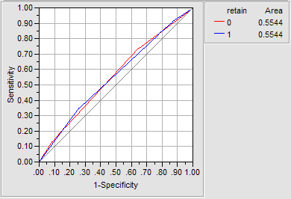
Why big data analytics (BDA)?
Shortcoming 10 of HT: Unknown error and circularity: If the researcher does not know whether the null is true or not, then he cannot tell whether the error is tied to Type I or Type II. But if he knows that the null is true, then there is no need to perform the test.
  In some BDA results the error rate is expressed by area under curve (AUC) and depicted in the Receiver Operating Characteristic (ROC) curve, not Type I or Type II error.

Slide 10

Why big data analytics (BDA)?
Shortcoming 11 of HT: Incapable of performing big data analytics
  BDA can handle extremely big sample sizes (count in million). Get as many observations as you can. Don’t worry about power analysis.
  Common misconception: I cannot use BDA methods when I have a small sample.
  Big data methods work best with big data, but some BDA technqiues are still valid in small-sample studies.
  If you have a bus, you can take 50, 40, 30, 20, 10, or 5 passengers. But if you have a sedan…

Slide 11

Why big data analytics (BDA)?
Do you need power analysis to determine the sample size in data mining/BDA?
Power = the probability of correctly rejecting the null.
Is there a null hypothesis for you to test in data mining/BDA?

Slide 12
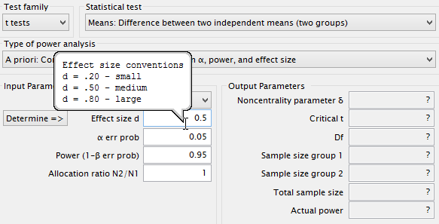
Why big data analytics (BDA)?
To perform a power analysis, you need the effect size. Small? Medium? Large?
Cohen determined the medium effect size using Journal of Abnormal and Social Psychology during the 1960s.
Welkowitz, Ewen, Cohen: One should not use conventional values if one can specify the effect size that is appropriate to the specific problem.

Slide 13
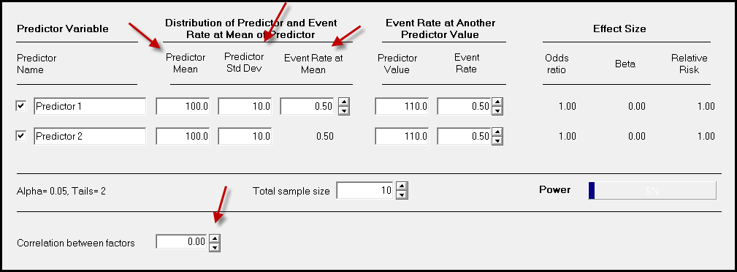
Why big data analytics (BDA)?
For example, to get the desirable sample size for logistic regression, I need to know the correlation between the predictors, the predictor means, SDs...etc. It could be very complicated.

Slide 14

Why big data analytics (BDA)?
Chicken or egg first?
The purpose of power analysis is to know how many observations I should obtain (not too many, not too few)
But if I know all those, it means I have already collected data.
One may argue that we can inquire prior studies to get the information, as what Cohen and APA suggested.
But how can we know the numbers from the past research are based on sufficient power and adequate data?

Slide 15


Why big data analytics (BDA)?
In HT, sample size determination based on power analysis is tied to Type I & Type II error, sampling distributions, alpha level, effect size...etc.
If you use BDA instead of HT, do you need to care about power? You can just lie down and relax!

Slide 16
Advantages of big data
It saves time, efforts, and money, because the data are online available Forget about IRB!
It provides a basis for comparing the results of secondary data analysis and your primary data analysis (e.g. national sample vs. local sample).
The sample size is much bigger than what you can collect by yourself. Many social science studies are conducted with samples that are disproportionally drawn from Western, educated, industrialized, rich, and democratic populations (WEIRD; Henrich, Heine, & Norenzayan, 2010). Nationwide and international data sets alleviate the problem of WEIRD.

Slide 17
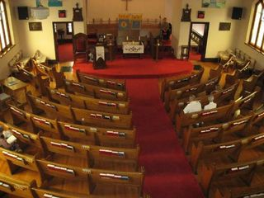
Advantages of big data
More importantly, the behavioral data collected in naturalistic settings (e.g. Google, Facebook) may be more accurate than experimental or survey data.
Opinion polls indicated that more than 40 percent of Americans attend church every week. However, by examining church attendance records, Hadaway and Marlar (2005) concluded that the actual attendance was fewer than 22 percent.

Slide 18

Advantages of big data
Schacter (1999) warned that the human memory is fallible.
  Transience: Forget information over time
  Absent-mindedness: Inattentive to the event
  Blocking: The temporary inaccessibility of memory
  Misattribution: Attributing a recollection to the wrong source
  Suggestibility: Implanted memories
  Bias: Retrospective distortions
  Persistence: Pathological events that we cannot forget
Or We lie

Slide 19

Advantages of big data
The dictator game: is used for studying morality and cooperative behaviors, is another good example.
In a typical experiment utilizing the dictator game, the participant is told to decide how much of a $10 pie he would like to give to an anonymous person who also signs up for the same experimental session.
The game is so named because the decision made by the giver is final.

Slide 20

Advantages of big data
Most experimental results are encouraging: Many participants were willing to share the wealth.
The result is completely different when the dictator game is conducted in a naturalistic setting.
In a study carried out by Winking and Nizer (2013) at a bus stop in Las Vegas, the researcher told some strangers that he was in a hurry to the airport and therefore he wanted to give away his $20 in casino chips.

Slide 21

Advantages of big data
The researcher explicitly suggested to the receivers to share a portion of the money to another stranger at the bus stop, who was actually a member of the research team.
No one in the naturalistic study gave any portion of the endowment to the stranger.
Winking and Nizer suspected that in the past the setting of the experimental context induced participants to choose prosocial options.

Slide 22
Advantages of big data
In 2016 election all polls indicate that more voters prefer Clinton to Trump.
The result is opposite. Why? What happened?
Many people did not want to say that they support Trump, especially after the Access Hollywood tape was released.

Slide 23
I never lie

Slide 24
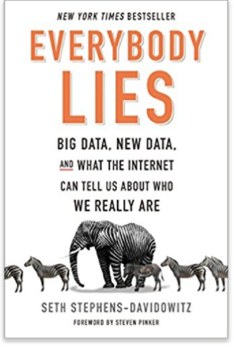
Everybody lies!
In survey most voters said that the race of the candidate doesn’t matter. Google search data show the otherwise!
https://www.youtube.com/watch?v=g0m4UQ3frws
https://trends.google.com/trends/

Slide 25

Advantages of big data
Turn to “behavioral” data e.g. Look at data in Netflix, YouTube, Amazon, Google, EBay to find out what people actually do rather than what they say.
Google, Facebook and Amazon might understand human behaviors more than what psychologists know.

Slide 26
Advantages of big data
“Facebook knows you better than anyone else”
In 2015 researchers at Cambridge and Stanford tested 17,000 Facebook users on personality and related the result to their Facebook activities. The prediction is more accurate than their parents, silblings, and spouses!
https://www.nytimes.com/2015/01/20/science/facebook-knows-you-better-than-anyone-else.html
“Google and the end of free will”: Google may know more about you than yourself.
https://www.ft.com/content/50bb4830-6a4c-11e6-ae5b-a7cc5dd5a28c?siteedition=intl

Slide 27
Caution: BDA is not always right
In 2009 Google researchers published a paper in Nature.
A predictive model about the spread of influenza across the US in real time (Nowcast)
Claimed to be faster than the CDC model because Google tracked the outbreak by looking at the search terms about flu symptoms.
Later it was found that Google’s estimates were overstated by almost a factor of two.
https://www.google.org/flutrends/about/
https://www.wired.com/2015/10/can-learn-epic-failure-google-flu-trends/

Slide 28
Caution: Ethical issues
In March 2018 the Federal Trade Commission opened an investigation into Facebook.
A data analytics firm named Cambridge Analytica worked with the Trump Campaign to access FaceBook data without the the knowledge of the users.
Legally speaking, Facebook must notify users and get their approval before sharing data with any third party.

Slide 29
Define the terms, at last!
Terms
  Data science
  Big data analytics
  Data mining
Common ground:
  Data-driven, not hypothesis-driven
  Pattern seeking, not cut-off thinking
  Utilize artificial intelligence and machine learning, not just human judgment.

Slide 30
Data science
Data science is an interdisciplinary field that synthesizes statistics and computer science (e.g. machine learning) for extracting knowledge or insights from structured or unstructured.
4 As (Saltz & Stanton, 2018):
  Data architecture: database design
  Data acquisition: Data collection
  Data analysis: pattern recognition
  Data archiving: Make the data reusable.

Slide 31
Data science: Goal
Hierarchy:
  Data: Raw and unprocessed (e.g. test scores and related variables)
  Information: processed (e.g. findings, figures, tables)
  Knowledge or insight: a summary statement that can describe or explain the phenomenon (e.g. test performance and self-efficacy form a curvilinear relationship)
  Understanding: information that leads to practical implications for actionable items (e.g. teachers should stop inflating students’ ego)
  Wisdom (e.g. a new theory)

Slide 32
Big data analytics: Deal with Big data
High volume:
  No definite cut-off, may carry thousands of rows or columns
  Challenges to data storage, data management, and data analysis.
High velocity:
  Data stream is ongoing
  Needs real-time analysis (e.g. credit card fraud detection)
High variety:
  Contains different types of data (e.g. numbers, texts, images, audio files, video clips…etc.).
  Challenges to traditional data analysts, who are accustomed to the analysis of structured data.

Slide 33

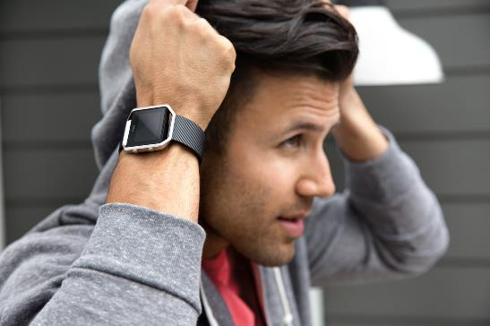
Big data analytics: Trend
Data-driven commercial operation e.g. Disney Magicbands
  Data-driven businesses are 5% more productive and 6% more profitable than others.
Quantified self-movement: Fitbit bands, Apple Watches
Sentient cities:
  Internet of things (IoT)
  Devices are connected to conduct real-time diagnosis.

Slide 34
Structural archival data
Center for Collegiate Mental Health (CCMH): http://ccmh.psu.edu/
European Values Survey (EVS): http://www.europeanvaluesstudy.eu/
Gallup Global Wellbeing (GGW): http://www.gallup.com/poll/126965/gallup-global-wellbeing.aspx
Happy Planet Index (HPI): http://www.happyplanetindex.org/
National Opinion Survey Center (NORC): https://gssdataexplorer.norc.org/

Slide 35
Structural archival data
Programme for International Student Assessment (PISA): https://www.oecd.org/pisa/pisaproducts/
Programme for the International Assessment of Adult Competencies (PIAAC): http://www.oecd.org/site/piaac/publicdataandanalysis.htm
Trends for International Math and Science Study (TIMSS): http://timssandpirls.bc.edu/
United Nations Human Development Programme (UNDP): http://hdr.undp.org/en/data
World Values Survey (WVS): http://www.worldvaluessurvey.org/wvs.jsp
US Government's open data: http://data.gov

Slide 36






Unstructured behavioral data
Unstructured data or semi-structured outnumber structured data!
Webpages and digital footprints on social media, such as Facebook and Twitter.
Experts on data science predict that the size of digital data will double every two years; this indicates a 50-fold growth from 2010 to 2020.

Slide 37
Unstructured behavioral data
Without face-to-face interaction, the internet gives you a sense of anonymity or protection. It is more likely that how people behave behind the Wi-Fi reflects their true nature.
Collecting these data necessitates Web content mining, also known as Web scraping, which involves automated “crawling” the Internet and extracting data from Websites (Landers, Brusso, Cavanaugh, & Collmus, 2016).
But if you work for Google or Facebook, you have direct access to the data and Web scraping is not necessary.

Slide 38
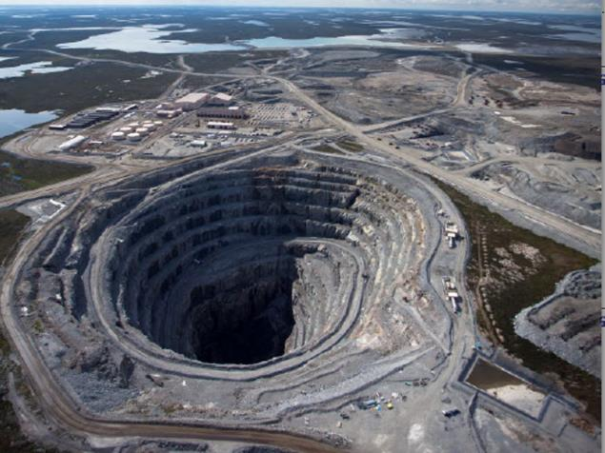
Data mining
A cluster of non-parametric techniques for automatically extracting useful information and relationships from immense quantities of data.
Assumption: the germ (knowledge) is buried by the rocks and thus it needs mining (filtering and extraction).
Usually it deals with structured data only.
For unstructured data the analyst uses text mining (the last unit of this class).

