Slide 1
Data Mining (DM) and Machine Learning
Chong Ho (Alex) Yu

Slide 2
Outline
Relationship between big data and machine learning
Attributes of machine learning
Why artificial neural networks (ANN) are better than regression analysis?
Compare manual Lambda smoothing and automated nonlinear modeling
Cross-validation
Examples in JMP and IBM SPSS Modeler

Slide 3
What is data mining?
Data mining (DM) is a cluster of techniques, including decision trees, artificial neural networks, and clustering, which has been employed in the field Business Intelligence (BI) for years.
Now DM is extended to other fields.
DM inherits the spirit of exploratory data analysis (EDA) but there is a crucial difference: No machine learning in EDA.

Slide 4
Characteristics of data mining
Use large quantities of data: Big data analytics
Exploration: Ask “what-if” questions
Pattern recognition.
Resampling (e.g. cross-validation, bootstrapping)
Automated algorithms; machine learning

Slide 5
Different types of data mining techniques
Decision tree (classification tree, recursive partition tree)
Bootstrap forest (random forest)
Boosted tree
Multivariate adaptive regression splines (MARS)
Support vector machine
Clustering
Artificial Neural Network (ANN)

Slide 6
Five schools of machine learning
Name | Origin | Approach
Symbolists | Logic, philosophy | Some form of logical deduction (e.g. if-then-else)
Connectionists | Neuroscience | Networking, pathway (e.g. Neuro networks)
Evolutionists | Evolutionary biology | Genetic programming
Bayesians | Statistics | Probabilistic inference (e.g. Given X, what is the chance of Y?)
Analogists | Psychology | Learn by examples (e.g. pattern recognition, computer vision)

Slide 7
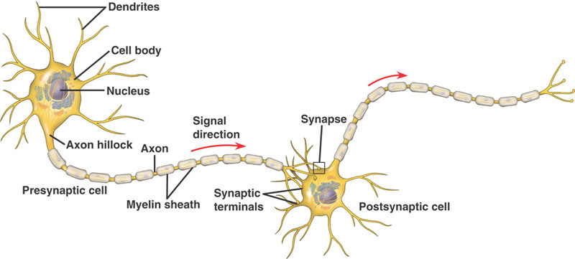
Neuropathway
Can a machine think like us if we can mimic the neuropathway?

Slide 8
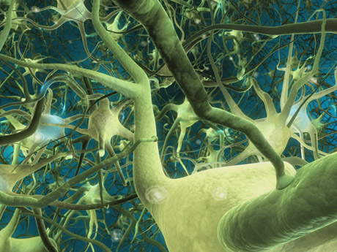
Neural networks, as the name implies, try to mimic interconnected neurons in the brain in order to make the algorithm capable of complex learning for extracting patterns and detecting trends.
But human brain neurons are much more complicated. ANN is just a simplification of human neural network.

Slide 9
It is built upon the premise that real world data structures are complex, and thus it necessitates complex learning systems.
Usually regression is “one-shot”; you cannot “train” a regression model. In other words, regression cannot “learn”.

Slide 10

A trained neural network can be viewed as an “expert” in the category of information it has been given to analyze. This expert system can provide projections given new solutions to a problem and answer "what if" questions.
More flexible models than regression and classification
Higher predictive power than regression and classification trees (CT will be discussed in Unit 5).

Slide 11

Machine learning
Supervised: Train the algorithm by giving labelled training data (examples).
Unsupervised: try to find the hidden structure in unlabeled data (without examples).

Slide 12
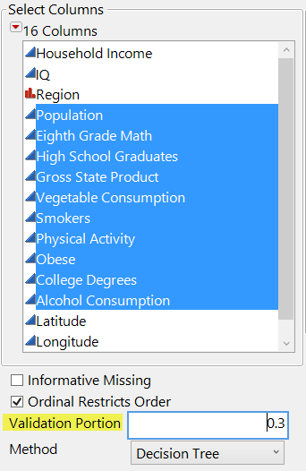
Machine learning
In resampling we can do cross-validation (CV).
CV is a form of supervised machine learning.
You can hold back a portion of your data (e.g. 30%).
The first subset is for training and the remaining is for validation.
You can further partition the sample into three subsets: training, validation, and testing.

Slide 13
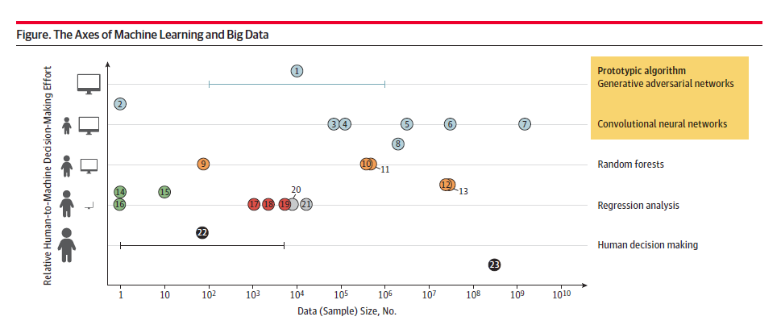
Big data is not the same as machine leaning, but related.
Usually research utilized ANN and big data are at the upper right corner.
Research based on smaller samples and human judgment are at the lower left corner.
Source: Bearn, A., & Kohane, I. S. (2018). Big data and machine learning in health care. JAMA, E1-E2.

Slide 14
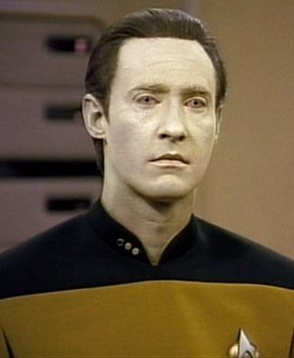
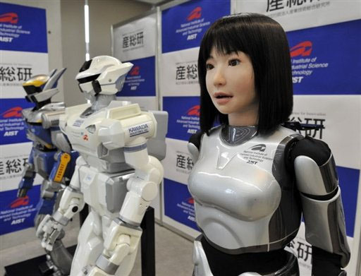
AI and Machine learning
Big data are too complicated to humans
Big data analytics can be more efficient and effective if we can count on a machine that can learn and improve (e.g. ANN).

Slide 15
Types of ANN
Convolutional NN
  Traditional; this is what we will focus on
  Forward-feed: pass signals along the network in a single direction
  Used by Google to develop computer vision; identify unlabeled static images extracted from YouTube.
Recurrent NN
  Operate over sequences of vectors
  Used for handwriting recognition & speech recognition

Slide 16

Types of ANN
Reinforcement NN
  Relatively new
  Inspired by the reinforcement theory in behavioral psychology
  Used in Game theory
Generative adversarial NN
  Very new (Goodfellow, 2014)
  Totally unsupervised learning
  Generate photos that look real to human viewers
  Used by Facebook
  https://code.facebook.com/posts/1587249151575490/a-path-to-unsupervised-learning-through-adversarial-networks/

Slide 17
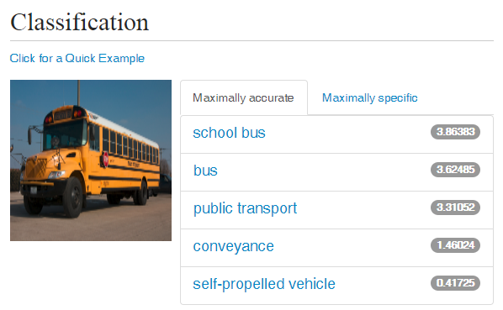
ANN can go beyond numeric data!
Computer vision/image recognition
http://demo.caffe.berkeleyvision.org/
Paste this into the box: https://upload.wikimedia.org/wikipedia/commons/7/76/ICCE_Illinois_School_Bus.jpg
Press Classify URL

Slide 18
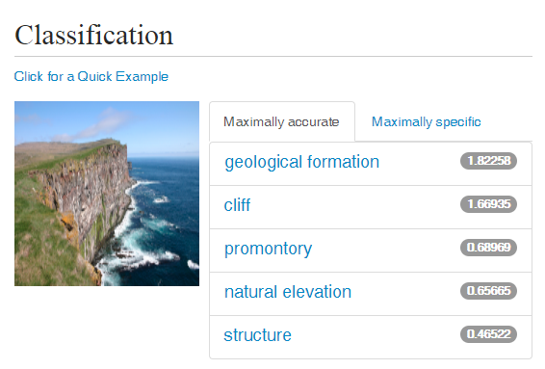
ANN can go beyond numeric data!
https://upload.wikimedia.org/wikipedia/commons/f/f6/Iceland2008-Latrabjarg.cliff.JPG
Self-drive car depends on computer vision, which requires analyzing a lot of data based on ANN/machine learning.

Slide 19


AI is not 100% fool-proof

Slide 20
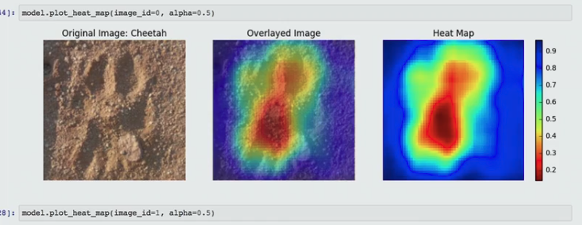
Creative way of using AI-based Computer Vision
Wildtrack: Track the footprints of endangered animals to locate and protect them.
https://www.sas.com/en_us/solutions/ai.html
http://video.sas.com/detail/videos/analytics-in-action/video/3844666657001/customer-success-overview:-wildtrack

Slide 21
Why not regression?
In many cases ANN is better than conventional OLS regression.
OLS regression is linear; it imposes a simple structure on the data.
When you have collinear predictors, you need to “orthogonalize” the problematic variables (e.g. Gram-Schmidt method).
Non-linear regression may overfit the data if it is not done properly.

Slide 22
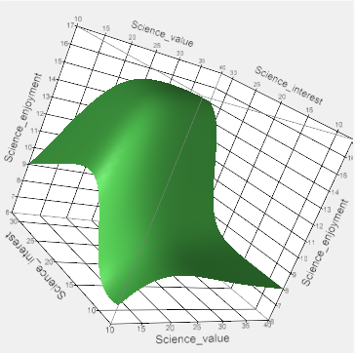
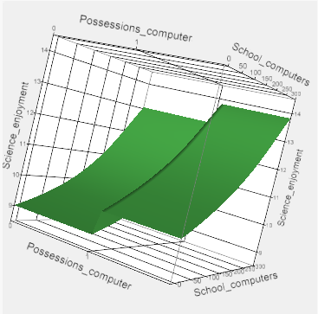
Why ANN? Advantages
Can handle different data types (nominal, ordinal, continuous).
Immune to outliers.
Perform data transformation for you. Artificial neural network can estimate ANY nonlinear functions no matter how many inputs and layers are entailed.
Learn and improve: ANN has stopping rules to prevent overfitting.
Researchers can go beyond numeric data by using image recognition, speech recognition…etc.
In the future an AI system might analyze a YouTube movie!

Slide 23
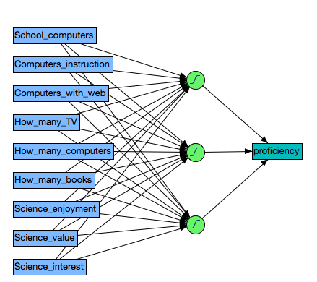
Structure of ANN
A typical neural network is composed of three types of layers
  input layer: data
  hidden layer: data transformation and manipulation
  output layer
If there are multiple hidden layers, it is called deep learning.
Data transformation? We were there before!

Slide 24
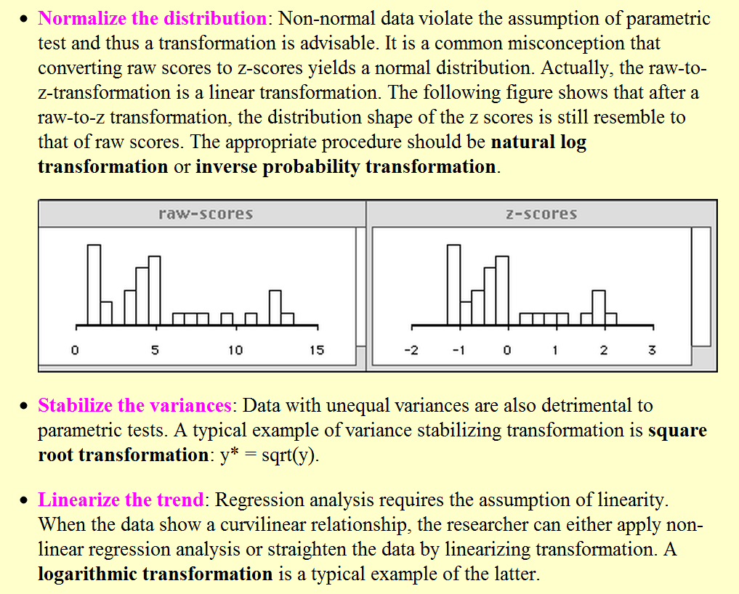

Slide 25
Example 1
In the first example we start with ONE input variable only.
Conventional statistical procedures often show unrealistic linear structure when the real world is often curvilinear.
Self-efficacy in science and self-report readiness to learn are correlated with test performance in a nonlinear fashion.
  Data sets collected from 2015 Programme for International Student Assessment (PISA)
  2016 Programme for International Assessment of Adult Competencies (PIAAC)

Slide 26
Limitations of Linear Models
“All models are wrong but some are useful” (George Box, 1987).
  A linear model might be wrong in that it oversimplifies a phenomenon, yet it could still have practical applications.
  Both a complicated/well-fitted model and a simple model may be appropriate at different times.
Psychological researchers should avoid using linear modeling prematurely.

Slide 27
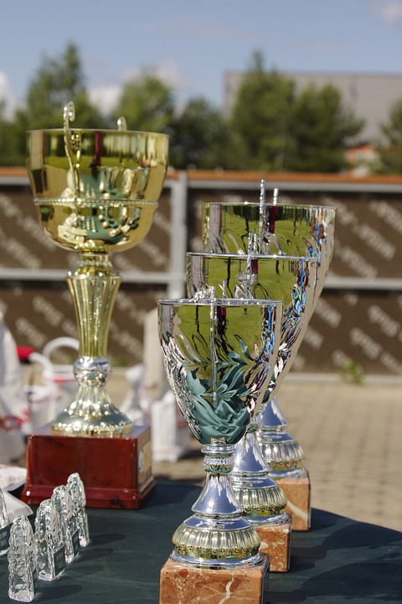
Debate in Self-Efficacy
Albert Bandura (1990, 1991, 1995, 1997) stressed the importance of self-efficacy in learning.
  One’s belief in one’s own ability can lead to success in accomplishing a task or fulfilling a goal.
Many educators boosted learners’ self-images regardless of their performance.
The ‘everybody gets a trophy’ mentality does not build true self-esteem (Twenge, 2010).
  Ego inflation and a sense of entitlement
Perhaps both views are right.

Slide 28
2015 Programme for International Student Assessment (PISA)
PISA is administered by Organization for Economic Cooperation and Development (OECD) every four years.
Assessment of student performance in literacy, math, and science, with a different focus in each round
The 2015 focus was on science learning:
  Science self-efficacy (SSE): student’s perception of their ability to successfully complete a science-related academic task
  Science Self-belief (SSB, aka self-concept): self-evaluation of one’s general ability in a domain (Marsh & Martin, 2011).
  Ambition: measured by the degree to the statement “I see myself as an ambitious person.”

Slide 29
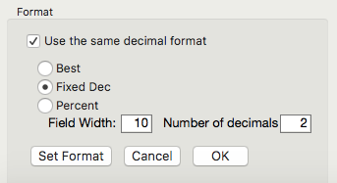
PISA 2015
Data set: PISA2015 in Unit 2
Look at the descriptive statistics first
Analyze → Tabulate
Drag Country/region into Y-axis
Drag Math score, science score, science self-efficacy, self belief and motivation, Ambition into X-axis (top row)
Drag Mean and Std. Dev on top of summary
Set the decimal format
Use Save as (Windows) or Export (Mac) to output the table
These math and science scores are extracted from plausible values (PV)
PV: Each student has a distribution of possible scores (from low to high).

Slide 30
PISA 2015
 | Math scores |  | Science scores |  | Self-efficacy |  | Self-belief |  | Ambition
Country/Region | Mean | SD | Mean | SD | Mean | SD | Mean | SD | Mean | SD
China | 541.74 | 100.84 | 528.34 | 98.56 | 0.06 | 1.17 | 0.19 | 0.87 | 2.98 | 0.73
Hong Kong | 550.55 | 88.48 | 525.60 | 79.58 | -0.07 | 1.22 | 0.21 | 0.95 | 2.80 | 0.80
Japan | 533.30 | 88.18 | 539.03 | 93.28 | -0.46 | 1.22 | -0.51 | 1.02 | 2.64 | 0.82
Macau | 543.98 | 79.03 | 528.59 | 81.84 | -0.03 | 1.12 | -0.50 | 0.81 | 2.63 | 0.81
S Korea | 523.91 | 99.97 | 514.75 | 95.00 | -0.02 | 1.23 | 0.34 | 0.98 | 2.84 | 0.75
Singapore | 557.08 | 95.75 | 545.95 | 104.60 | 0.07 | 1.14 | 0.42 | 0.94 | 3.00 | 0.79
Taiwan | 539.20 | 103.79 | 530.85 | 99.85 | 0.19 | 1.19 | -0.01 | 0.89 | 2.92 | 0.76
USA | 474.35 | 87.92 | 502.60 | 98.04 | 0.29 | 1.29 | 0.65 | 0.95 | 3.25 | 0.72
Students in the U.S. have the lowest math and science scores but the highest scores in self efficacy in science, self-belief, and ambition.

Slide 31
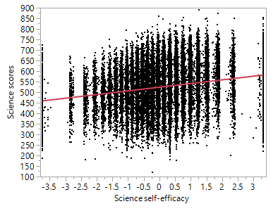
OLS Regression
The regression line is perfectly straight but this is misleading.
Due to overplotting (too many data), we cannot detect the real pattern.

Slide 32
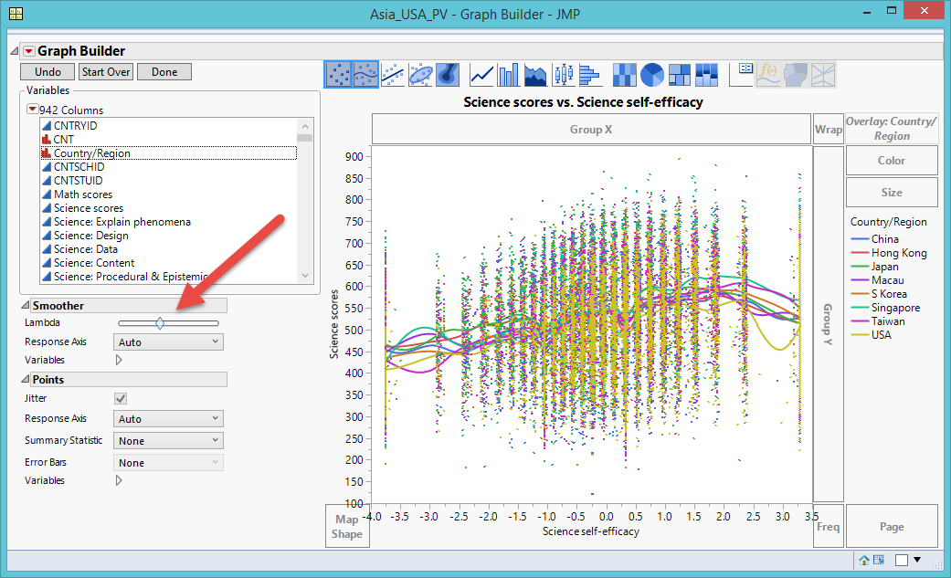
Lambda Smoothing:
Over-Complicated
Graphic Builder → Lambda smoother
Default = Middle
Too complicated
Notes:
Specialized modeling → Fit Curve
Nonlinear fitting techniques
However, counting on numeric criteria (e.g. AICc, BIC, SSE, R-square…etc.) could result in an erroneous conclusion.

Slide 33
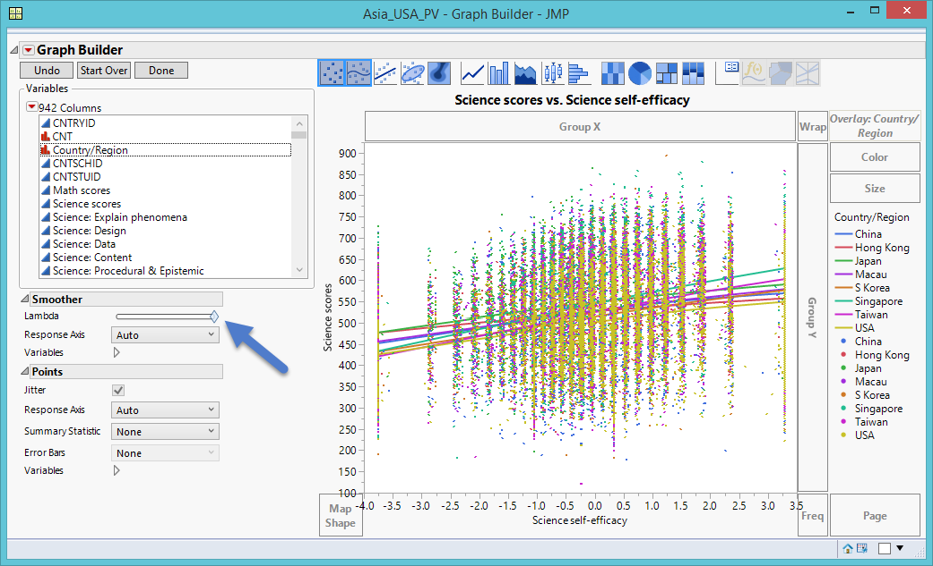
Lambda Smoothing: Over-Simplistic
Farthest Right: Shows all countries as perfectly straight
Too simplistic

Slide 34
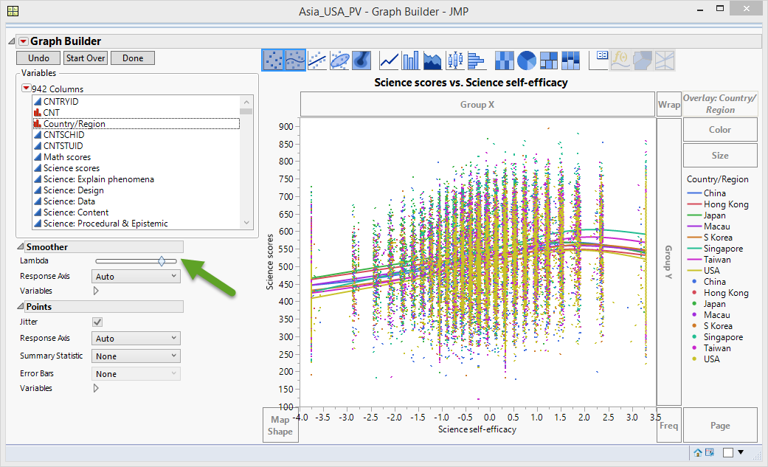
Lambda Smoothing: Non-Linear
Curvilinear relationship between science test performance and science self-efficacy
As self-efficacy improves, science test scores increase
After science self-efficacy passes a certain threshold, science test performance is reduced.

Slide 35
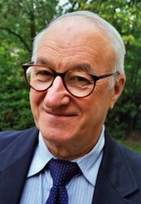
Benefits of Non-Linear
  Useful in two ways:
    It explains why educators implementing Bandura’s theory did not produce expected results
    Necessitates a reform in our pedagogical approaches
  But one may argue the preceding models are based on subject human judgment.
  Let’s turn to machine learning

Slide 36
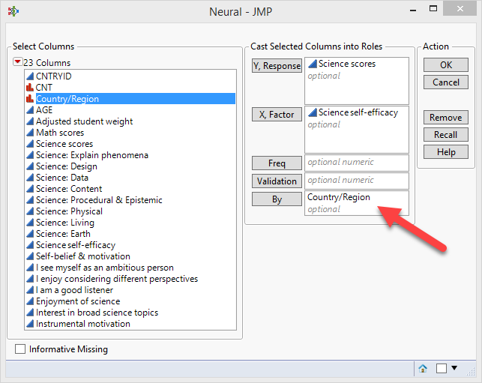
ANN
Analyze → Predictive Modeling → Neural
Run separate ANNs by Country/region
Accept all default settings and press Go
Select Profiler from the second inverted triangle in each ANN

Slide 37
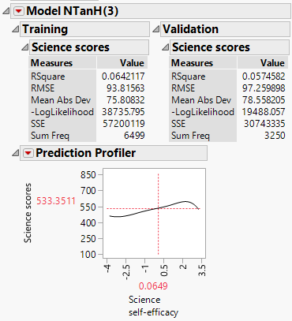
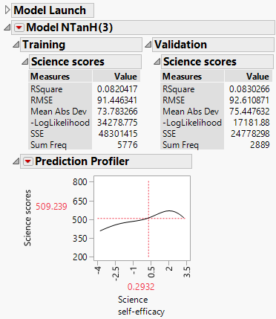
ANN
ANN suggests that while enhancing self-efficacy can improve performance initially, inflating one’s self-efficacy could drag down one’s actual performance.
Smoothing the nonlinear curves is not subjective

Slide 38
Assignment 4.1
Use PIAAC2016.
Open Graph Builder.
Put science: data into Y and science self-efficiency into X.
Open Local data filter and add Country/region. Select China
Use Lambda smoother to smooth the curve.
Run ANN by putting science: data into Y, self-efficacy into X, and Country/region into By
Click Go in the China subset only
Show Profiler
Compare the results of manual smoothing and automated ANN.

Slide 39
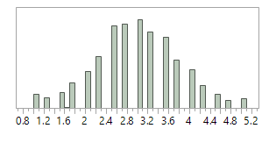
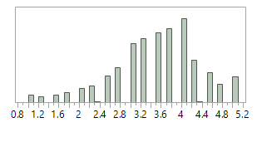
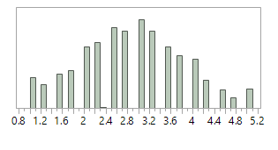
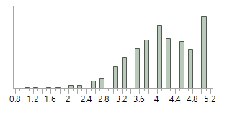
Example 2: 2016 PIAAC
Japan and South Korea: Fairly normal
Singapore: Slightly skewed.
  U.S.: Skewed towards high RTL values,
  The mode is 5, meaning that most of the U.S participants view themselves as being extremely ready to learn.
Distribution of RTL of Japan
Distribution of RTL of Singapore
Distribution of RTL of South Korea.
Distribution of RTL of USA.

Slide 40
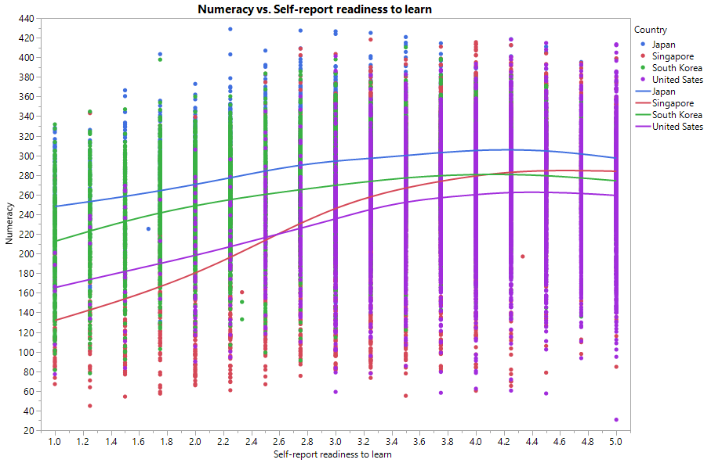
Lambda Smoothing
Curvilinear association between numeracy and RTL across all countries in the data set.
Increasing perceived RTL has less adverse effect on individual’s performance.

Slide 41
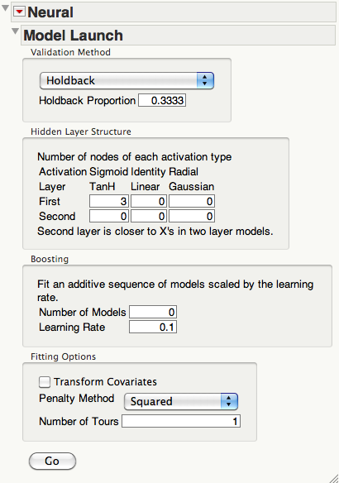
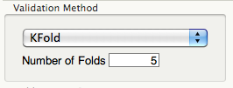
Cross-validation
For cross-validation (CV) you can hold back a certain portion of the data (usually 33% for validation and all the rest for training)
Or choose K-fold (Number of subsets and replications).

Slide 42
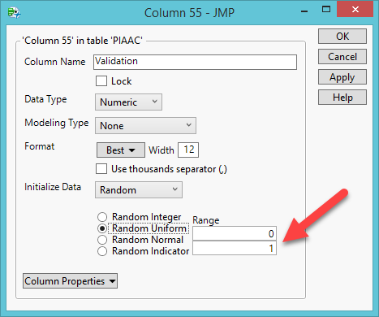
Create constant subsets
The previous methods allow the computer randomly select observations to create subsets. But when you re-run the procedure, you have different subsets.
You can randomly assign each observation to fixed groups. Next time when you re-run the procedure, you have the same subsets.
Create a validation variable using Random Uniform (50% for training and 50% validation sets)

Slide 43
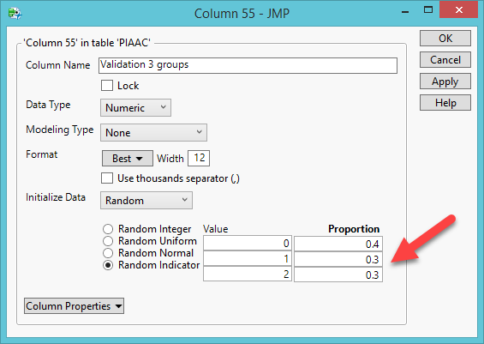
Create constant subsets
Create three subsets (training, validation, and testing) by Random Indicator.
Assign the proportion to each subset.
There is no universal rule.
Usually more data are needed for training (e.g. 40%)

Slide 44
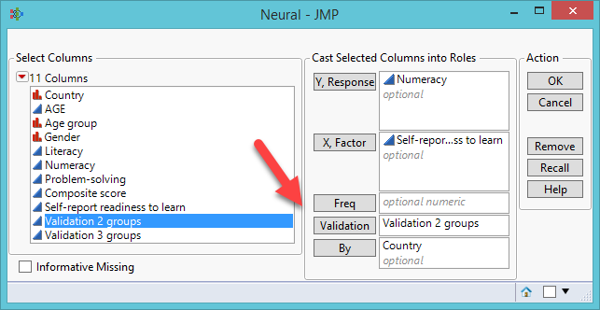
Create constant subsets
When you run data analysis, put the validation variable into Validation.

Slide 45
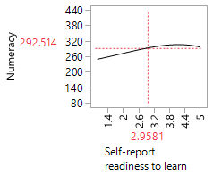
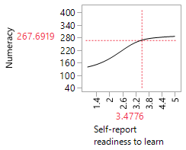
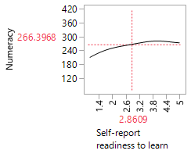
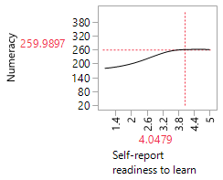
Artificial Neural Network
The findings of Lambda smoothing and ANN were congruent to each other.
ANN of Japan
ANN of Singapore
ANN of South Korea
ANN of USA

Slide 46
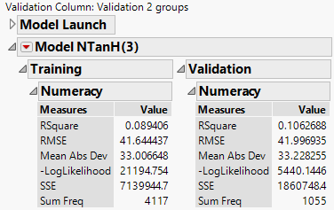
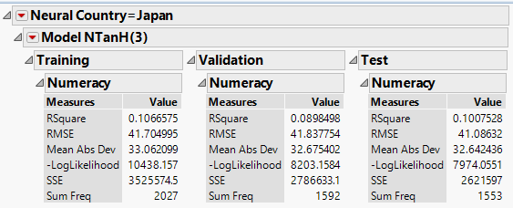
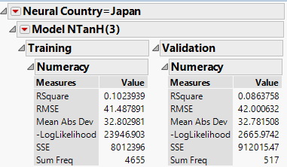
Cross-validation
2 subsets
3 subsets
5 subsets

Slide 47
Cross-validation
When you have more and more subsets, it seems that it is getting “worse and worse”.
It is a blessing in disguise: The first or the first few may be over-fitted.
The latest model is more realistic.

Slide 48
Assignment 4.2
Create a validation variable with 2 groups.
Create another validation variable with 3 groups. Assign a larger proportion into the training set (the first group).
Run ANN by putting Problem-solving into Y, Self-report readiness to learn into X, Validation 2 groups into Validation, and Country into By.
Click Go in the Japan subset only.
Examine the Validation result (on the right)
Open Neural again and Press Recall.
Replace Validation 2 groups with Validation 3 groups.
Click Go in the Japan subset only.
Examine the Test result. Is it better or worse?

Slide 49
Example 3
Let’s try multiple input variables. There are three sets of potential factors for predicting 2006 science test performance in the US sample.
Dichotomous dependable variable: Proficient or not proficient.
School variables: How many computers at school? How many computers are used for instructions? How many computers are connected to the Internet?
Home variables: Do you have a computer at home? If so, how many? Do you have your own software? Is your home computer connected to the Internet? How many books at home?
Individual variables: Do you enjoy science? Is science valuable? Ae you interested in science?

Slide 50
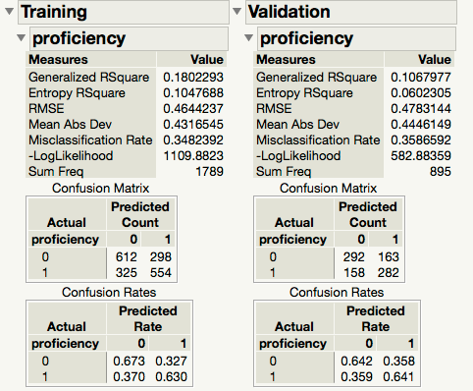
Overall model adequacy
The confusion rates tells you the hit rate (accuracy of classifying students into proficient or non-proficient)
(0 & 0) or (1 & 1) = Hit
(1 & 0) or (0 & 1) = Miss
The results of the training set and the validation set are close.
Hit rate of predicting not proficient: 67.3%, 64.2%
Hit rate of predicting proficient: 63%, 64.1%

Slide 51
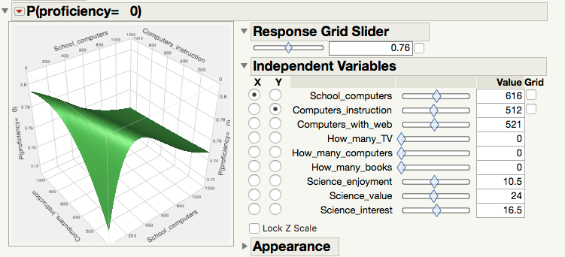
Surface profiler
From the second inverted red triangle, go to Surface Profiler.
You can explore the inter-relationships among many variables in a single panel.

Slide 52
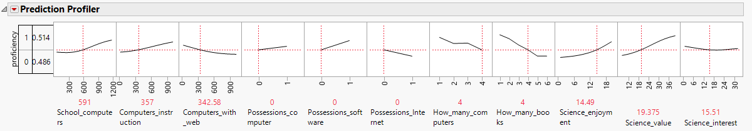
Categorical profiler
Ask what-if questions
What if we put more computing resources at school?
What if we put more resources at home?
What if learners like science?

Slide 53
Assignment 4.3
Download the data set ‘PISA2006_USA.jmp’
Run a neural network.
Use ability as Y, use all school variables, home variables, and individual variables as Xs.
Open Profiler.
Are the curves linear or nonlinear?
Are the slopes steep or flat?
Why?

Slide 54
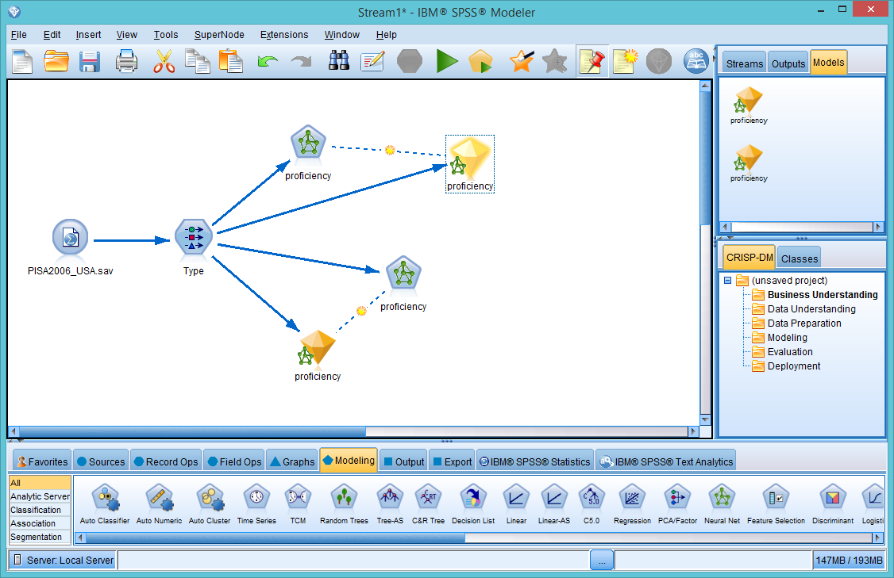
ANN in IBM SPSS Modeler
Use a flowchart interface
The trail (steps) is automatically documented.
You can go back to revise a step or certain steps
You can also create alternate models and compare them side by side

Slide 55
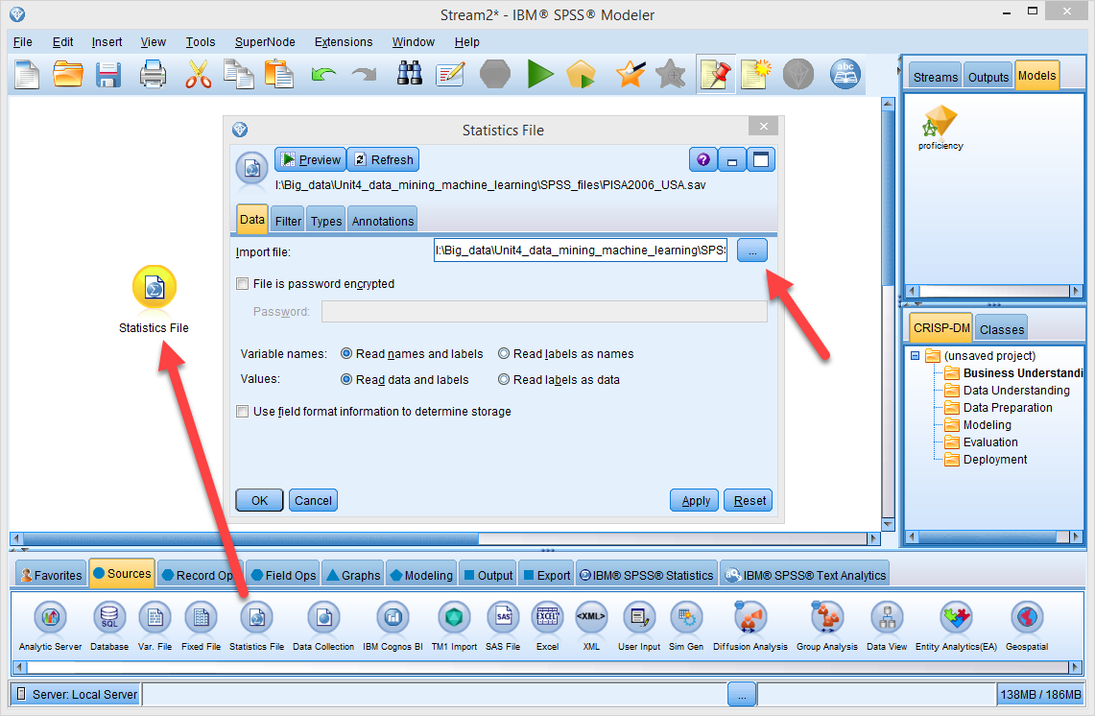
ANN in IBM SPSS Modeler
Sources → Statistics File
Right click to Edit
Point to the data file.

Slide 56
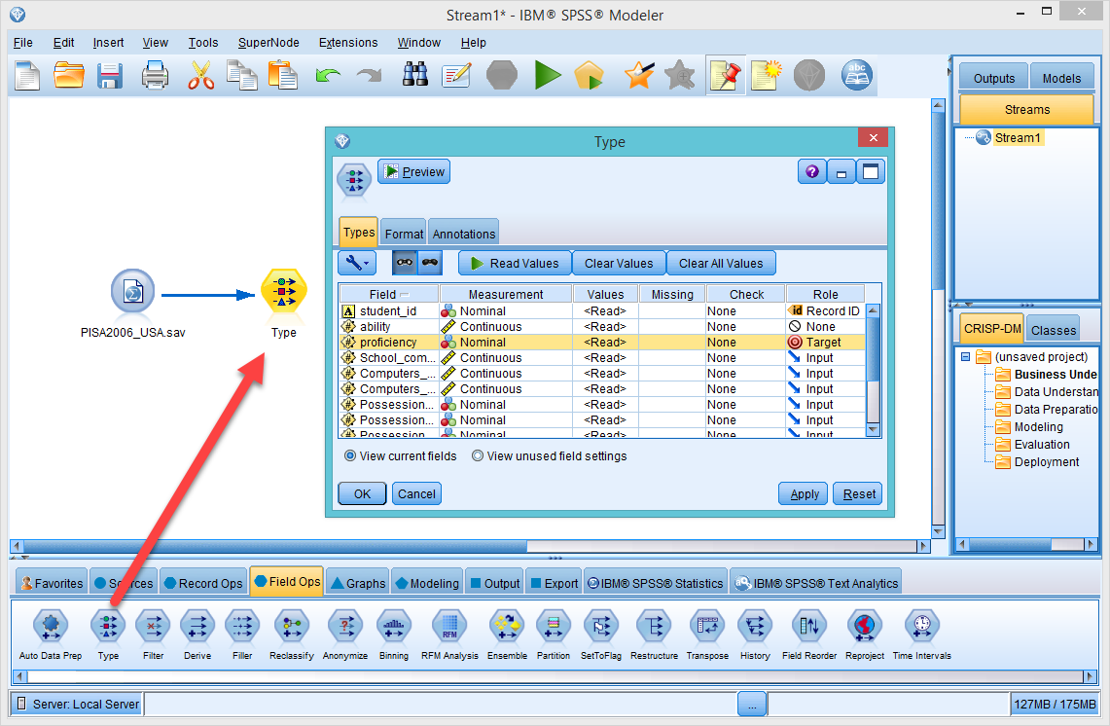
ANN in IBM SPSS Modeler
Field Operator → Type
Right click the data file to Connect
Right click Type to Edit
Make proficiency into Target

Slide 57
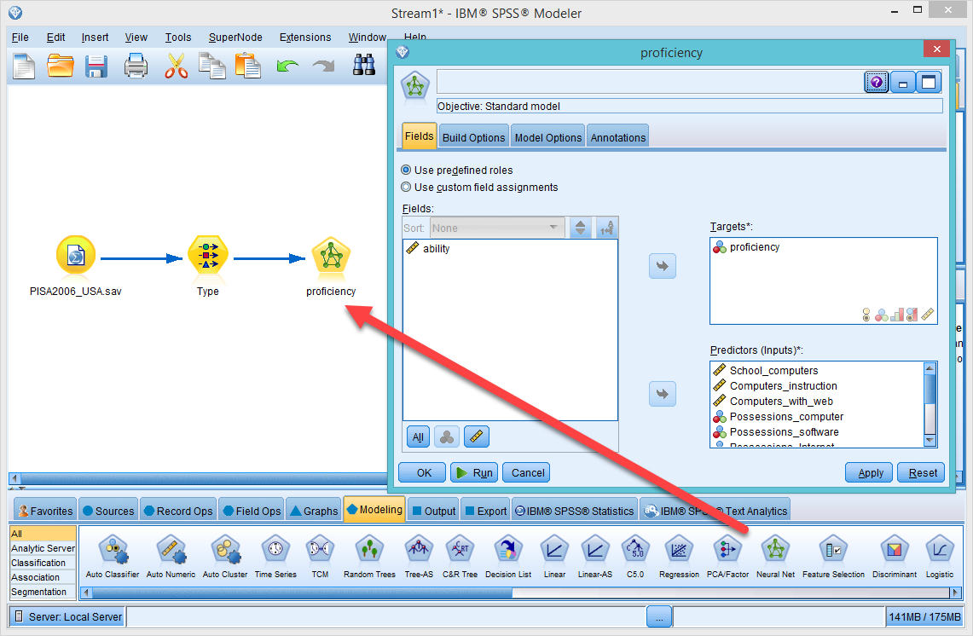
ANN in IBM SPSS Modeler
Modeling→ Neural Net
Connect Type and Proficiency
Right click Proficiency to Edit
The DV and IVs are automatically assigned

Slide 58
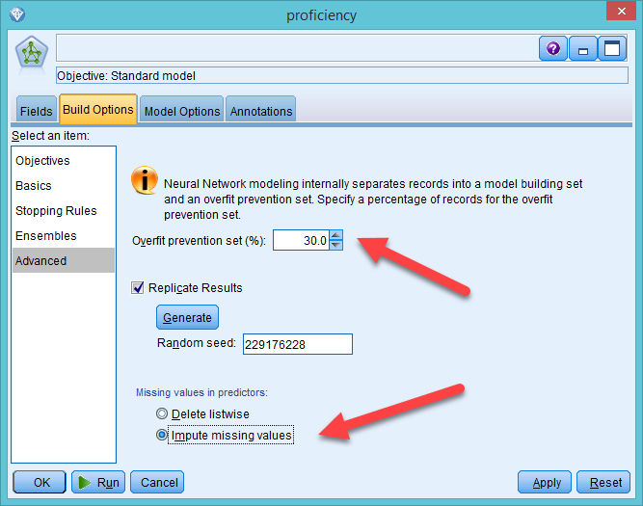
ANN in IBM SPSS Modeler
Go to Build Options → Advanced
Partition the sample into training set and validation set to avoid overfitting
Impute missing data
Click Run

Slide 59
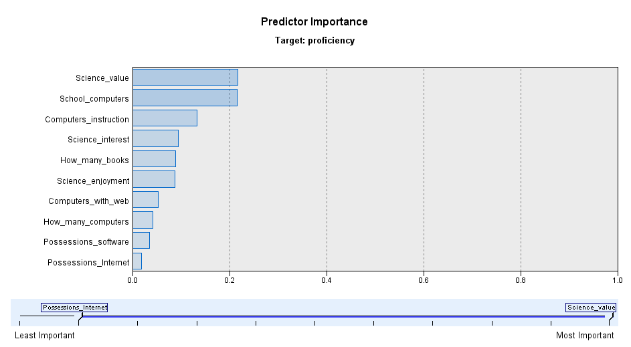
SPSS’s ANN output
Drawback; No dynamic graph; no linking and brushing

Slide 60
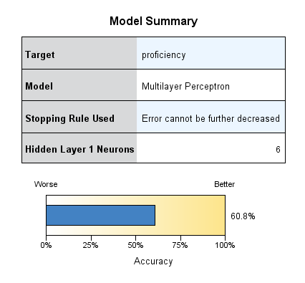

ANN output
Same as Confusion Matrix in JMP

Slide 61
Assignment 4.4
Open IBM Modeler
Use Sources → Statistics to import PISA2006_USA
Drag Field Ops → Type into the canvas
Connect the two icons
Edit type, assign ability as the target
Create a Neural Net from Modeling but remove grade and age
Go to Build Options → Advanced, select impute missing data
Run the model
Examine the output. Is the predictive power better or worse than using proficiency?

Slide 62
Drawbacks
There are three types of layers, not three layers, in the network. There may be more than one hidden layer and it depends on how complex the researcher wants the model to be.
Because the input and the output are mediated by the hidden layer, neural networks are commonly seen as a “black box.”
Harder to interpret and understand

Slide 63
Recommendations
Use it when predictive accuracy is the most important objective
When you need a non-linear fit but do not want over-fitting and want to avoid the tedious work of orthogonalization
When you have mixed data type, such as nominal, ordinal, and continuous, but want to avoid the laborious data transformation

