Slide 1
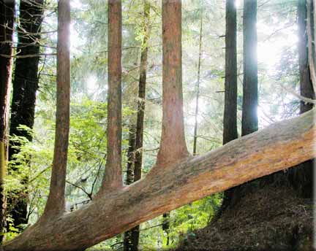
Ensemble methods: Bagging and boosting
Chong Ho (Alex) Yu

Slide 2
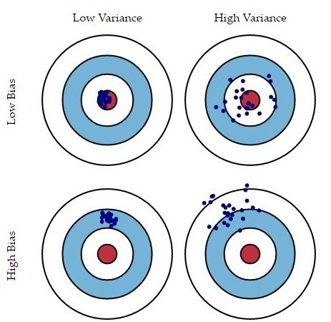
Problems of bias and variance
The bias is the error which results from missing a target.
For example, if an estimated mean is 3, but the actual population value is 3.5, then the bias value is 0.5.
The variance is the error which results from random noise.
When the variance of a model is high, this model is considered unstable.
A complicated model tends to have low bias but high variance.
A simple model is more likely to have a higher bias and a lower variance.

Slide 3
Solutions
Bagging (Bootstrap Aggregation): decrease the variance
Boosting (Gradient boosted tree): weaken the bias
Both bagging and boosting are resampling methods because the large sample is partitioned and re-used in a strategic fashion.
When different models are generated by resampling, some are high-bias model (underfit) while some are high-variance model (overfit).
Each model carries a certain degree of sampling bias, but In the end the ensemble cancels out these errors.
The results is more likely to be reproducible with new data.

Slide 4
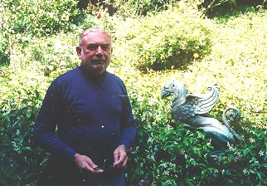
Bootstrap forest (Bagging)
When you make many decision trees, you have a forest!
Bootstrap forest is built on the idea of bootstrapping (resampling).
Originally it is called random forest, and it is trademarked by the inventor Breiman (1928-2005) and the paper is published in the journal Machine Learning.
RF pick random predictors & random subjects.
SAS JMP calls it bootstrap forest (pick random subjects only)
IBM SPSS calls it random tree

Slide 5
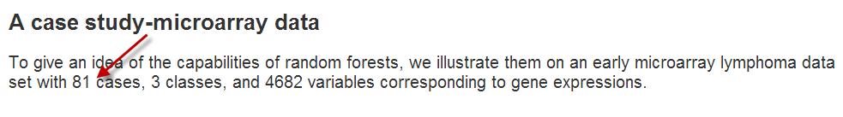
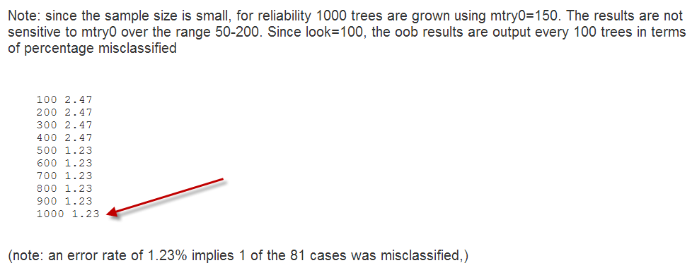
The power of random forest!

Slide 6
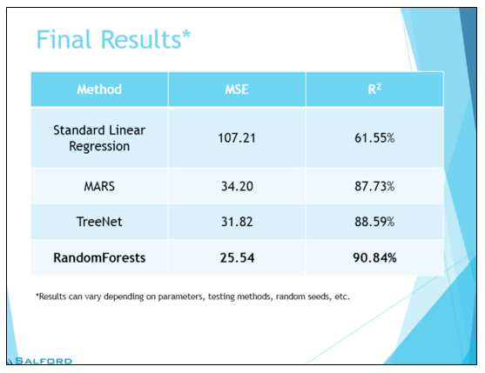
Much better than regression!
Salford systems (2015) compared several predictive modeling methods using an engineering data set.
It was found that OLS regression could explain 62% of the variance whereas the mean square error is 107!
In the random forest the R-square is 91% while the MSE is as low as 26%.

Slide 7
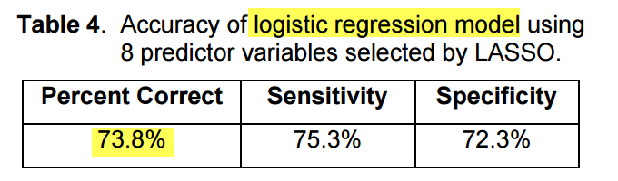
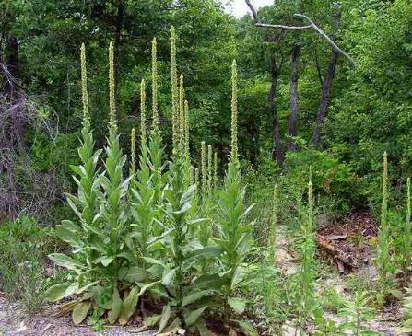
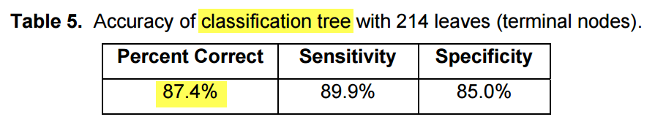
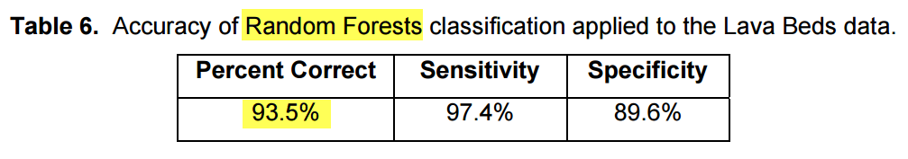
Much better than regression!
In a study about identifying predictors of the presence of mullein (an invasive plant species) in Lava Beds National Monument, random forests outperform a single classification while the classification tree outperforms logistic regression.
Cutler, R. (2017). What statisticians should know about machine learning? Proceedings of 2017 SAS Global Forum.

Slide 8
Bagging
All resamples are generated independently by resampling with replacement. In each bootstrap sample about 30% of the observations are set aside for later model validation. These observations are grouped as the out of bag sample (OOBS)
The algorithm converges these resampled results together by averaging them out. Consider this metaphor: After 100 independent researchers conducted his/her own analysis; this research assembly combines their findings as the best solution.

Slide 9
Bagging
The bootstrap forest is an ensemble of many classification trees resulting from repeated sampling from the same data set (with replacement). Afterward, the results are combined to reach a converged conclusion.
While the validity of one single analysis may be questionable due to a small sample size, the bootstrap can validate the results based on many samples.

Slide 10
Bagging
The bootstrap method works best when each model yielded from resampling is independent and thus these models are truly diverse.
If all researchers in the team think in the same way, then no one is thinking.
If the bootstrap replicates are not diverse, the result might not be as accurate as expected.
If there is a systematic bias and the classifiers are bad, bagging these bad classifiers can make the end model worse.

Slide 11
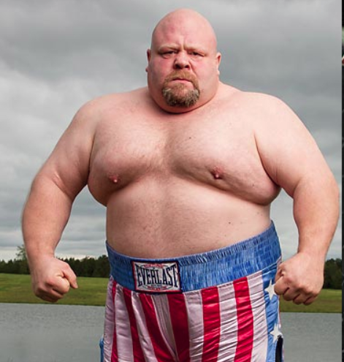
Boosting
A sequential and adaptive method
The previous model informs the next.
Initially, all observations are assigned the same weight. If the model fails to classify certain observations correctly, then these cases are assigned a heavier weight so that they are more likely to be selected in the next model.
In the subsequent steps, each model is constantly revised in an attempt to classify those observations successfully.
While bagging requires many independent models for convergence, boosting reaches a final solution after a few iterations.

Slide 12
Comparing bagging and boosting
 | Bagging | Boosting
Sequent | Two-step | Sequential
Partitioning data into subsets | Random | Give misclassified cases a heavier weight
Sampling method | Sampling with replacement | Sampling without replacement
Relations between models | Parallel ensemble: Each model is independent | Previous models inform subsequent models
Goal to achieve | Minimize variance | Minimize bias, improve predictive power
Method to combine models | Weighted average or majority vote | Majority vote
Requirement of computing resources | Highly computing intensive | Less computing intensive

Slide 13
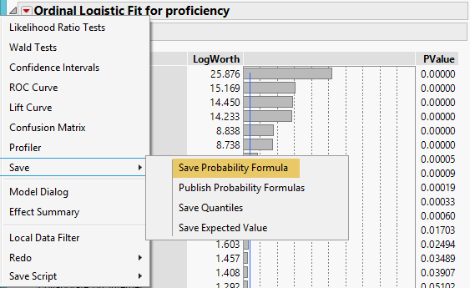
Example: PISA
PISA 2006 USA and Canada
Use Fit Model to run a logistic regression
Y = Proficiency
Xs = all school, home, and individual variables
From the inverted red triangle choose Save Probability Formula to output the prediction.
Every one is assigned the probability of proficient or not proficient.

Slide 14
Hit and Miss : (Mis-classification) rate
The misclassification rate is calculated by comparing the predicted and the actual outcomes.
Subject | Prob[0] | Prob[1] | Most Likely proficiency | Actual proficiency | Discrepancy?
1 | 0.709660358 | 0.290339642 | 0 | 1 | Miss
2 | 0.569153931 | 0.430846069 | 0 | 0 | Hit
3 | 0.266363358 | 0.733636642 | 1 | 1 | Hit
4 | 0.53063663 | 0.46936337 | 0 | 1 | Miss
5 | 0.507966808 | 0.492033192 | 0 | 1 | Miss
6 | 0.26676262 | 0.73323738 | 1 | 1 | Hit
7 | 0.535631438 | 0.464368562 | 0 | 0 | Miss
8 | 0.636997729 | 0.363002271 | 0 | 1 | Miss
9 | 0.136721803 | 0.863278197 | 1 | 1 | Hit
10 | 0.504198458 | 0.495801542 | 0 | 1 | Miss

Slide 15
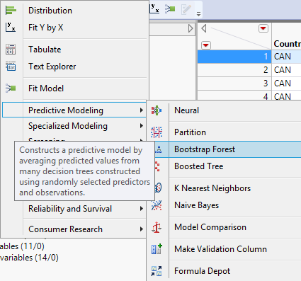
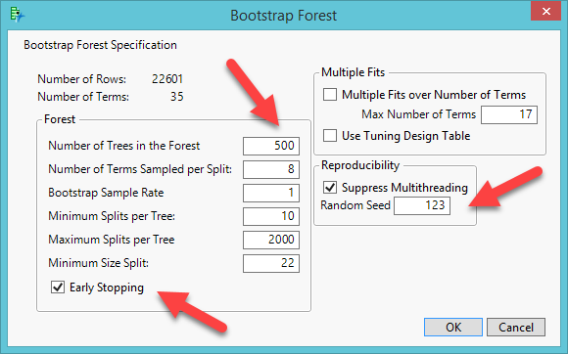
Example: PISA
Analyze → Predictive modeling → bootstrap forest
Validation portion= 30% and no informative missing
Enter the same random seed to enhance reproducibility and check early stopping.
Caution: If your computer is not powerful, stay with the default: 100 trees

Slide 16
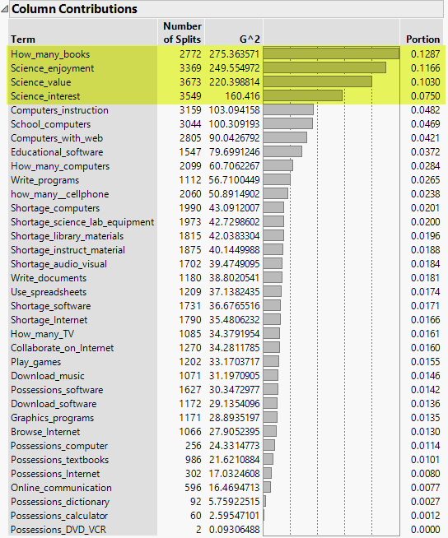
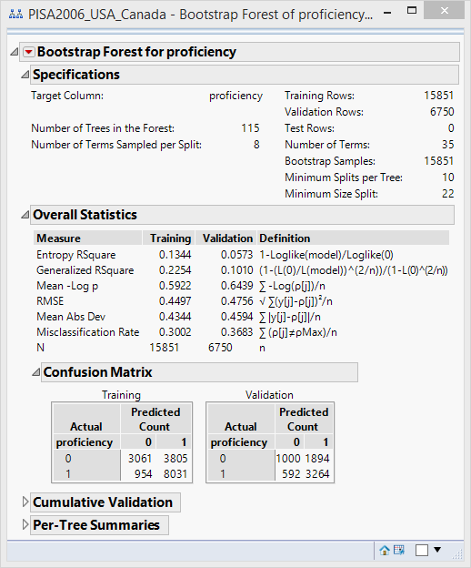
Bootstrap forest result
From the red triangle select Column Contributions.
No cut-off. Retain the predictors by inflection.
After three to four variables, there is a sharp drop.

Slide 17
Column contributions
The importance of the predictors is ranked by both the number of split, G2, and the portion.
The number of splits is simply a vote count: How often does this variable appear in all decision trees?
The portion is the percentage of this vaiable in all trees.

Slide 18
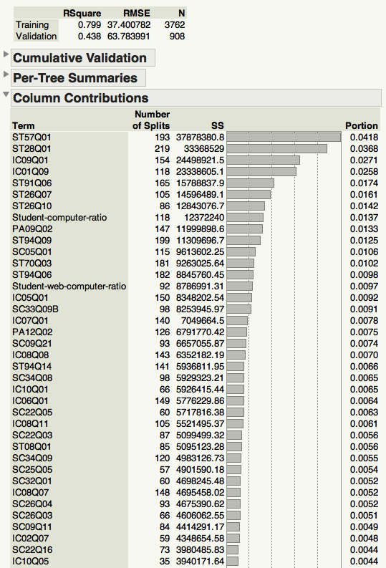
Column contributions
When the dependent variable is categorical, the importance is determined by G2, which is based on the LogWorth statistic.
When the DV is continuous, the importance is shown by Sum of Sqaures (SS).
If the DV is binary (1/0, Pass/Fail) or multi-nominal, we use majority or plurality rule voting (the number of splits)
If the DV is continuous, we use average predicted values (SS).

Slide 19
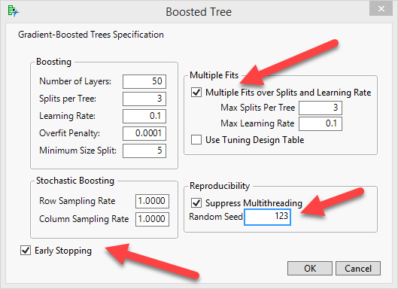
Boosting
Analyze → Predictive Modeling → Boosted Tree
Press Recall to get the same variables
Check multiple fits over splits and learning rate
Enter the same random seed to improve reproducibility

Slide 20
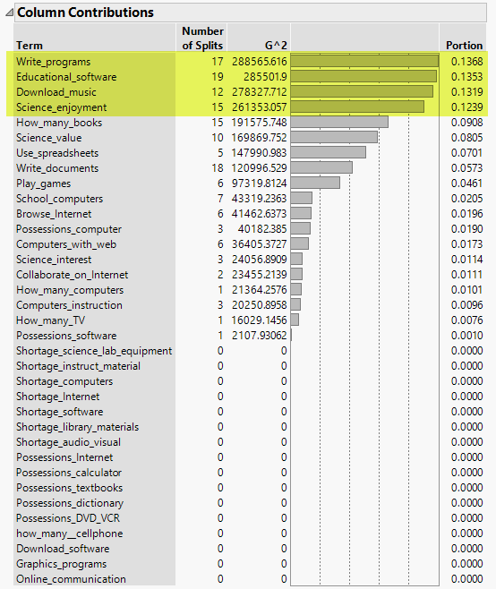
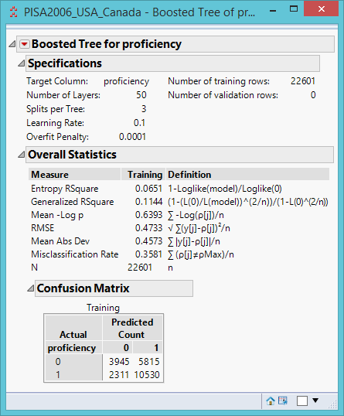
Boosting
Unlike bagging, boosting exclude many variables

Slide 21
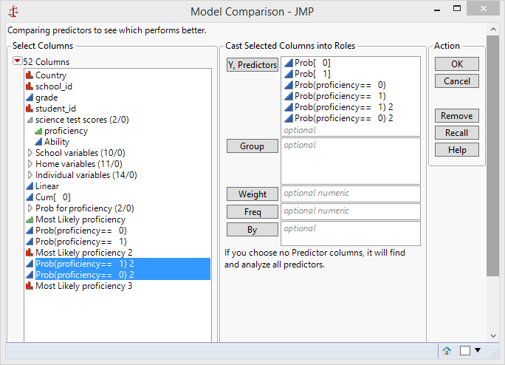
Model comparison
Analyze → Predictive Modeling → Model Comparison
In the output from the red triangle select AUC comparison (Area under curve).

Slide 22
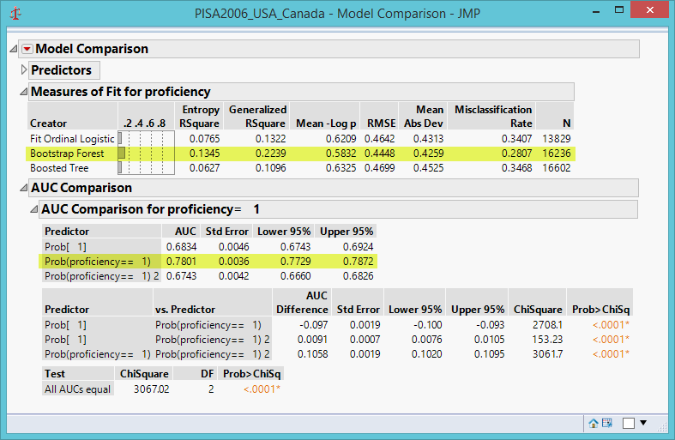
And the winner is…
Bagging!
Highest Entropy R-square (based on purity)
Lowest Root Mean Square Error
Lowest misclassification rate
Highest AUC for classifying proficient students: Prob(1)
Lowest standard error

Slide 23
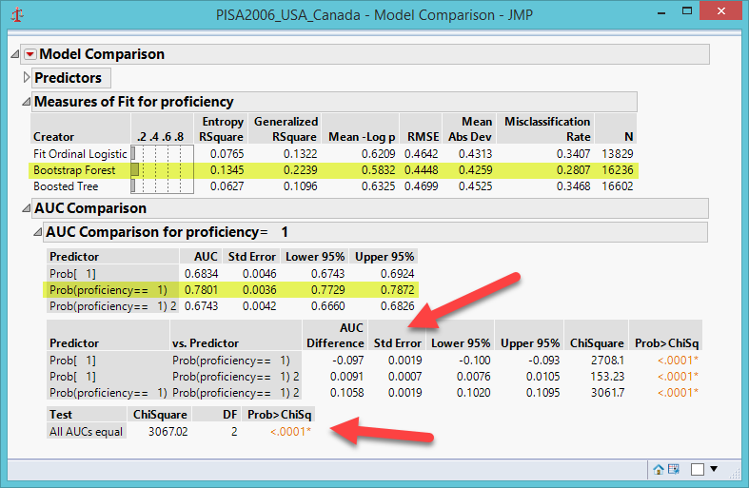
And the winner is…
The bottom table shows the test result of the null hypothesis: all AUCs are not significantly different from each other (all are equal) but they are not.
The table above shows the multiple comparison results (logistic vs. bagging; logistic vs. bagging; bagging vs. boosting) All pairs are significantly different from each other.

Slide 24
Recommended strategies
Bagging is NOT always better. Th result may vary from study to study. Run both bagging and boosting in JMP, perform a model comparison, and then pick the best one.
If you have a very very very HUGE data set (count in million or billion), use SAS high performance procedure: Proc HPForest. The default is GINI.
If the journal is open to new methodologies, you can simply use ensemble approaches for data analysis.
If the journal is conservative, you can run both conventional and data mining procedures side by side, and then perform a model comparison to persuade the reviewer that the ensemble model is superior to the conventional regression model.

Slide 25

Recommended strategies
You can use two criteria (the number of splits and G2 or the number of splits and SS) to select variables if and only if the journal welcomes technical details (e.g. Journal of Data Science; Journal of Data Mining in Education...etc.)
If the journal does not like technical details, use the number of splits only. If the reviewers don't understand SS, Logworth, G2...etc., it is more likely that your paper will be rejected.

Slide 26
Assignment 6.2
Use PISA2006_USA_Canada
Create a subset: Canada only
Y: Proficiency
Xs: All school, home, and individual variables
Run logistic regression, bagging and boosting
Run a model comparison
Which model is better?

Slide 27
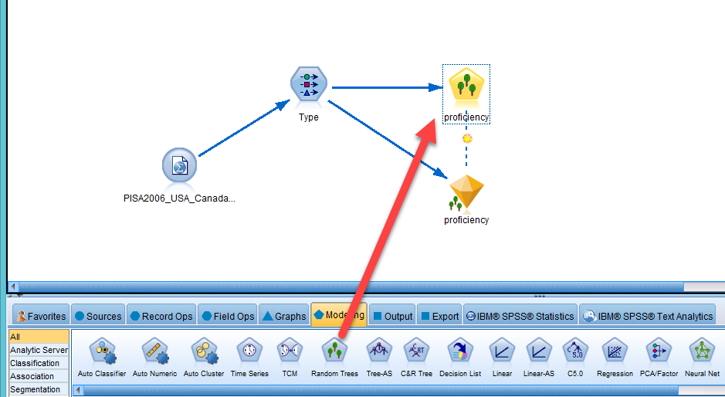
IBM Modeler
Like Random Forest, Random Trees generate many models.
Each time it grows on a random subset of the sample and based on a random subset of the input fields.

Slide 28
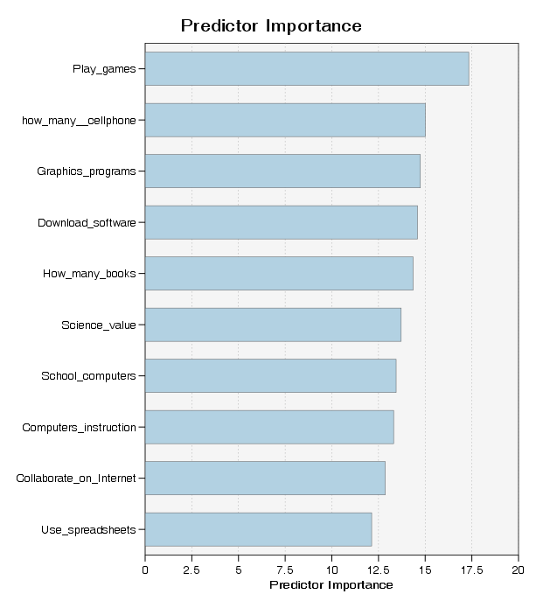
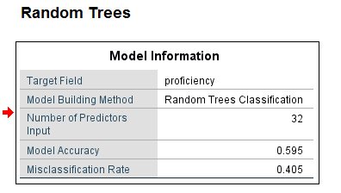
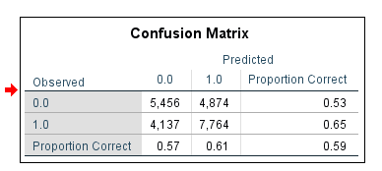
IBM Modeler result
The list of important predictors is different from that of JMP.
The mis-classification rate is VERY high.

