Slide 1
Resampling: Making up data?
Chong Ho Yu

Slide 2
Resampling and data mining
Resampling is NOT big data analytics.
In contrast, resampling was developed to deal with the problem of small sample size
  Lady‘s tasting tea: 8 observations
  Law school data: 15 observations
Two resampling methods, cross validation (CV) and bootstrapping, are commomly used in many big data analyitcs.

Slide 3

Definition
Reuse the same data
Root: Monte Carlo simulation – researchers "make up" data and draw conclusions based on many possible scenarios.
"Monte Carlo" comes from an analogy to the gambling houses on the French Riviera.
Study how to maximize their chances of winning by using simulations.

Slide 4
Common ground & difference
Common ground: Both find the probability by generating all or many possible scenarios.
Difference: Monte Carlo simulations create totally hypothetical data whereas resampling must start with some real data.
Application of MCS: test the test – If you want to know whether a robust test can accept a messy data structure, you can utilize MCS to generate different types of strange data to examine the robustness of the test.

Slide 5
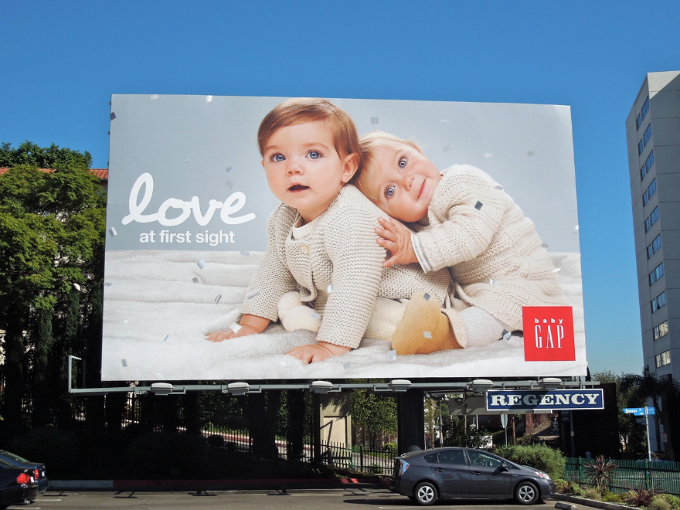
Making up data?
Some people rejected resampling because the idea of 'making up' data seems very unethical.
Indeed we experience similar things everyday.

Slide 6

Extrapolation
You took a picture of Grand Canyon last summer. The picture is great!
Most camera sensors can capture an image with 16-24 mega pixels.
The picture will be very sharp even if you enlarge it to 16X20.

Slide 7
Extrapolation
But if you want to enlarge your photo to the poster size or the billboard size, there will not be enough pixels to fill up the canvas. NP!
Some software package, such as OnOne's Perfect Resize, can sample from the existing pixels, duplicate them, and use the resampled pixels to populate the canvas.

Slide 8
Resampling in CLT
The idea is not completely new.
Remember the Central Limit Theorem (CLT) and sampling distributions?
Regardless of what the distribution of the underlying population is (mesa, camel back, skew, normal...etc), the distribution of the sample statistics approaches normality as repeated sampling is done.

Slide 9
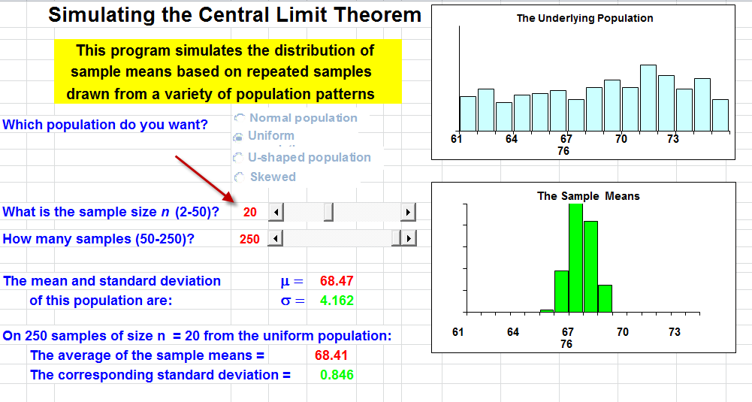
Sampling distribution from unifrom

Slide 10
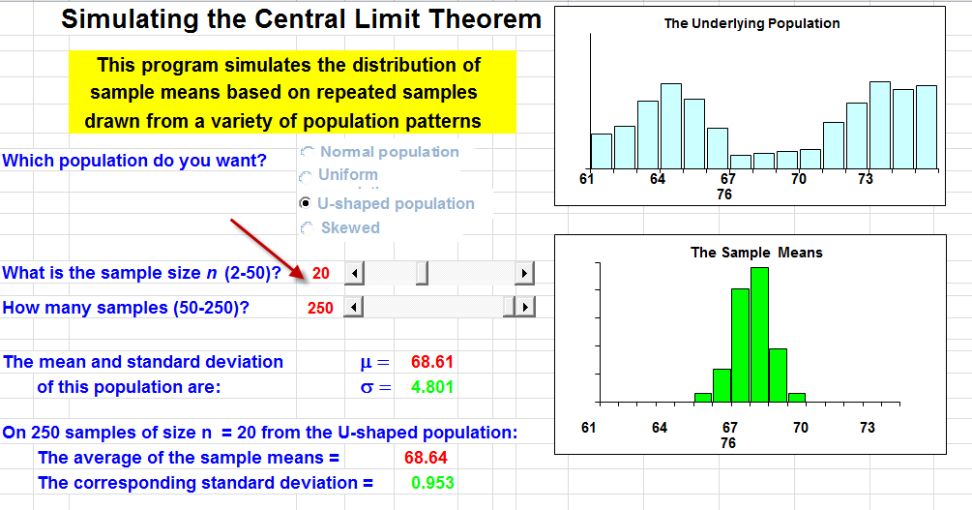
Sampling distribution from camel back

Slide 11
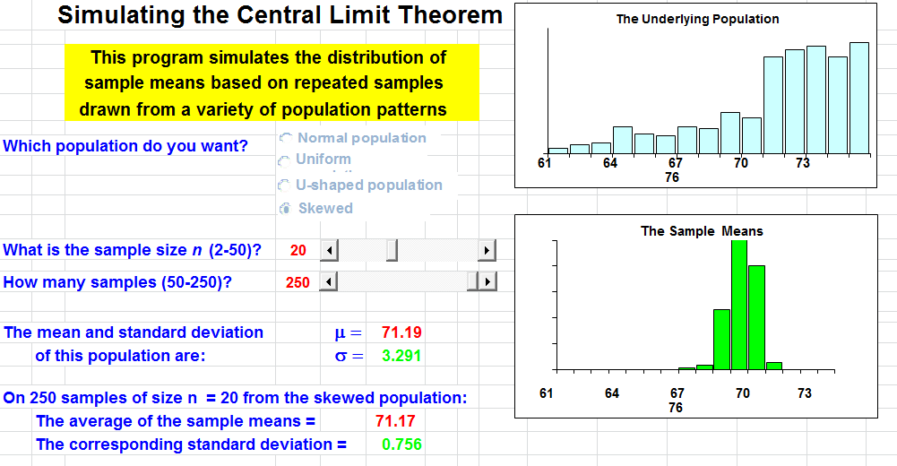
Sampling distribution from skew

Slide 12
Why resampling?
Common criticisms of any research study
  The sample size is too small (Many dissertations end with a sentence like this: In the future more studies with a larger sample size is needed.)
  The data are not normally distributed and do not conform to the parametric assumptions.
  This is one study only. It can be capitalized on chance. You may not be able to replicate the finding next time.
  The n is too large. The test is over-powered.
Resampling can help.

Slide 13

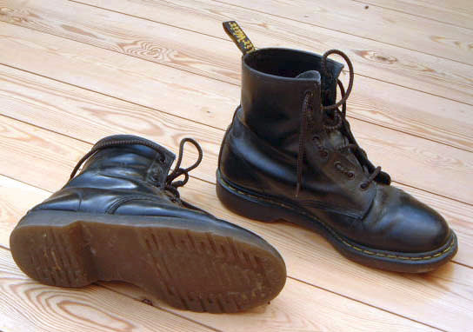
4 types of resampling
Randomization exact test: Permutate different possibilities
Cross-validation: divide one sample into 2 or more subsets.
Jackknife: leave one out
Bootstrap: one sample gives rise to many others by resampling (pulling yourself up by your own bootstrap)

Slide 14
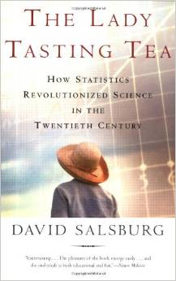
Exact test
R, A, Fisher met a lady who insisted that her tongue was senstive enough to detect a subtle difference between a cup of tea with the milk being poured first and a cup of tea with the milk being added later.
He tested the lady with eight cups of tea. She was right 6 out of eight trials!

Slide 15
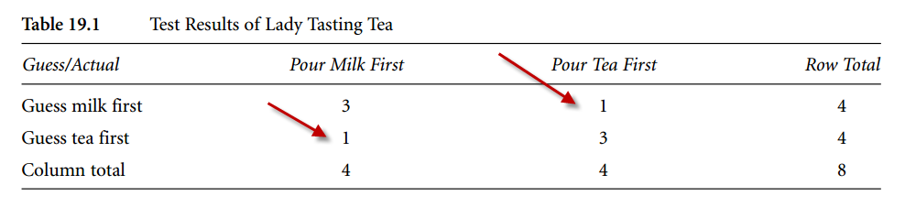
Exact test
With eight observations only, you cannot do a Pearson's chi-square test (some cell count is as low as one).
What can Fisher do?

Slide 16
Exact test
In classical tests we compare the sample statistics against the theoretical sampling distribution.
The p value tells you how rare the sample statistics is in the long run (sampling distributions).
Fisher permuted all possible scenarios to create an empirical sampling distribution.
Compare the observed data to the empircal distribution.

Slide 17
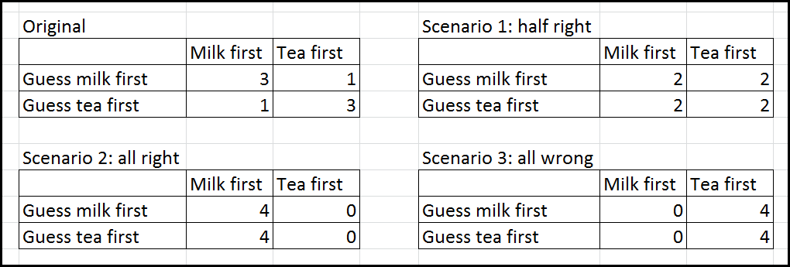
Exact test
Exact test is so named because in classical parametric tests you can obtain the approimate p value.
In Exact test you can know exactly how often or how rare the event can happen given all possible scenarios.

Slide 18
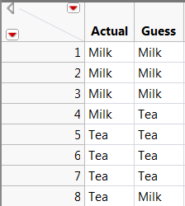
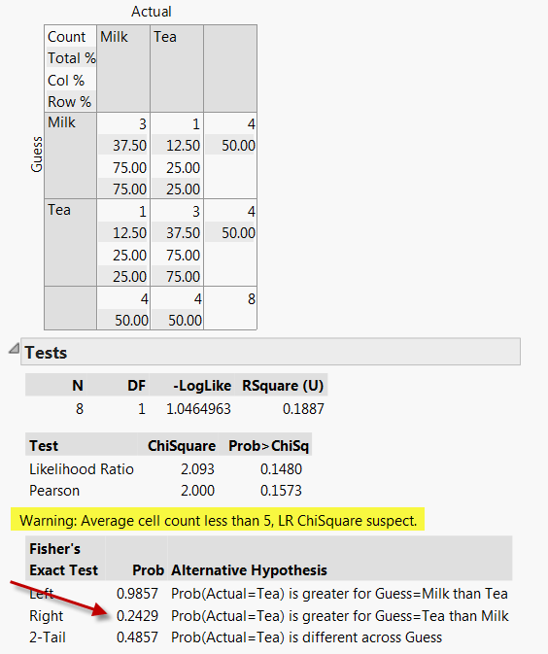
Exact test in JMP

Slide 19
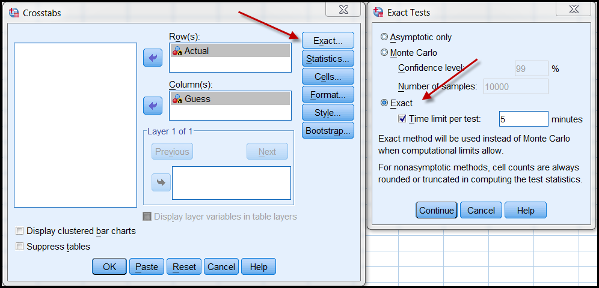
Exact test in SPSS

Slide 20
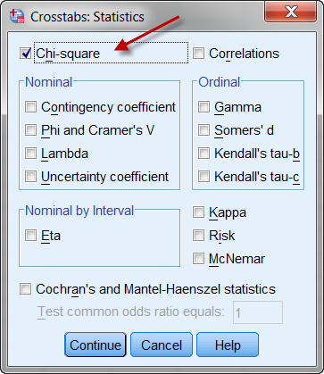
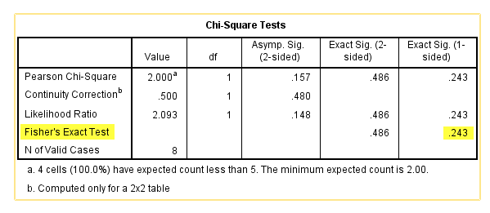
Exact test in SPSS

Slide 21
Cross-validation
Many conventional tests tend to overfit the model to a single sample.
How can you know the result can be replicated in another study?
You can hold back a portion of your data for cross-validation (CV).
CV is a precursor of machine learning, which divides the sample into training set and validation set.

Slide 22

Too much power can hurt you!

Slide 23
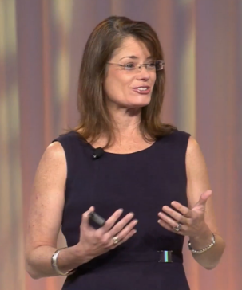
Problem of too many subjects!
“Tell someone to do a t-test with a billion subjects!”
If you have a huge sample size (e.g. 2000), you can easily reject the null hypothesis. Any trivial effect may be mis-identified as significant.
If you divide your large sample into 10 subsets for CV, then each subset contains 200 subjects only. No test is over-powered.
But if n = 50, then sub-dividing them may not be practical.

Slide 24
Jackknife
Co-invented by John Tukey, the Father of EDA.
Jackknife: all-purpose tool.
Leave out one observation at each analysis.
Re-do the analysis n-1 times. Why?
  To see how extreme cases and outliers influence the result (senstivity analysis)
  To counteract the issue of non-independent data.

Slide 25
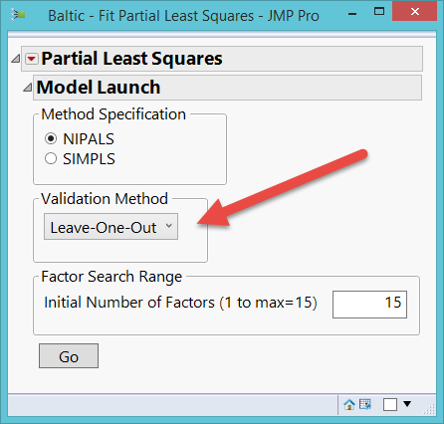
When to use Jackknife
Jackknife is available in many JMP procedures.
If the sample size is very huge, your CPU may burn.
e.g. 10,000 – 1 = re-running the test 9,999 times!
Use JF with a smaller sample.
Leave-one-out assumes every observation is treated equally (100%).

Slide 26
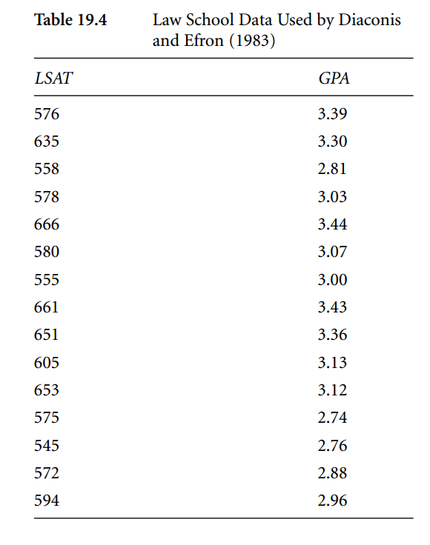
Bootstrap
The idea of bootstrapping originated from Bradley Efron (1979, 1981) and further developed by Efron and Tibshirani (1993).
"Bootstrap" means that one available sample gives rise to many others by resampling (a concept reminiscent of pulling yourself up by your own bootstrap).

Slide 27
Bootstrap
LSAT data: What can you do with 15 observations?
The Pearson' r of the original data set is .776.
Diaconis and Efron duplicated the data set 1 billion times. 15 → 15 billions.
Treated the new data set as the proxy or virtual population.

Slide 28
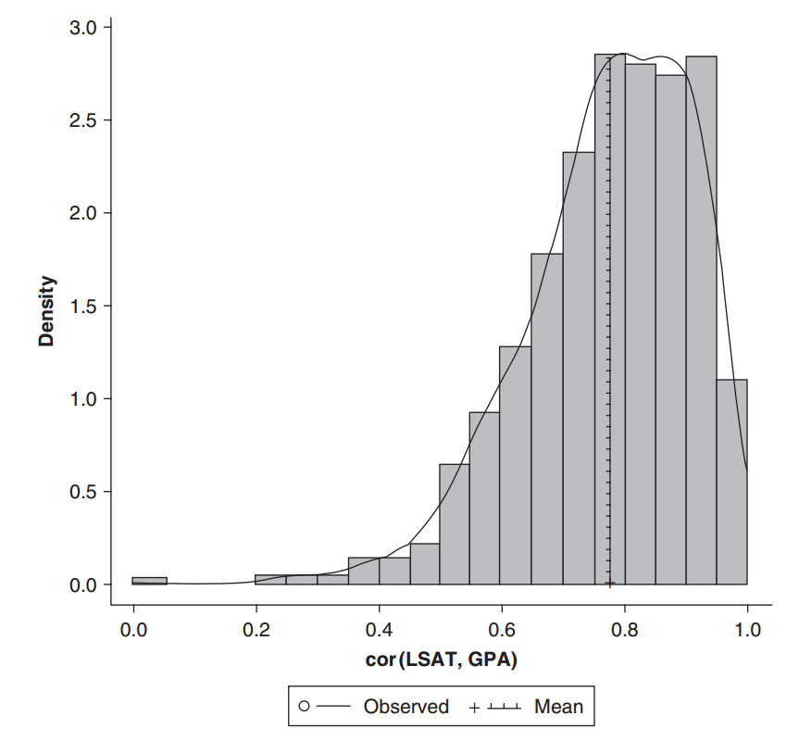
Bootstrap
Draw 1000 random samples from the virtual population (with replacement).
In each draw compute the Pearson's r.
Sometime the r is big, sometimes it is small. You have a sampling distribution, but it is not necessarily normal.

Slide 29
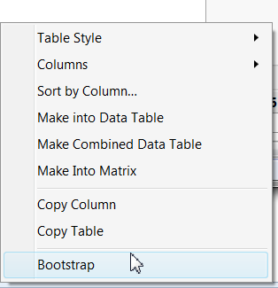
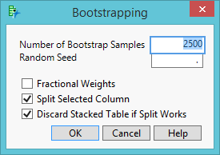
Bootstrap in JMP
Run a regular Pearson's r using multivariate methods
Go to pairwise correlations from the inversed red triangle.
Mouse over the correlation coeficient and right click to select bootstrap
The default # of bootsrap samples is 2500. If your computer is ot powerful, reduce the number.

Slide 30
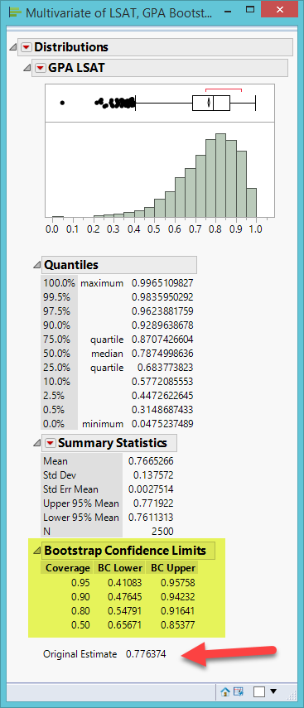
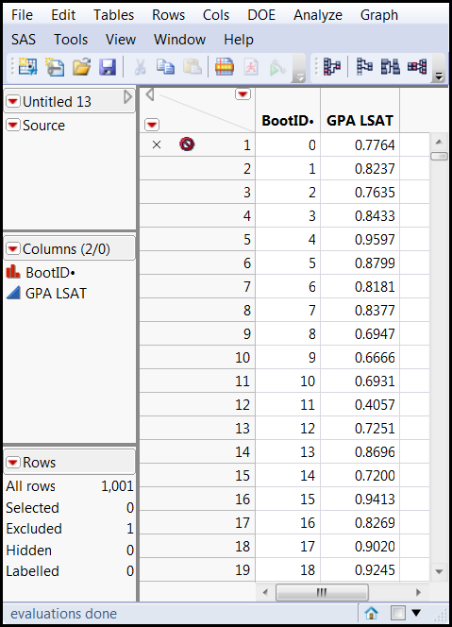
Bootstarp in JMP
The observed r is 0.7763.
In the bootstrapped distribution of r, the mean is .7665.
Check the bootstrap CI

Slide 31
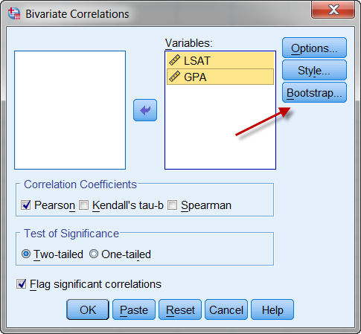
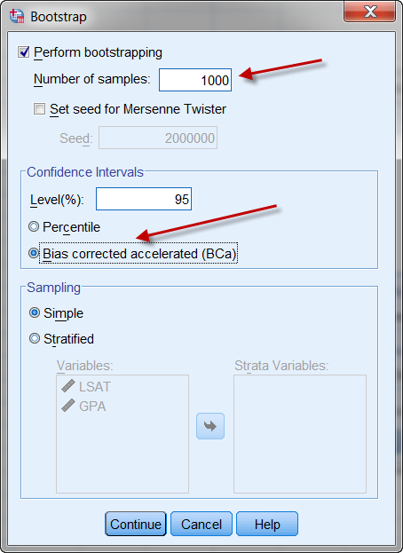
Bootstrap in SPSS

Slide 32
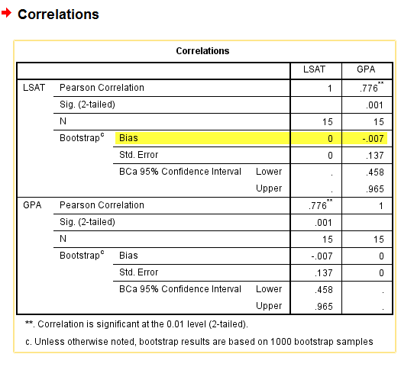
Bootstrap in SPSS
The bias is the distance between the observed and the resampled.
Very small (-0.007)

Slide 33
Assignment
Use the data set 'visualization_data' in the Unit 2 folder.
In JMP run an OLS regession. Use GPA and SAT to predict test scores.
Right click on parameter estiamtes and do a bootstrap with 1,000 samples.
Use Distributions to examine the resampled results.

