Slide 1
PCA, EFA, and PA
Chong Ho Yu

Slide 2
PCA and EFA
Principal components analysis: find the optimal way of collapsing many correlated variables into a small number of subsets so that the study is more manageable. The subsets do not need to make any theoretical sense. It is for convenience only.
Exploratory factor analysis: identify the underlying theoretical structure of diverse variables. If certain items are loaded into a subscale called intrinsic religious orientation, then the items must be related to this construct both mathematically and conceptually.

Slide 3
Example of PCA:
Insurance policy
The policy variables (Maitra & Yan):
Fire Protection Class
Number of Building in Policy
Number of Locations in Policy
Maximum Building Age
Building Coverage Indicator
Policy Age

Slide 4
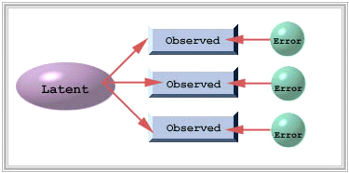
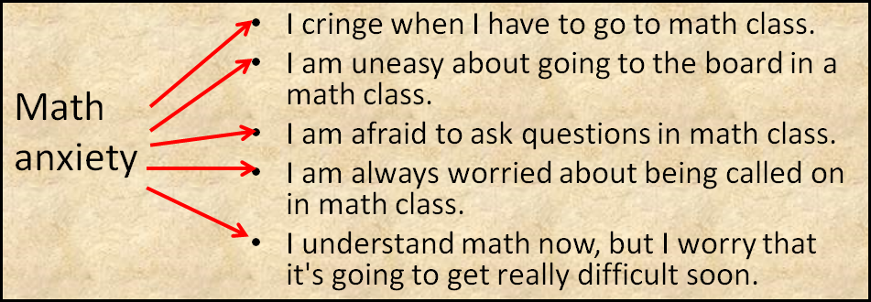
Example of factor analysis?
Find out what observed items can indicate latent constructs.

Slide 5
PCA and factor analysis
FA is more demanding than PCA
PCA is simply data reduction for convenience; you don’t need further psychometric validation.
FA → construct validity
You need a different sample for confirmatory factor analysis.

Slide 6
EFA is not enough
We need confirmatory factor analysis (CFA)? Why?
'EFA is an error-prone procedure even when the scale being analyzed has a strong factor structure, and even with large samples. Our analyses demonstrate that at a 20: 1 subject to item ratio there are error rates well above the field standard alpha = .05 level…It should be used only for exploring data, not hypothesis or theory testing, nor is it suited to “validation” of instruments.'
Osborne, J. W. (2014). Best practices in exploratory factor analysis (Kindle Locations 2305-2310). Amazon Digital Services.

Slide 7
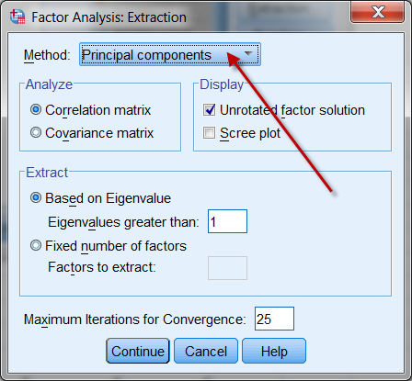
Confusion between PCA & EFA
Although factor analysis and PCA are two different procedures, some researchers found that the procedures yield almost identical results on many occasions. SPSS makes PCA as the default when EFA is requested.

Slide 8
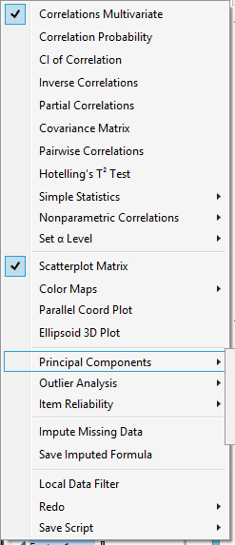
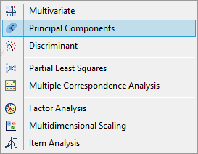
JMP
• In JMP there are different ways to do PCA
– Multivariate methods → Multivariate
– Multivariate methods → Principal Components

Slide 9
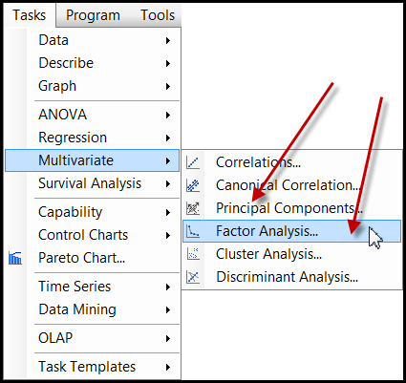
SAS
Less confusing in SAS. Both PCA and EFA are shown in the Tasks menu.
But if you do programming, PROC FACTOR in SAS makes PCA as the default method.

Slide 10
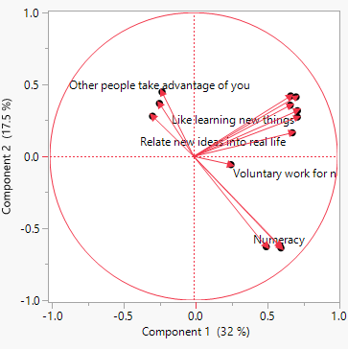
PCA
Data set: PIAAC_for_PCA.jmp
Analyze → multivariate methods → Principal components
Use all numeric variables except age, problem-solving, literacy, and numeracy.
Besides the scree plot, we can look at the loading plot.

Slide 11
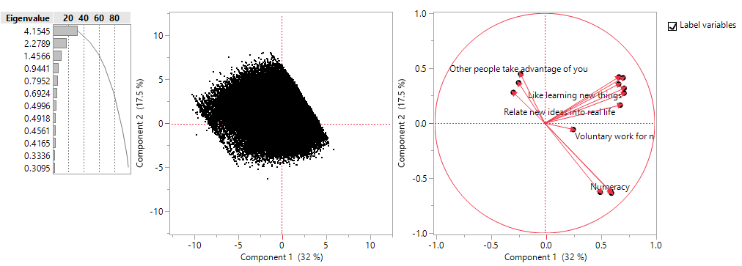
Vectors
Showing the directions and relationships.
Cos(the angle between two vectors) = r

Slide 12
Vector
A mathematical object with a numeric value is called a scalar.
A mathematical object that has both a numeric value and a direction is called a vector.
If I just tell you to drive 10 miles to reach my home, this instruction is definitely useless. I must say something like, "From Claremont drive 10 miles West to Azusa."

Slide 13
Vector
Vector-based graphics: the image is defined by the relationships among vectors instead of the composition of pixels.
For example, to construct a shape, the software stores the information like "Start from point A, draw a straight line at 45 degrees, stop at 10 units, draw another line at 35 degrees..."

Slide 14
Vector
In quantitative analysis, vectors help us to understand the relationships among variables.
The word eigen, coined by Hilbert in 1904, is a German word, which means "own“ or "peculiar“.
An Eigenvalue has a numeric property while an eigenvector has a directional property. They define the attributes of a variable.
“Eigen” emphasizes the unique nature of a specific transformation in Eigenvalues.

Slide 15
Data as matrix
 | GRE-Verbal | GRE-Quant
David | 550 | 575
Sandra | 600 | 580
The columns denote the subject space, which are {550, 600} and {575, 580}. The subject space tells you that how GRE-Verbal and GRE-Quantitative scores are distributed between two subjects, David and Sandra.
The rows reflect the variable space, which are {550, 575} and {600,580}. The variable space indicates that across the variables GRE-V and GRE-Q, how the scores of the subjects are distributed.

Slide 16
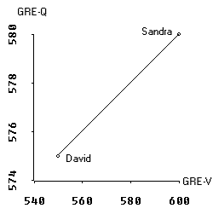
Variable space
In a scatterplot we deal with the variable space.
In the scatterplot GRE-V lies on the X-axis whereas GRE-Q is on the Y-axis.
The data points are the scores of David and Sandra. In a two data-point case, the regression line is perfect, of course.

Slide 17
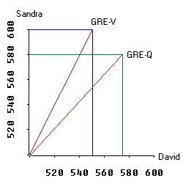
Subject space
The graph on the right is a plot of subject space.
The X axis and Y axis represent Sandra and David. In GRE-V David scores 550 and Sandra scores 600. A vector is drawn from 0 to the point where Sandra's and David's scores meet.

Slide 18
Subject space
The scale of the graph is not of the right proportion. Actually it starts from 500 rather than 0 in order to make other portions of the graph visible.
The vector for GRE-Q is constructed in the same manner.

Slide 19
Hyperspace
When subject space and variable space are combined, we call it the hyperspace.
In reality, a research project always involves more than two variables and two subjects.
In a multi-dimensional hyperspace, the vectors in the subject space can be combined to form an eigenvector, which depicts the Eigenvalue.
The longer the length of the eigenvector is, the higher the Eigenvalue is and the more variance it can explain.

Slide 20
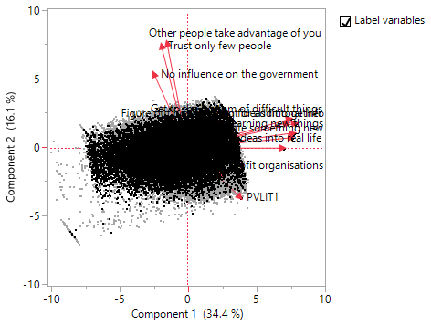
Biplot
You can depict bi-space (subject space and variable space) in a biplot.
But if you have many subjects, the biplot would be very cluttered.

Slide 21
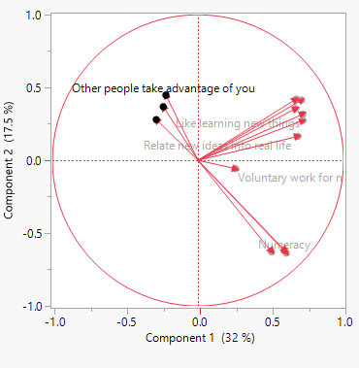
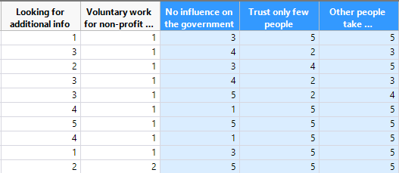
Data visualization
Use vectors to examine the clustering patterns and the inter-relationships between variables.
If the labels are obscured in the graph, you can “brush” the vectors to highlight the variables.

Slide 22
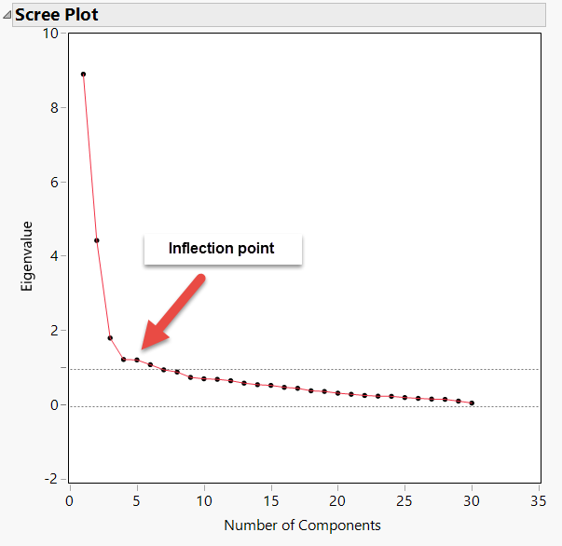
Scree plot
Determine the number of factors
How much additional information can I get by adding more complexity into the factor model?

Slide 23
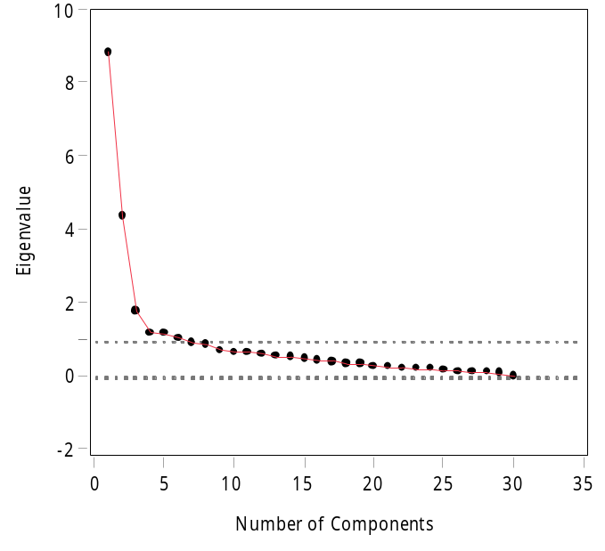
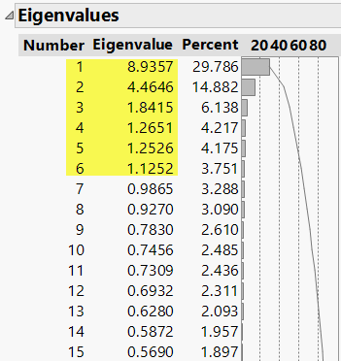
Kasier criterion
Just like the cutoff using p value < .05, Kasier criterion (Eigenvalue => 1) is just a convention.
If necessary, you should override it.
Dr. Shaynah Neshama developed a scale with two constructs, but EFA suggests six factors based on Kasier criterion => 1.

Slide 24
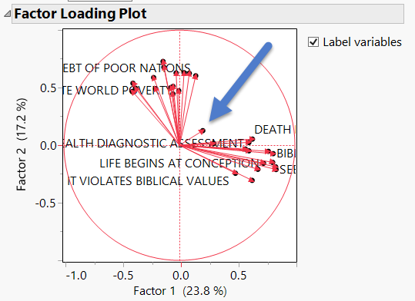

Factor loading plot
When the variables are represented as vectors, it is clear that there are two clusters. Only one item does not belong to any group. Cut it!

Slide 25
Assignment 7.3
Data set: PIAAC_for _PCA,jmp
Run a PCA with problem-solving, literacy, and numeracy.
Examine the loading plot
Can we put all three test scores together as a composite score? Are all vectors close to each other?

Slide 26
Various criteria
Kasier criterion
the scree plot
parallel analysis
Many studies had verified that by far PA is the most accurate method (Buja & Eyubuglu, 1992; Glorfeld, 1995; Horn, 1965; Hubbard & Allen, 1987; Humphreys & Montanelli, 1975; Velicer et al., 2000; Zwick & Velicer, 1986).

Slide 27
Parallel Analysis: Resampling
The logic of parallel analysis resembles that of resampling: the number of factors extracted should have eigenvalues greater than those in a random matrix.
The algorithm generates a set of random data correlation matrices by bootstrapping the data set (resampling with replacement), and then the average eigenvalues and the 95th percentile eigenvalues are computed.

Slide 28
PA: Resampling
The observed eigenvalues are compared against the re-sampled eigenvalues, and only factors with observed eigenvalues greater than those from re-sampling are retained.
The resampled result functions as a sampling distribution, in which the observed is compared against. The rationale of using the 95th percentile of the resampled data eigenvalues is that this is analogous to setting the value of alpha to .05 in hypothesis testing (Cho, Li, & Bandalos, 2009).

Slide 29
Underfactoring vs. overfactoring
Parallel analysis can be used with PCA or EFA. Which one should be used?
PA with PCA tends to under-factoring (extract fewer factors than what it should be).
PA with EFA tends to over-factoring (extract more factors than what it should be).

Slide 30
Underfactoring vs. overfactoring
Under-factoring is a more serious problem than over-factoring.
In the former scenario the researcher totally misses some information.
In the latter the result may include some meaningless factors (Crawford, Green, Levy, Lo, Scott, Svetina, & Thompson, 2010), but the researcher can always trim the redundant factors later.

Slide 31
Underfactoring vs. overfactoring
It is better to over-prepare than under-prepare.
Consider this analogy: I travel with 2-3 cameras. If I don't need the backup, it is fine. But if I have one camera only and it malfunctions, there is nothing I can do!
If your coauthor sends you a 50-page draft, you can remove the redundant information. If she sends you two pages only, there is nothing you can do!

Slide 32
Scree plot: Raw, PA means and 95th percent

Slide 33
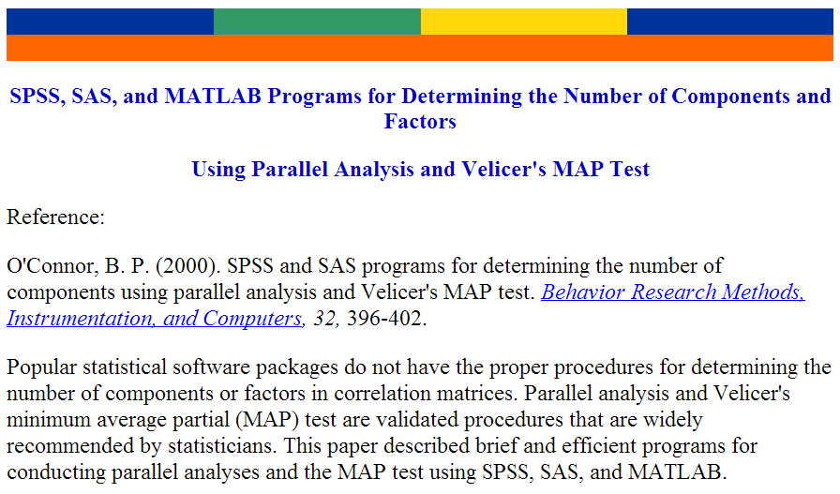
EQS, SAS or SPSS

Slide 34

SAS
Caution: You must have clean data to run the PA program. If you have missing data, you have to remove those observations, otherwise it won't run.
It is better to retain only the items that will be used for PA. Nothing else. It will be much easier to read the data. e.g. read all numeric variables into the raw data set.

Slide 35
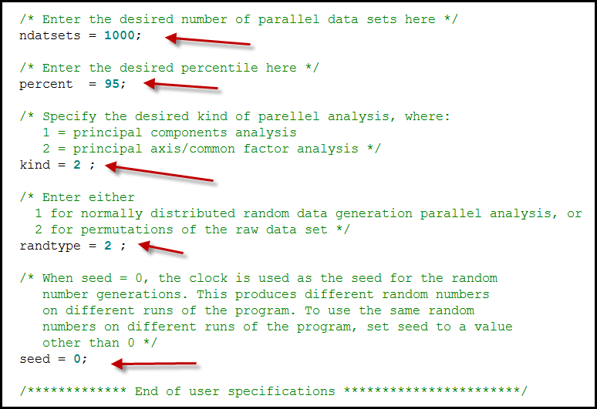
SAS

Slide 36
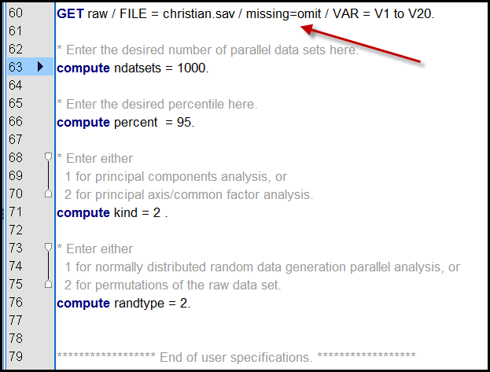
SPSS
SPSS can omit missing.

