Slide 1

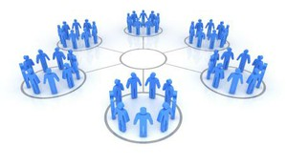
Cluster analysis
Chong Ho Yu

Slide 2
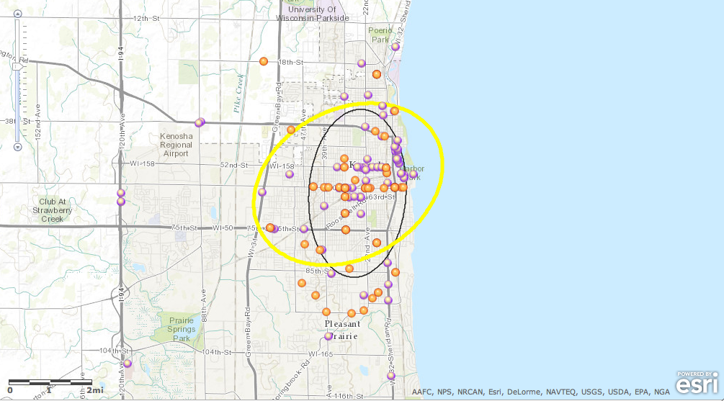
Crime hot spots
How can criminologists find the hot spots?

Slide 3
Data reduction
    Group variables into factors or components based on people’s response patterns
      PCA
      Factor analysis
    Group people into groups or clusters based on variable patterns
      Cluster analysis

Slide 4
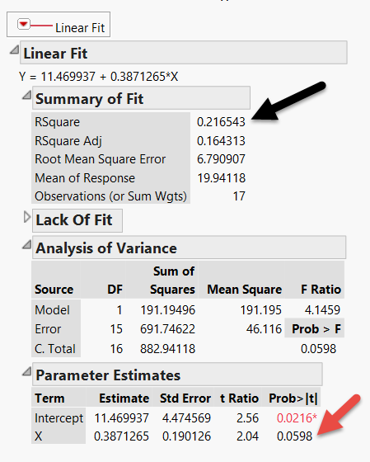
Why do we look at grouping (cluster) patterns?
Consider this example: This regression model yields 21% variance explained.
The p value is not significant (p=0.0598).
But remember we must look at (visualize) the data pattern rather than reporting the numbers only.

Slide 5
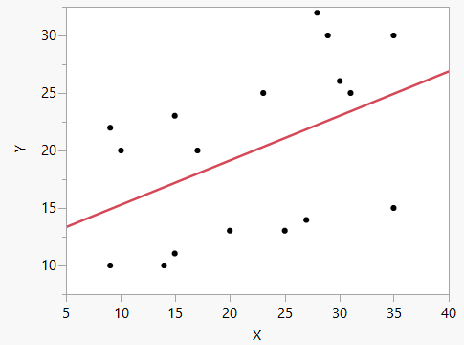
These are the data!

Slide 6
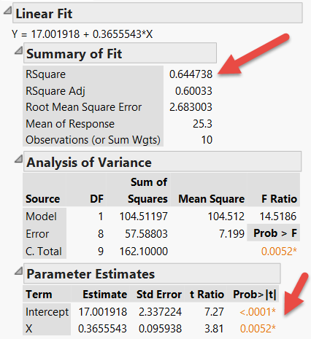
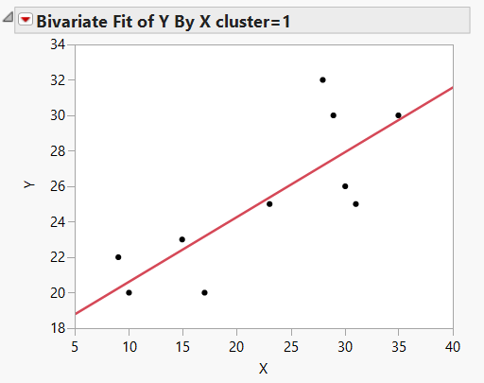
Regression by cluster
Fit a line for each cluster

Slide 7
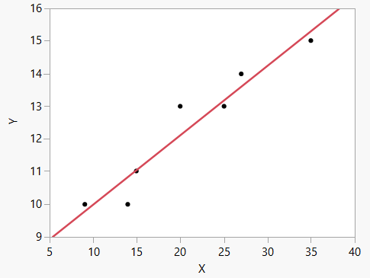
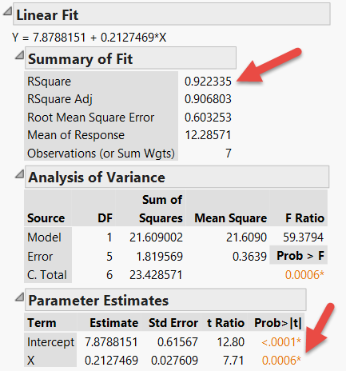
Regression by cluster

Slide 8
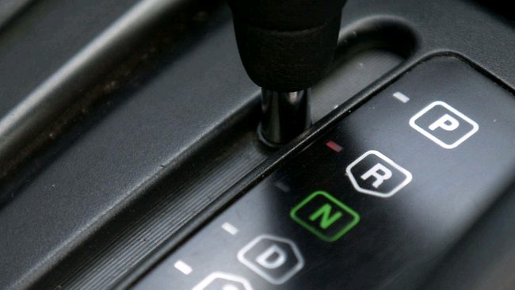
CA: ANOVA in reverse
In ANOVA participants are assigned into known groups.
In cluster analysis groups are created based on the attitudinal or behavioral patterns with reference to certain independent variables.

Slide 9
Discriminant analysis (DA)
There is a test procedure that is similar to cluster analysis: Discriminant analysis (DA)
But in DA both the number of groups (clusters) and their content are known. Based on the known information (examples), you assign the new or unknown observations into the existing groups.

Slide 10
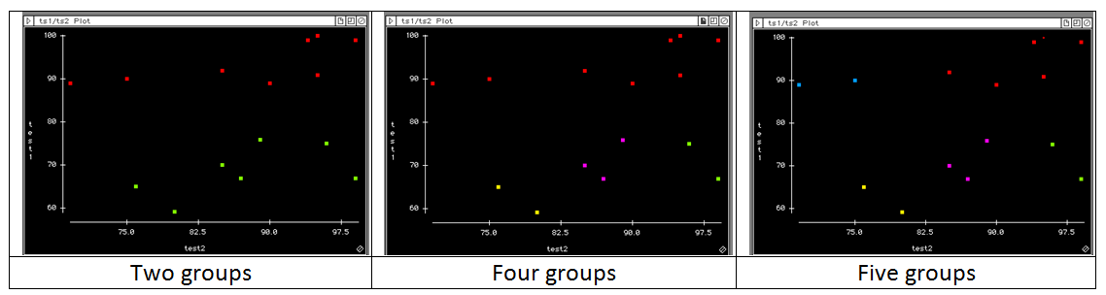
Eye-balling?
In a two-dimensional data set (X and Y only), you can “eye-ball” the graph to assign clusters. But it may be subjective.
When there are more than two dimensions, assigning by looking is almost impossible, and so we need cluster analytical algorithms.

Slide 11
Type of Cluster analysis
  Specific:
    Normal mixtures: need numeric variables and data come from a mixture of multivariate normal distribution.
    Latent class analysis: need categorical variables
  General:
    K-mean clustering
    Density-based clustering
    Hierarchical clustering
    Two-step clustering

Slide 12
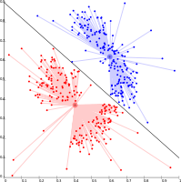
K-mean
Select K points as the initial centroids
Assign points to different centroids based upon proximity
Re-evaluate the centroid of each group
Repeat Step 2 and 3 until the best solution emerges (the centers are stable)

Slide 13
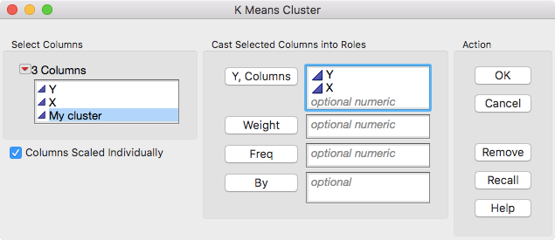
Sometimes it doesn’t make sense
Data set: regression by cluster.jmp
Analyze → Clustering → K means cluster

Slide 14
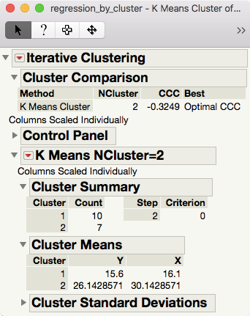
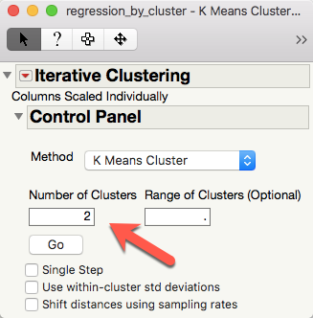

Slide 15
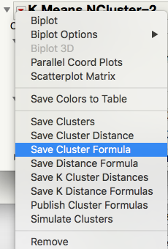
Do these 2 groups make sense?
Out put the cluster result by Save Cluster Formula.
Graph → Graph Builder
Put Y into Y-axis
Put X into X-axis
Put Cluster Formula into overlay

Slide 16
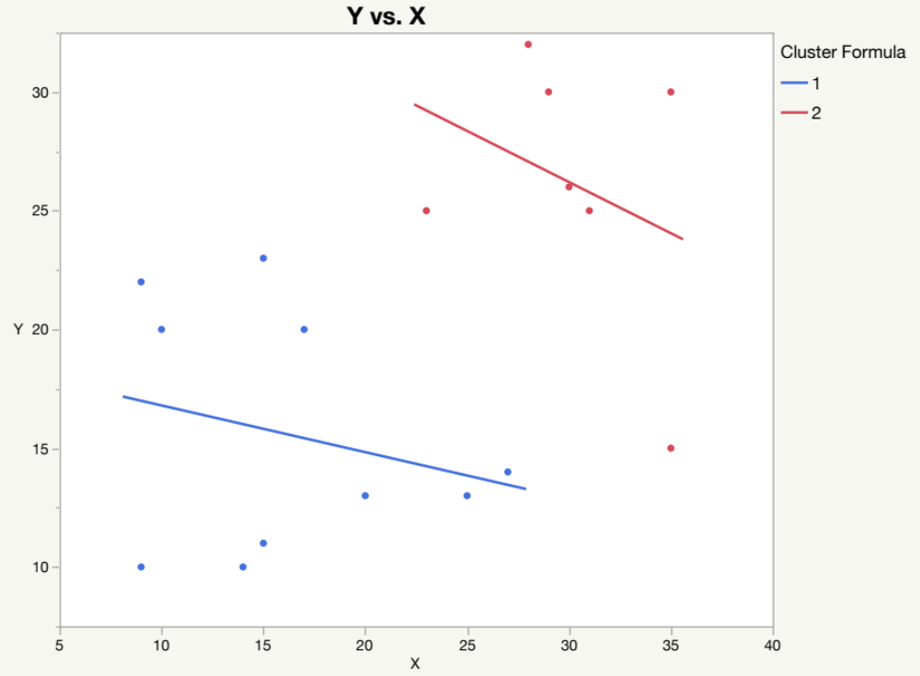
Do these 2 groups make sense?

Slide 17
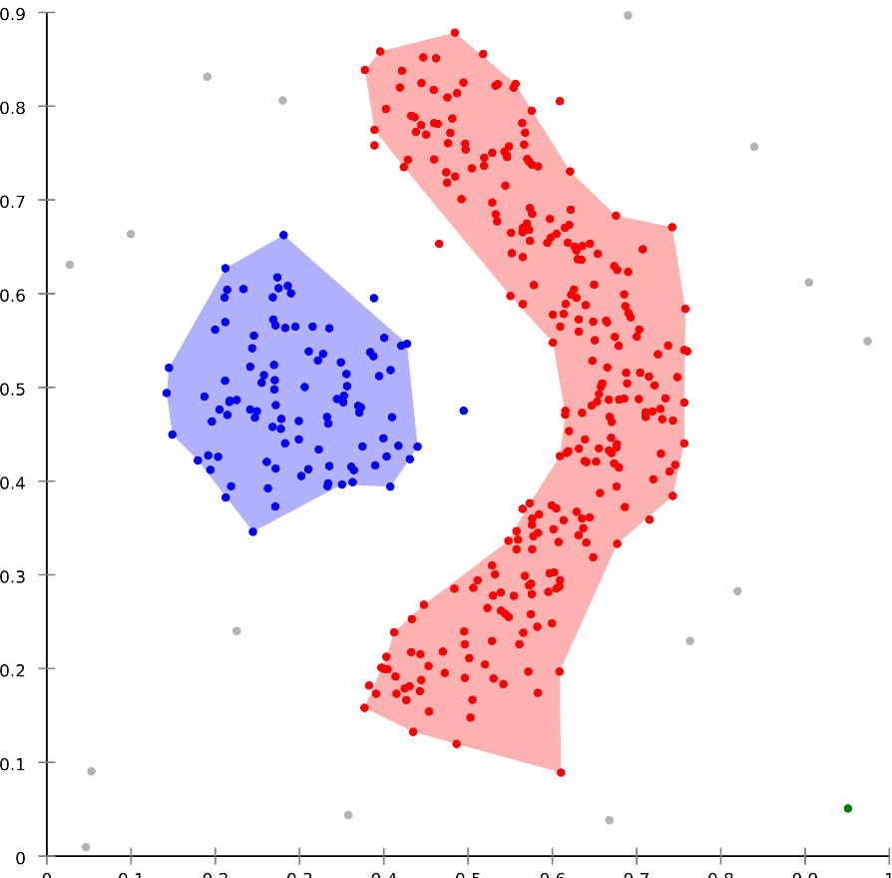
Density-based Spatial Clustering of Applications with Noise (DBSCAN)
Available in SAS/Stat
Invented in 1996
In 2014 the algorithm won the Test of Time Award at Knowledge Discovery and Data Mining Conference.

Slide 18
Density-based Spatial Clustering of Applications with Noise (DBSCAN)
Unlike K-mean, it can discover clusters in any shape, not necessarily an ellipse based on a centroid.
Clusters are grouped by data concentrations, meaning that dense and spare areas are separated.
Outlier/noise excluded

Slide 19
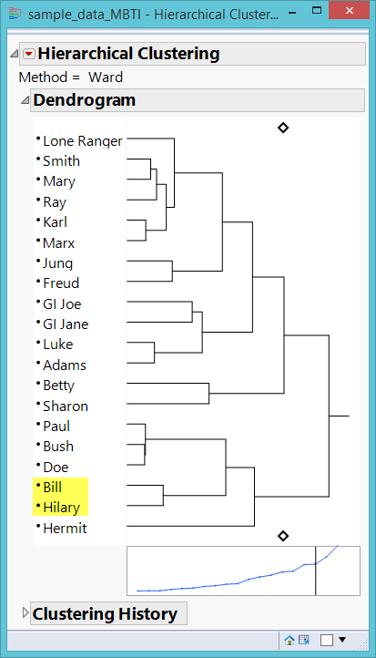
Hierarchical clustering
Grouping/matching people like what e-harmony and Christian-Mingle do.
Who is the best match?
Who is the second best? The third…etc.

Slide 20
Hierarchical clustering
Top-down or Divisive: start with one group and then partition the data step by step according to the matrices
Bottom-up or Agglomerative: start with one single piece of datum and then merge it with others to form larger groups

Slide 21
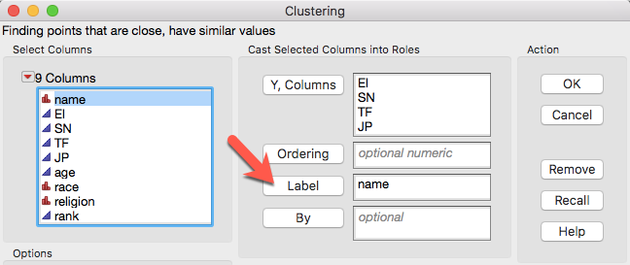
Hierarchical clustering
Data set: MBTI.jmp
MBTI is a measure of personality
Analyze → Clustering → Hierarchical clustering

Slide 22
Hierarchical clustering
HC can work with Multidimensional scaling (MDS) on some data sets.
MDS is a way of visualizing the level of similarity of individual cases of a data matrix (rows and columns are the same).
Bonney, L., & Yu, C. H. (2018, January). Sharing tacit knowledge for school improvement. Paper presented at International Congress for School Effectiveness and Improvement, Singapore.
Five superintendents reviewed 68 statements regarding leadership in education, and decided which concepts are related by pairing them.

Slide 23
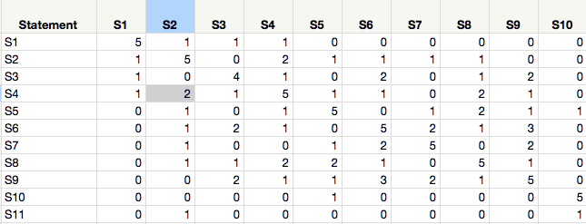
Hierarchical clustering
The numbers show the frequency of pairing.
e.g. Two superintendents said that S2 and S4 are conceptually related.
S4 is related to itself and so the default count is 5.

Slide 24
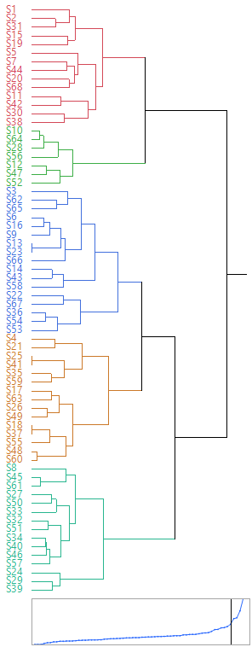
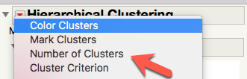
Hierarchical clustering
Based on the result it was decided that there should be 5 clusters.
Assign the number of clusters
Assign a different color to each cluster.

Slide 25
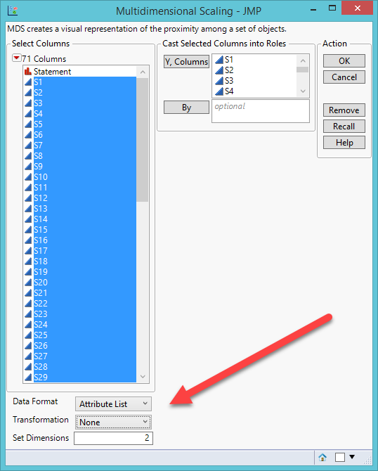
Hierarchical clustering
Analyze → Multivariate Methods → Multidimensional scaling
Data format = Attribute list (distance matrix is constructed from the correlation structure)

Slide 26
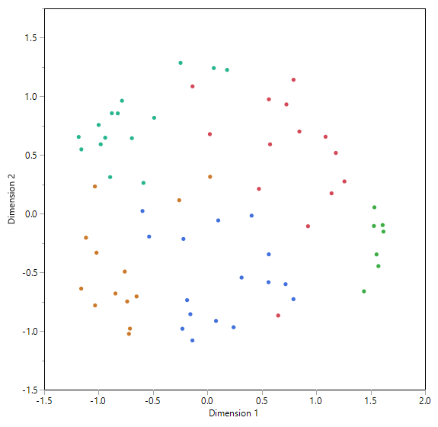
Compare HC and MDS
HC and MDS agree with each other to a large extent
But there are some discrepancies

Slide 27
Compare HC and MDS
Discrepancy is good! Always triangulate with more than one method.
The results are different. Should you side with HC or MDS?
Quantitative methods cannot resolve it.
Read the statements and determine which statement can conceptually (qualitatively) fit into which cluster.

Slide 28
Assignment 7.1
Use JMP sample data: Crime.jmp
Run a hierarchical clustering by including all crime rate.
Set the number of cluster to 5.
Assign a different color to each cluster.
Open Graph Builder and put state into Map Shape
Are crime rates clustered by location?
Subset the “orange” cluster
What are their common characteristics in terms of crime rate? Why?

Slide 29
Two-step clustering
Example: Clustering recovering mental patients
Tse, S., Murray, G., Chung, K. F., Davidson, L., Ng, J., Yu, C. H. (2014). Differences and similarities between functional and personal recovery in an Asian population: A cluster analytic approach. Psychiatry: Interpersonal and Biological Processes, 77(1), 41-56. DOI: 10.1521/psyc.2014.77.1.41

Slide 30
Two-step clustering
What are the relationships between subjective and objective measures of mental illness recovery?
What are the profiles of those recovered people in terms of their demographic and clinical attributes based on different configurations of the subjective and objective measures of recovery?

Slide 31
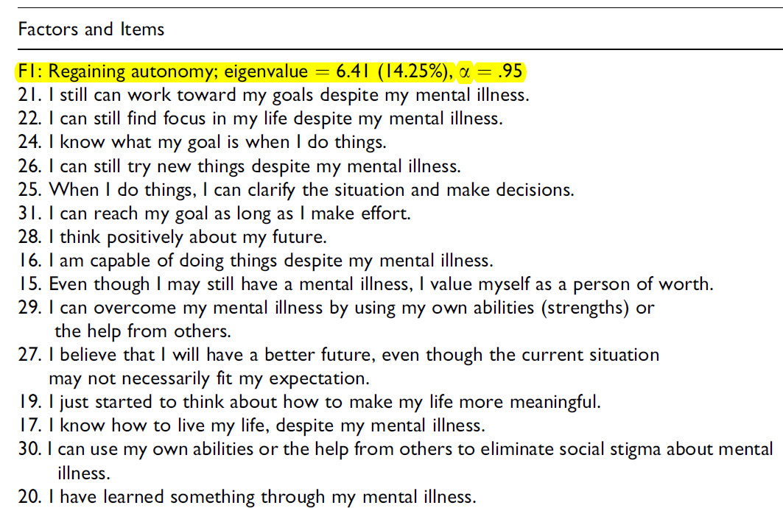
Subjective recovery scale
(E2 Stage model)

Slide 32
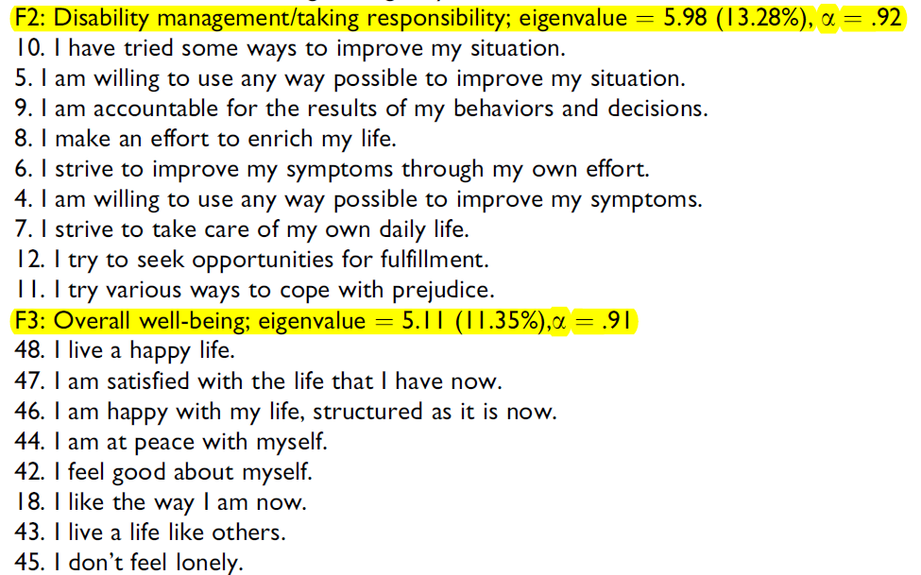
Subjective recovery scale

Slide 33
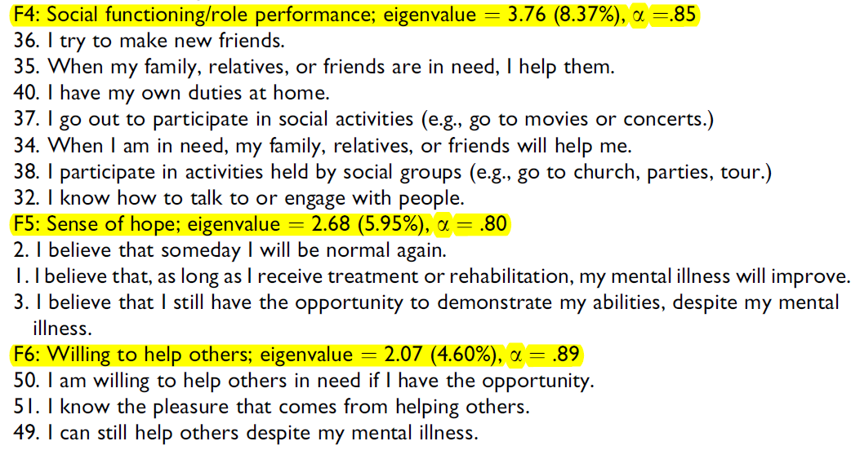
Subjective recovery scale

Slide 34
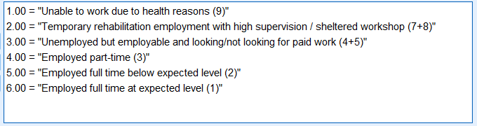
Objective scale 1:
Vocational status
The numbers on the right are the original codes. They were recoded to six levels so that the scale is ordinal. e.g. Employed full time at expected level is better than below expected level.

Slide 35
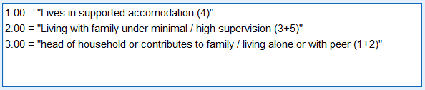
Objective recovery scale 2:
Living status
The numbers on the right are the original categories. They were collapsed and recoded so that the scale is converted from nominal to ordinal. e.g. Head of household is better than living with family under supervision.

Slide 36

Participants
150 recovering or recovered patients (e.g. bipolar, schizophrenia) in Hong Kong.
Had not been hospitalized in the past 6 months.

Slide 37
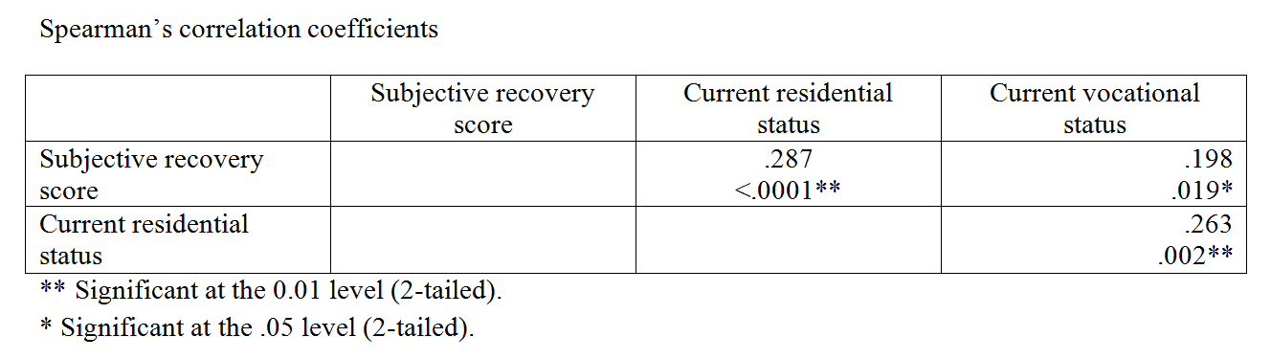
Analysis:
Correlations among the scales
The Spearman’s correlation coefficients are small but significant at the .05 or .01 level. However, the numbers alone might be misleading and further insight could be unveiled via data visualization.

Slide 38
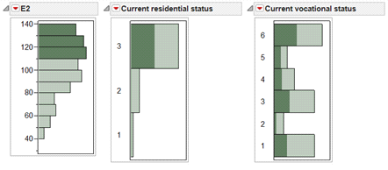
Data visualization: Linking and brushing
The participants who scored high in the subjective scale (E2) also ranked high in the current residential status
But they are all over the vocational status, implying that the association between the subjective scale and the vocational status is weak.

Slide 39
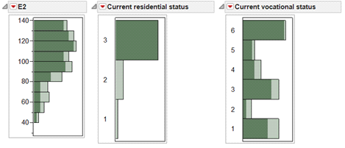
Data visualization: Linking and brushing
The reverse is not true. The subjects who scored high in the residential status (3) spread all over in the subjective scale (E2) and the vocational status

Slide 40
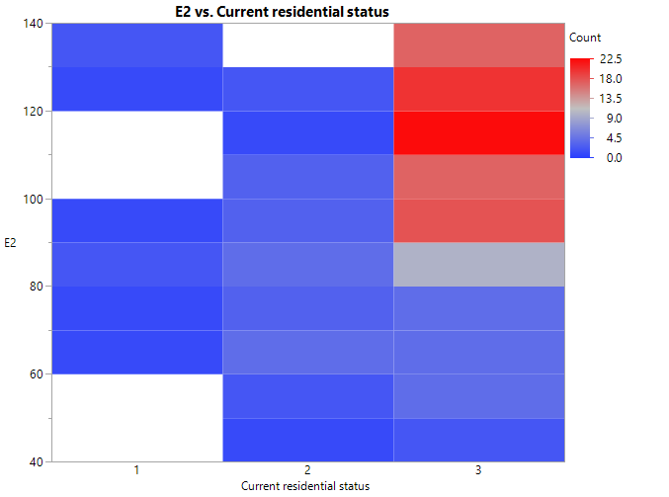
Data visualization: Heat map
View data concentration

Slide 41
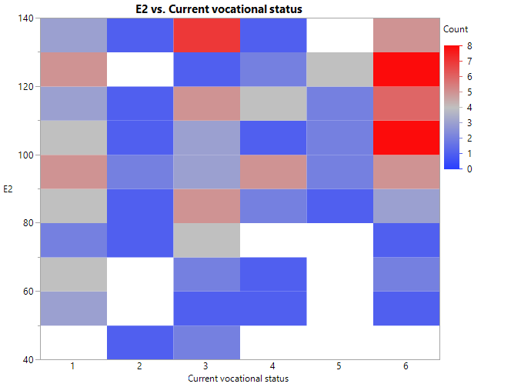
Data visualization: Heat map

Slide 42
Two-step cluster analysis
In this study one subjective and two objective measures of recovery were used to measure the rehab progress of the participants.
Two-step
  Step 1: To avoid unnecessary complexity, cluster analysis condenses the dependent variables by proposing certain initial clusters (pre-clusters).
  Step 2: Make final clusters

Slide 43
Two-step cluster analysis
Available in SPSS
Use AIC or BIC to avoid complexity
Can take both continuous and categorical data (vs. K-mean can take continuous data only)
Truly exploratory and data-driven (vs. K-mean prompts you to enter the number of clusters)
Group sizes are almost equal (vs. K-mean groups are highly asymmetrical)

Slide 44
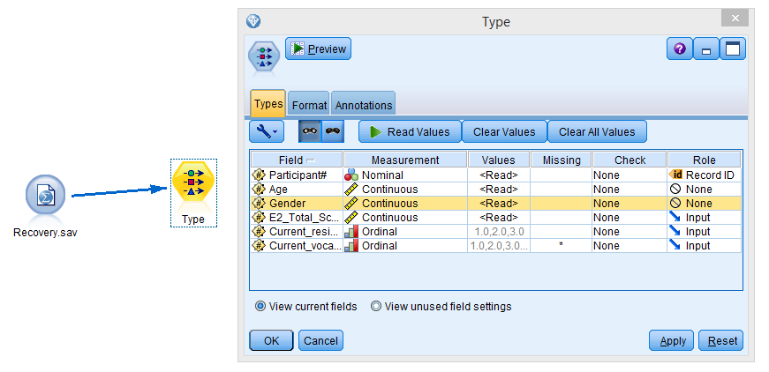
IBM SPSS Modeler

Slide 45
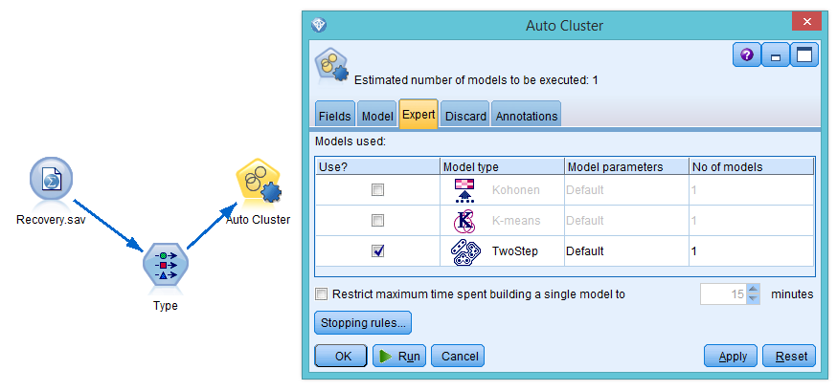
IBM SPSS Modeler

Slide 46
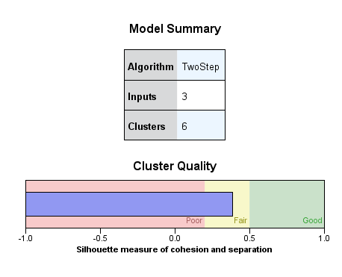
Cluster quality
Yellow or green: go ahead
Pink: pack and go home

Slide 47
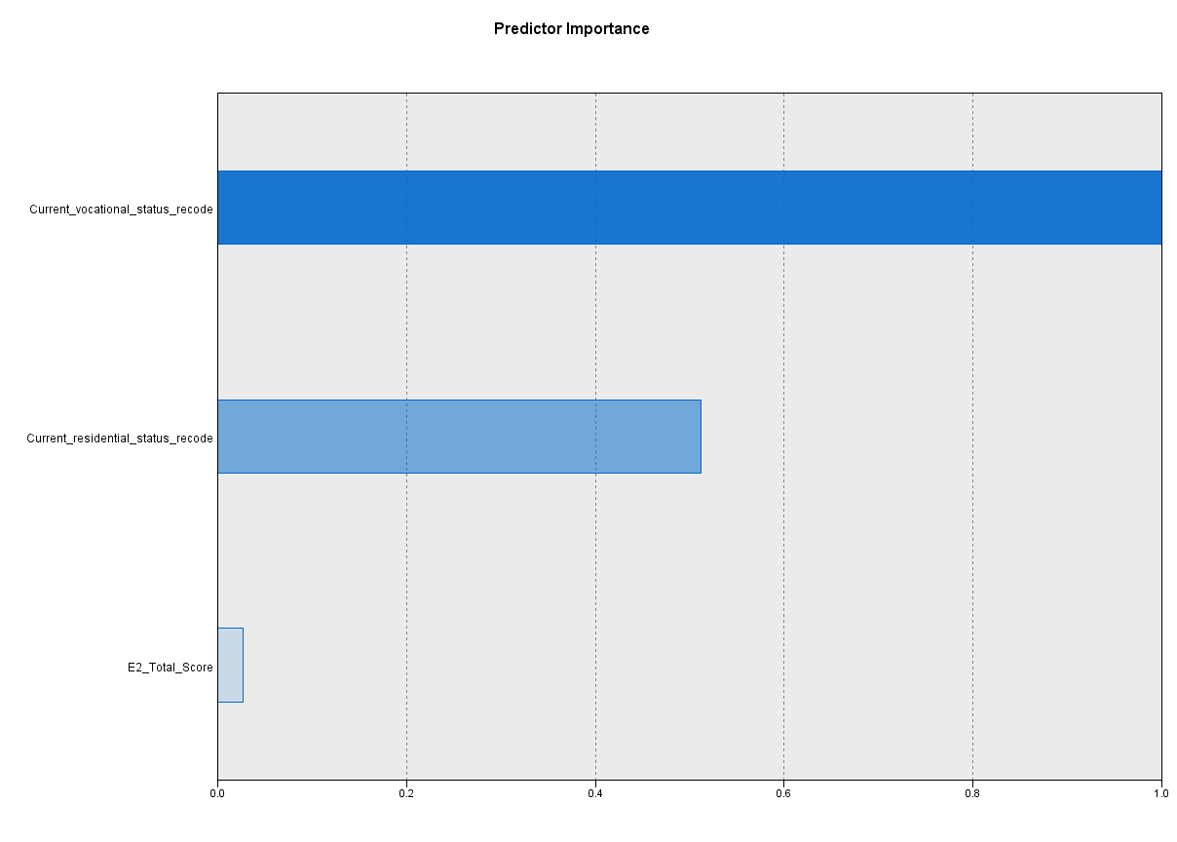
Predictor importance
Subjective feeling doesn’t matter!

Slide 48
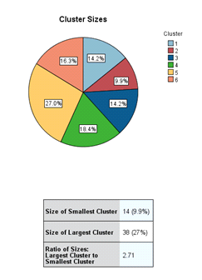
Number of clusters

Slide 49
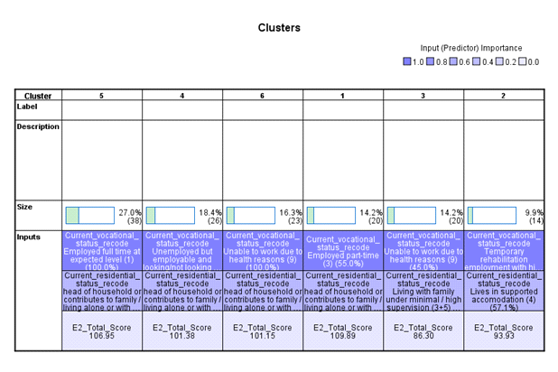

Slide 50
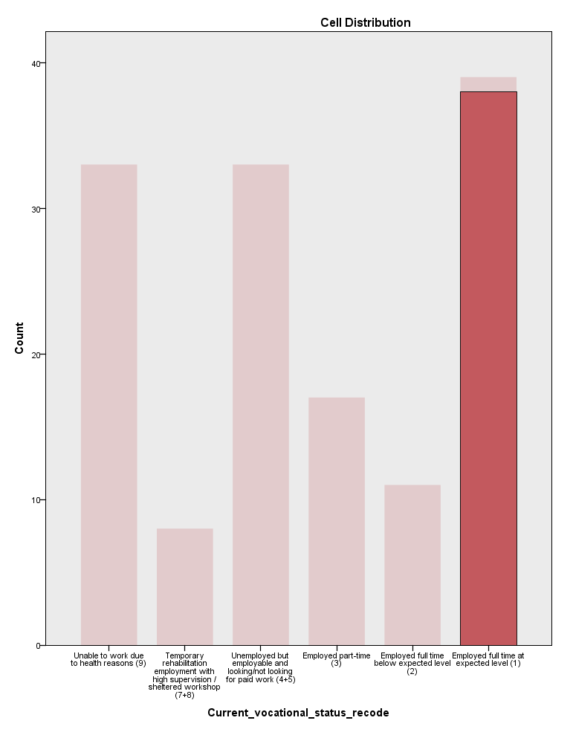
Cluster 5
In cluster 5 the grouping by vocational is very “clean” or decisive because almost all subjects in the group chose “employed full time at expected level”.

Slide 51
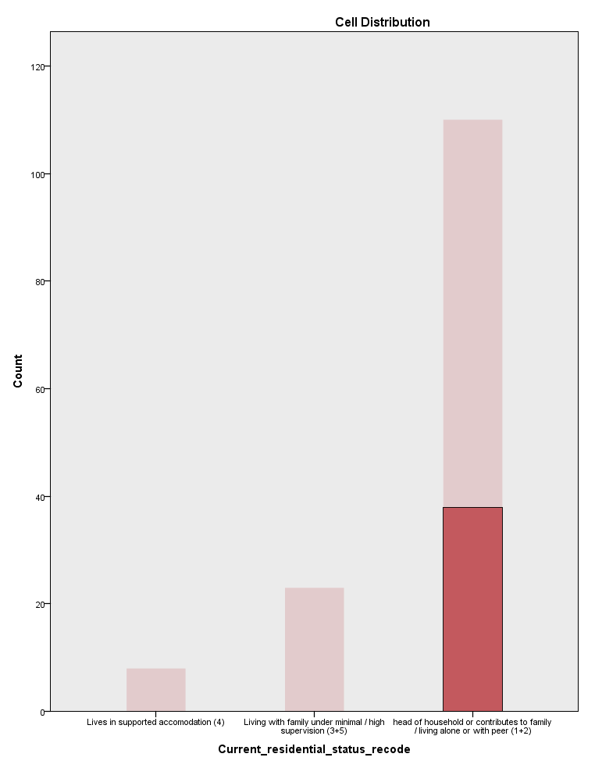
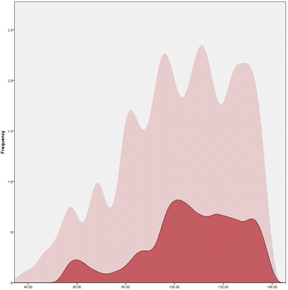
Cluster 5

Slide 52
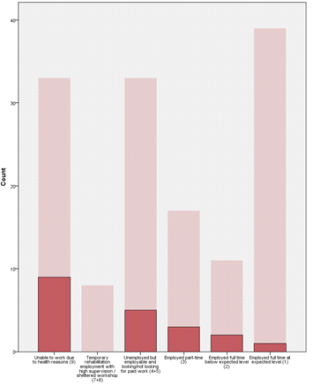
Cluster 3: Messy

Slide 53
Cluster 5: The best
The clustering pattern suggests that Cluster 5 has the best cluster quality in terms of the homogeneity (purity) in the partition. In addition, the subjects in Cluster 5 did very well in all three measures, and therefore it is tantalizing to ask why they could recover so well.
But cluster analysis is a means rather than an end. Further analysis is needed based on the clusters. Our team found that family income can predict whether the subjects are in Group 5 or others.

Slide 54
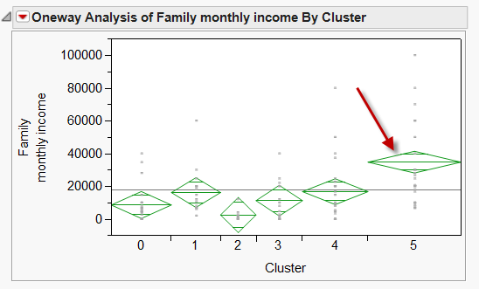
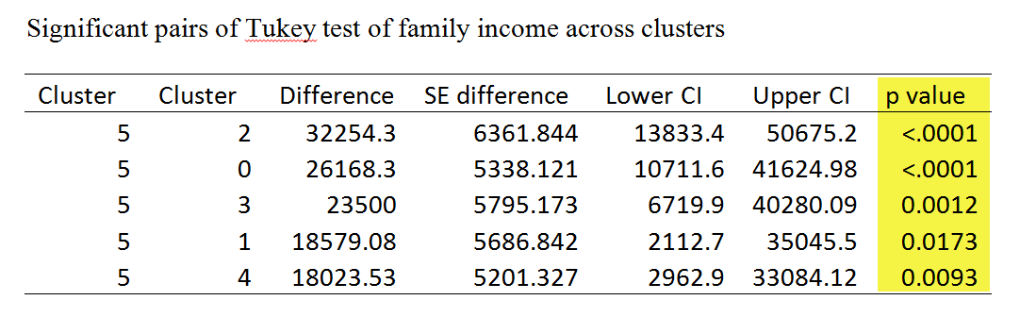
Diamond plot

Slide 55
Family income: Cause or effect?
Cluster 5 (the best group in terms of both subject and objective recovery) has a significantly higher income level than all other groups.
Plausible explanation 1: they recovered and are able to find a full time job, resulting in more income.
Plausible explanation 2: the family have more money and thus more resources to speed up the recovery process.

Slide 56
Assignment 7.2
Data set: Best_college.sav
Lists 400 world’s best colleges and universities compiled by US News and World Report. The criteria include:
  Academic peer review score
  Employer review score
  Student to faculty score
  International faculty score
  International students score
  Citations per faculty score

Slide 57
Assignment 7.2
Educational researchers might not find the list helpful because the report ranks these institutions by the overall scores.
We want to find the grouping pattern (Categorizing the best schools by common threads).
Use IBM SPSS Modeler to run a two-step cluster analysis.
Use all criteria set by US News and World Report, plus geographical location.

