Slide 1
Text Mining
Chong Ho Yu, Ph.D., D. Phil.

Slide 2

What is text mining?
Also known as text analytic.
A process of extracting useful information from document collections through the identification and exploration of interesting patterns (Feldman & Sanger, 2007).

Slide 3
What is text mining?
While data mining is often used to analyze structured data, which is a small percentage of existing data sources, text mining is the ideal tool for tapping into under-utilized, unstructured data.
Difference: numeric data vs. textual data
Same principles
  Extraction (mining)
  Exploration
  Pattern seeking
You! yes, you created textual data everyday! Whenever you send emails and post messages on your FaceBook or blog, these become data! And we have tons of back data (historical archives)

Slide 4
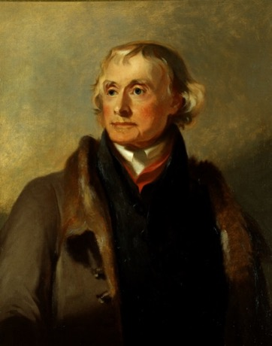
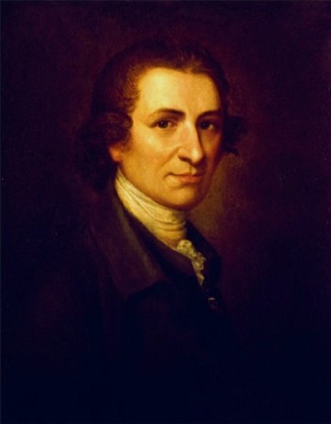
Question 1
Some scholars argue that America is not a Christian nation in the sense that the Christian belief is not the foundational ideology shared by our founding fathers.
Indeed several founding fathers and influential figures are deists, such as Thomas Jefferson and Thomas Paine.
How can you respond to this question?

Slide 5
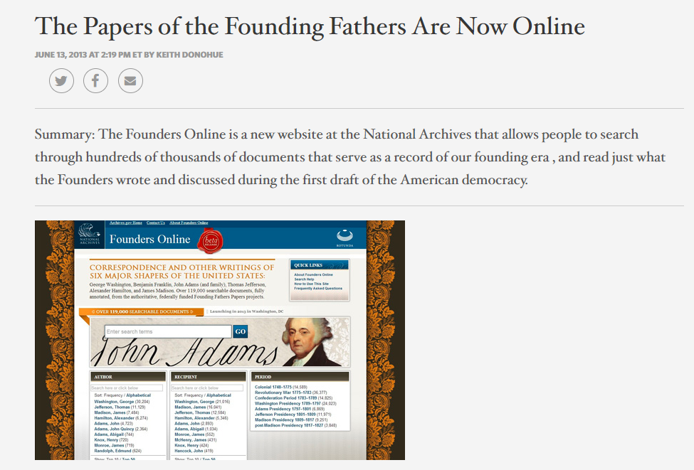

Slide 6

Question 2
How is American idols related to text mining?
May 2010 show
23 million viewers
Who will be the winner?

Slide 7
Text mining predicted winner
MTV.com: “American idol’ Finale: Lee DeWyze upsets Crystal Bowersox”
But text miners saw it coming without polling data.
They monitored social media and conducted sentiment analysis (will be discussed later)

Slide 8
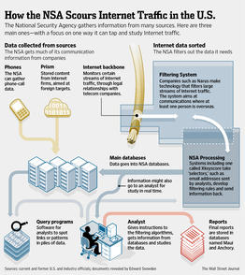
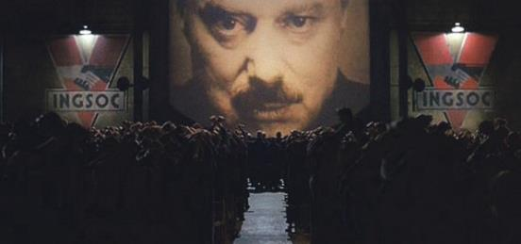
Question 3
How is anti-terrorism
related to text mining?
NSA veteran William Benny estimates that NSA had collected between 15 and 20 trillion transactions in 11 years.
Big brother is watching you!

Slide 9

How is anti-terrorism related to text mining?
DoD funded ASU researchers to study the messages posted by Islamists.
They concluded that verses extremists cite from the Quran do not emphasize conquest of infidels.

Slide 10
The forerunners of TM
TM is not entirely new.
Qualitative researchers have been doing content analysis and grounded theory
Yu, C. H. & Marcus-Mendoza, S. (1993). Attitudes of correctional staff. In B. R. Fletcher, L. D. Shaver, & D. G. Moon (Eds.), Women prisoners: A forgotten population (pp.111-118). Westport, Connecticut: Praeger.

Slide 11


Qualitative method
Classify how correctional officers perceive the objective of imprisonment by reading their responses to open-ended questions.
  Retribution
  Deterrence
  Rehabilitation/restoration
This is tedious to read through the documents! Today we have AI!

Slide 12
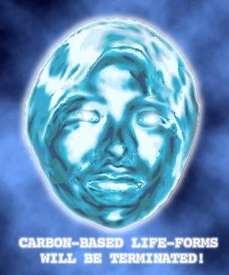
Artificial intelligence
TM utilizes the technology of natural language processing, a subfield of artificial intelligence (AI) & computational linguistics.
Why do we need natural language processing in data mining?
The software app must be smart enough to understand the context.

Slide 13
Natural Language Processing
They don’t mean the same thing
I book a ticket to Paris.
Hanna read Dr. Yu’s boring book.
Peter is a senior at Azusa Pacific University.
Alex received a senior discount at TJX (soon).
Paul is a senior manager at TJX.
Age and sex are included in the demographic data.
Jesse Helms proposed an amendment to ban sex education.

Slide 14
Artificial intelligence
Well, I don’t work at NSA. I don’t have AI software. What I have is the opposite of artificial intelligence: genuine stupidity.
Can I still do something about text mining?

Slide 15
What can TM do?
Hypothesis generation by Swanson process.
Based on the idea of concept linking, Swanson (1986) carefully scrutinized the medical literature and identified relationships between some apparently unrelated events, namely, consumption of fish oils, reduction in blood viscosity, and Raynaud’s disease.

Slide 16
Hypothesis generation
His hypothesis that there was a connection between the consumption of fish oils and the effects of Raynaud’s syndrome was eventually validated by experimental studies (DiGiacomo., Kremer, & Shah, 1989).
Using the same methodology, the links between stress, migraines, and magnesium were also postulated and verified.

Slide 17
Steps
Pre-processing and extraction: Obtain meaningful terms and phrases.
  Tokenization
  Stop-word removal
  Stemming
  Lemmatization
Categorization: Classifying terms and phrases into concepts or themes.
Concept linking: Identifying the relationships between concepts

Slide 18
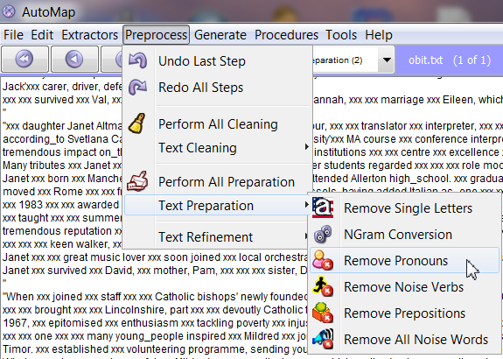
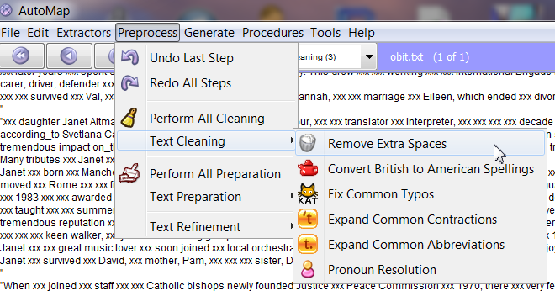
Some software apps (e.g. AutoMap [freeware]) require too much manual pre-processing inputs

Slide 19
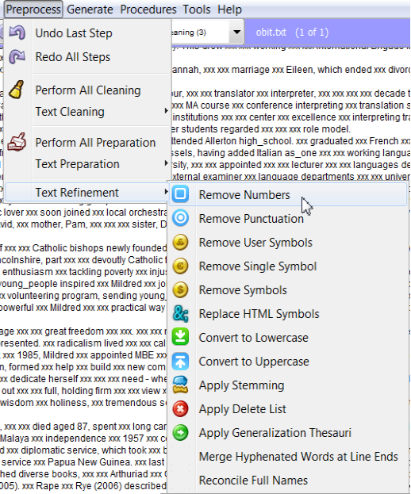
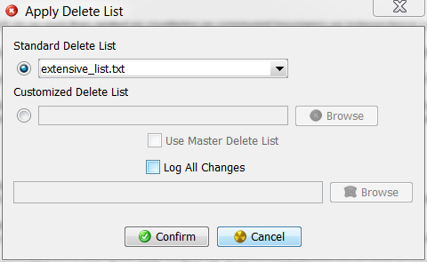
Too much manual pre-processing inputs

Slide 20
Tokenization
Pre-processing should be automatic
Separating the punctuation from the words yet the results are still meaningful.
For example, there are periods inside a string of IP address, such as “129.2.13.105,” but if all periods are removed, then the string “129213105” would become meaningless

Slide 21
Stop-word removal
Remove trivial words, such as “a,” “an,” “the,” “is,” “am,” “are,” “however,” “although,” “but,” etc.,
This process necessitates AI, otherwise, on some rare occasions important information might be lost.
“To be or not to be”
“If it is to be, it is up to me.”

Slide 22
Stemming and Lemmatization
Stemming: remove prefix and suffix e.g. “computer”, “computational”, and “computing” can be reduced to the same stem, “compute”
Lemmatization: use a set of rules to reduce the inflectional forms of a word to its root form e.g. “boys” can be changed to “boy” and “children” becomes “child”

Slide 23
Software modules
We will compare the results of several text mining approaches, including:
  JMP Pro: Text Explorer
  IBM SPSS Modeler: Sentiment analysis
  IBM SPSS Modeler: Text Mining: No pre-built category
  IBM SPSS Modeler : Customer survey category

Slide 24
Example 1
The same data source, which encompasses responses to an open-ended survey item collected from a US Southwestern university, was used for extracting common threads.
“If you had the ability to design your ideal online learning environment--What would you like to see? How would it look and feel? What features would it have?”
Effective sample size: 3,193

Slide 25
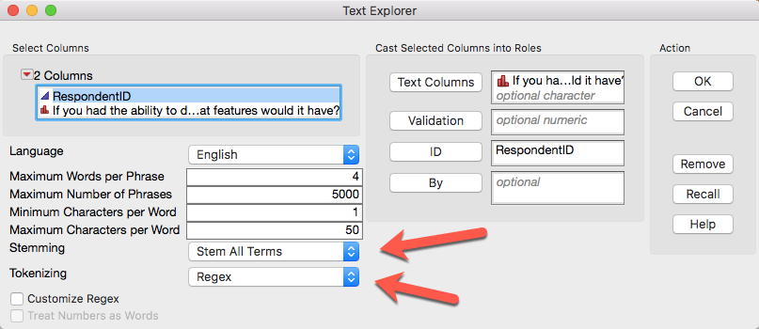
Text Explorer in JMP
Analyze → text explorer

Slide 26
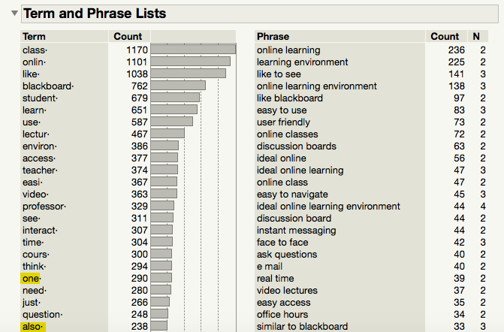
Text Explorer in JMP
Phrases are good.
Terms: Stop-word removal isn’t good.

Slide 27
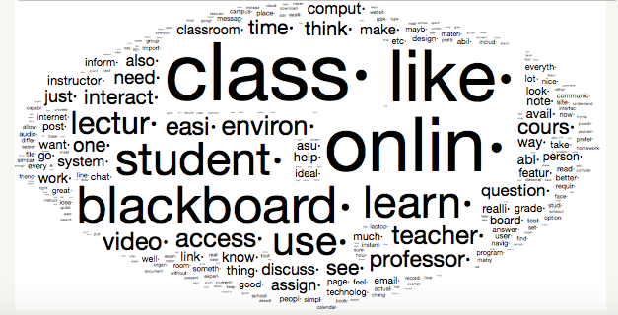
Word Cloud
Fun to look at but may not be helpful to research

Slide 28
Sentiment analysis
Also known as opinion mining
Sentiment means an attitude or judgment based on one’s feeling e.g. “I don’t like the computer lab”
Opinion is a view or appraisal about a particular matter e.g. “I think the computers at the lab are outdated”
Used interchangeably

Slide 29
Challenges to SA
In some cases classifying sentiment as positive, negative, or neutral is straight-forward while in some situations it is tricky.
  Sarcasm
  Negation
  Valence-shifting
  Irrealis

Slide 30
Sarcasm
When the writer made sarcastic expressions, it could fool a regular text mining software package
Consider this passage: “The professor is very great! I didn’t study at all. I closed my eyes throughout the whole semester and still got an A!”

Slide 31
Negation
The positive polarity is reversed by a negative word.
“No one thinks it is good.” In this case, although “good” is a positive word, the phrase “no one” alters its connotation

Slide 32
Value-shifting
In some cases a single word in a sentence shifts the meaning.
This is a missed opportunity”
“The medicine kills cancer cells”

Slide 33
Irrealis
When a conditional sentence implies a counterfactual scenario, it might be difficult to tell whether it is positive or negative
“It would be better if the Wi-Fi network is faster.” The student might be satisfied with the existing connection speed but he is looking for more bandwidth. It might also be the case that he could not stand the slowness of the current Wi-Fi network.

Slide 34
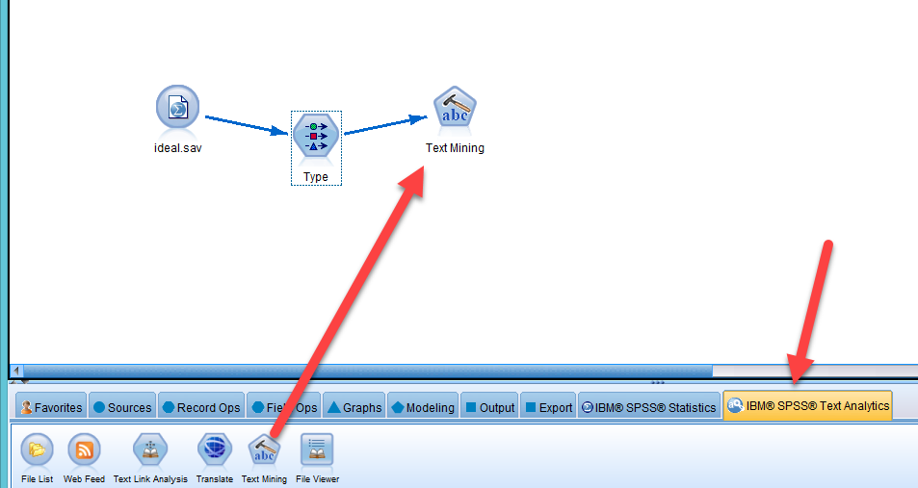
IBM SPSS Modeler:
Text Analytics
Windows only

Slide 35
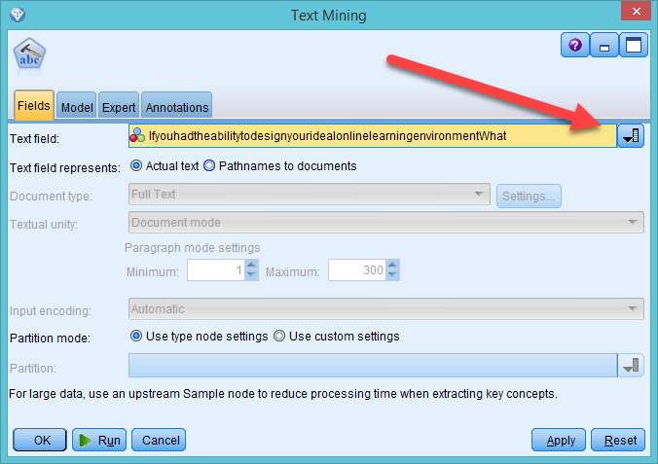
IBM SPSS Modeler:
Text Analytics
Choose the text field to analyze

Slide 36
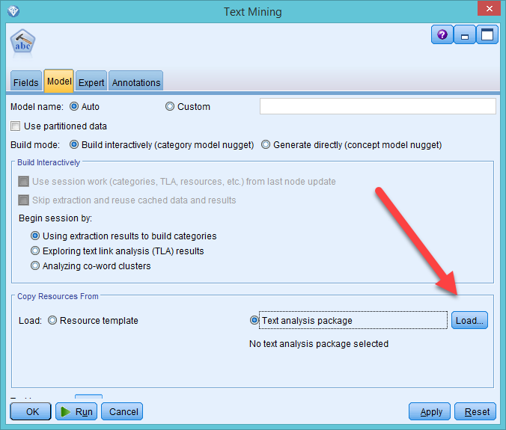
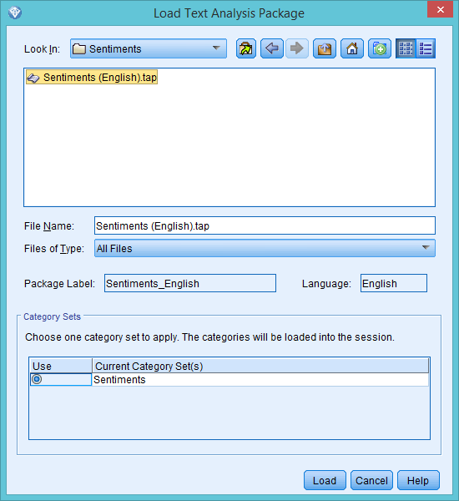
IBM SPSS Modeler:
Text Analytics
Load a pre-set package → English → Sentiment

Slide 37
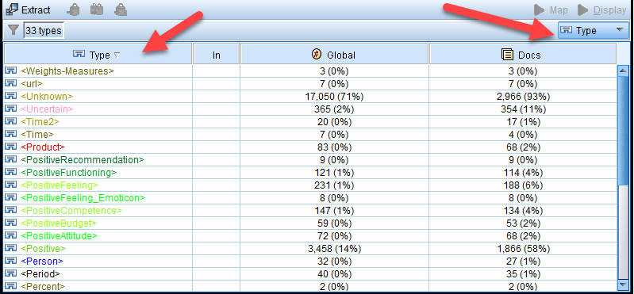
IBM SPSS Modeler:
Text Analytics
Choose Type and Sort
Look for sentiment: Positive and negative

Slide 38
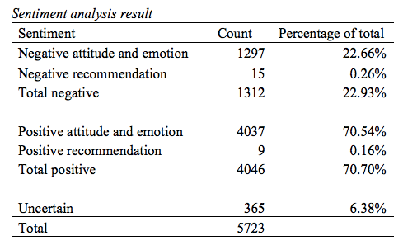

Slide 39
Example of positive recommendation
“The features that Blackboard has are very nice, the only difference is that the email program does not always work very well when sending messages to classmates through the roster, so I would try to improve that.”

Slide 40
Example of negative recommendation
“Classes categorized either by day/time, or by subject. It would be neat if they were in chronological order because that's how I go about my week. Color coding or a ranking system for announcements that teachers put out to class-- i.e. is it about today's cancelled lecture or is it a review for the test? And if there IS a cancelled class, it should show up as the first thing I see, or it should send me an e-mail so I KNOW it's cancelled before I get there.”

Slide 41
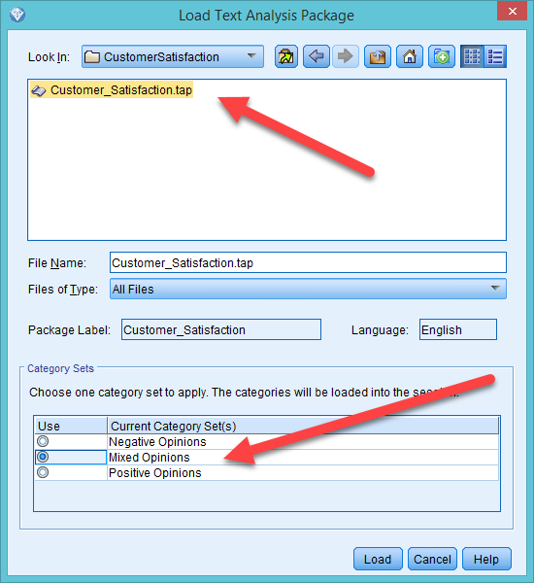
IBM SPSS Modeler
The software app is made for business, and thus it has a pre-built text mining package for customer satisfaction.
Let’s treat students as customers.

Slide 42
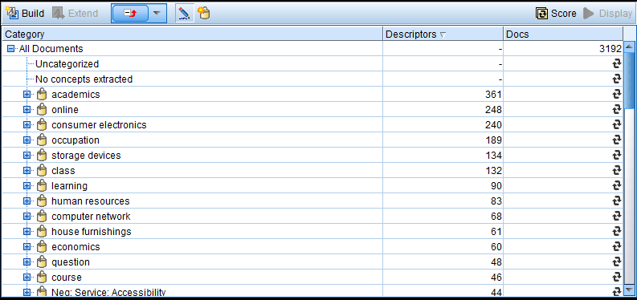
IBM SPSS Modeler:
Build the categories (concepts) based on the recurring terms and phrases.

Slide 43
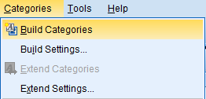
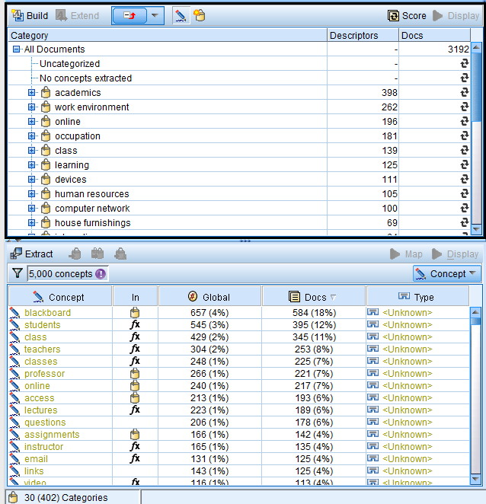
Categorization
Modeler counts the frequency of terms and phrases.
Based on the words it builds categories.

Slide 44
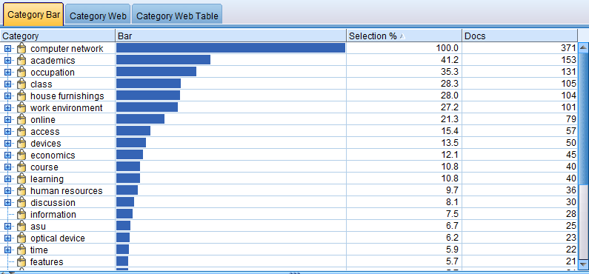
Category Bar by frequency
Hit Display to show the table and the map.

Slide 45
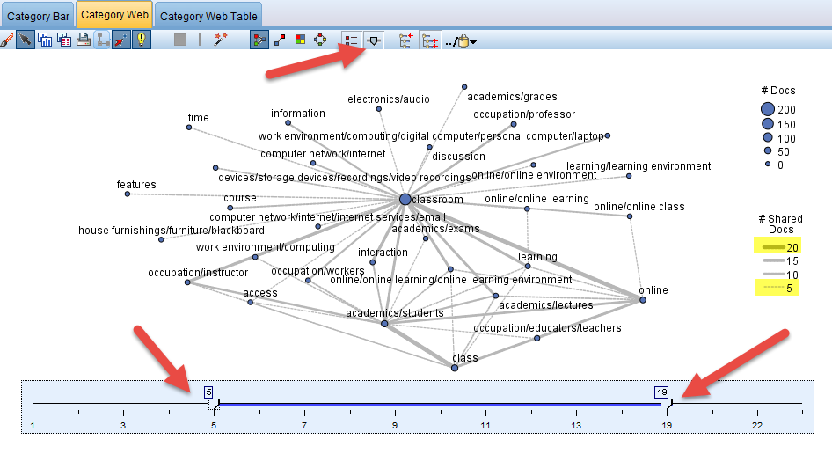
Category Web:
Show how themes are related.
Set the range of the frequency to avoid over-plotting.

Slide 46
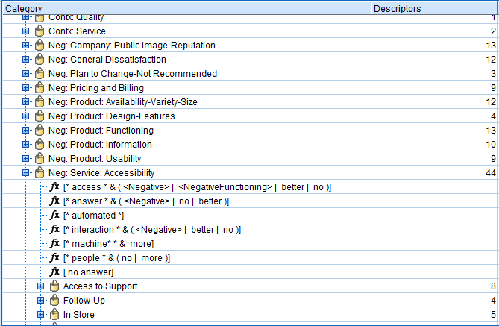
Pre-built categorization: Customer Survey
When a pre-built category package (e.g. customer survey) is used, the result is different.
Text analysis looks for “usability”, “functioning”, “accessibility”…etc.
You can mine the text without using any pre-built package.

Slide 47
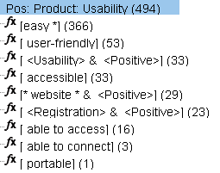
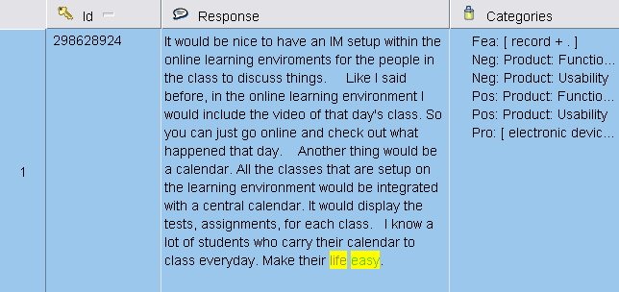
Example of sub-categories
The researcher can drill down the category to view the sub-categories.
The original responses are highlighted for the researcher to cross-examine.

Slide 48
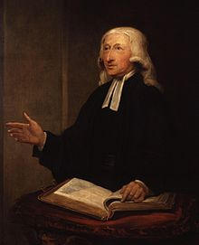
Question
What are the central theme of John Wesley's Methodist movement?
Some people said that he had no intention to start a new denomination, and thus his sermons were not opposed to the Church of England.
How could we find out?

Slide 49
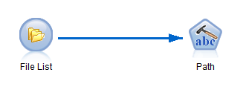
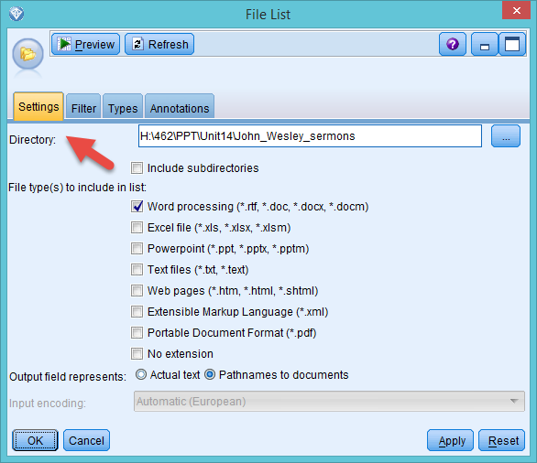
Mine documents
You can save documents (e.g. Word, PDF…etc,) in a folder and make Modeler to scan all files on the list.

Slide 50
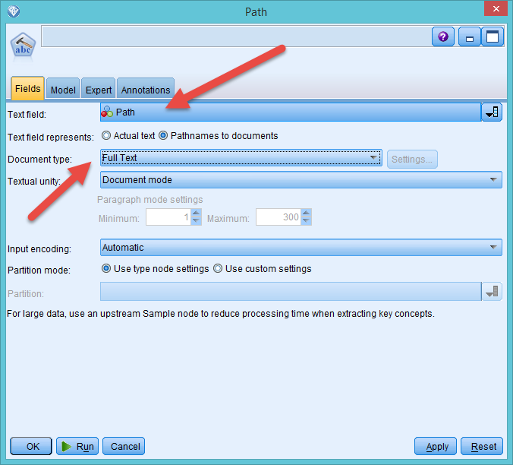
Mine documents

Slide 51
Similar question
One of the most famous sermons written by Johnathan Edwards (1703-1758) is "Sinners in the Hands of an Angry God”
The message is simple: if you don’t believe in Jesus, you will go to Hell.
Is fear of divine punishment the central theme during the Second Great Awakening?
Text mining of all his sermons: http://www.jonathan-edwards.org/

Slide 52
Example 2:
Psychology of religion
Yu, C. H. (2015). Are positive trait attributions for the deceased caused by fear of supernatural punishments?: A triangulated study by content analysis and text mining. Journal of Psychology and Christianity, 34, 3-18.
This project is a replicated and enhanced study of Jesse Bering’s research on perceptions of dead agents.
Utilizing the framework of cognitive psychology and evolutionary psychology, Bering hypothesized that humans have a natural tendency to perceive that cognitive systems continue to function after death, and this disposition might be the psychological foundation of religion.

Slide 53

Context
Bering and his associates conducted a content analysis by extracting trait attributions from 496 obituaries published in the New York Times. The trait attributions were classified according to the categories in the Evaluation of Other Questionnaire (EOOQ).

Slide 54
Context
Bering found that in those obituaries pro-social and morality-related attributes of the dead people appeared more frequently than other types of qualities, such as achievements.
Along with the findings form other similar studies, Bering and his colleagues asserted that this behavioral pattern might result from adaptions during the evolutionary process.

Slide 55

Specifically, if dead agents were believed to be aware of what the living people said and did, it could strengthen our moral framework.

Slide 56
Limitation of Bering’s study
Bering’s study has certain limitations. It is important to point out that 41% Americans attend church on a regular basis, and Christianity has major impacts on every aspect of people’s life.
A Gallup poll shows that 92% Americans believe in the existence of God. Thus, the wording patterns found in New York Times obituaries and the idea of afterlife among the Americans could be a cultural product, instead of a natural tendency.

Slide 57
Purpose
Another sample is needed in order to further examine Bering’s notion. In contrast to the US, in the UK churchgoers are 10% of the entire population, and 44% of UK citizens believe in God.
UK is more secular than the US. If the perception of active dead agents is really natural or a-cultural, then the trait attributions found in the US sample should also be observed in the UK.
In this project 400 obituaries were sourced from two UK newspapers, namely, Guardian and Independent.

Slide 58
Methodology
Replicate the study using content analysis based on EOOQ and data-driven categories in MAXQDA
Triangulate data analysis using SPSS Text Analytics
Content analysis relies on human on coders whereas text mining is automated by natural language processing and computational linguistics.
Coded variables were exported to JMP for quantitative analysis

Slide 59
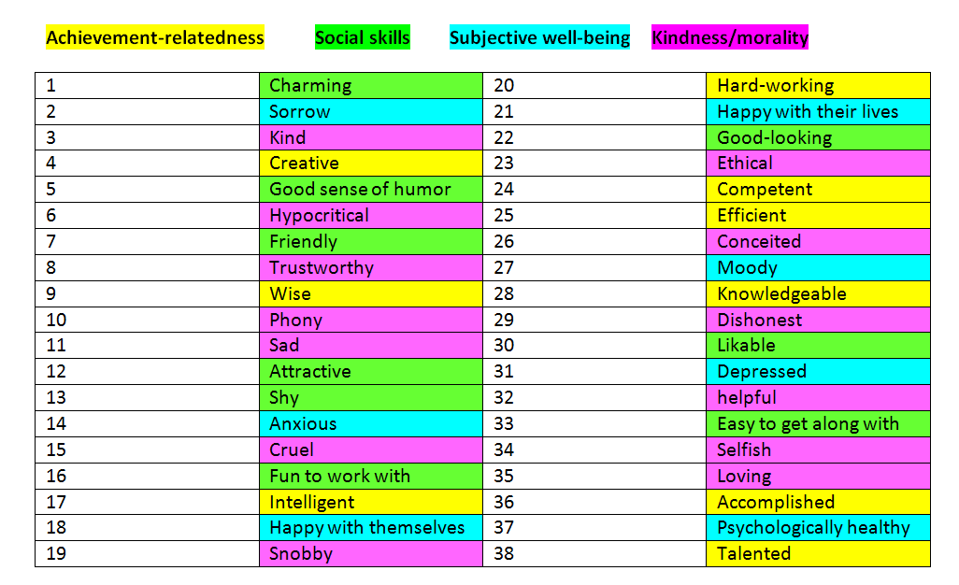
EOOQ
It is extremely rare to see negative attributes, such as “hypocritical” and “selfish” in those obituaries, and thus these categories are not useful.

Slide 60
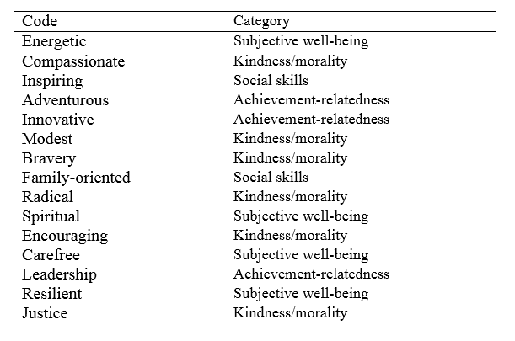
New categories driven by the data
Some new categories were created by the coders.

Slide 61
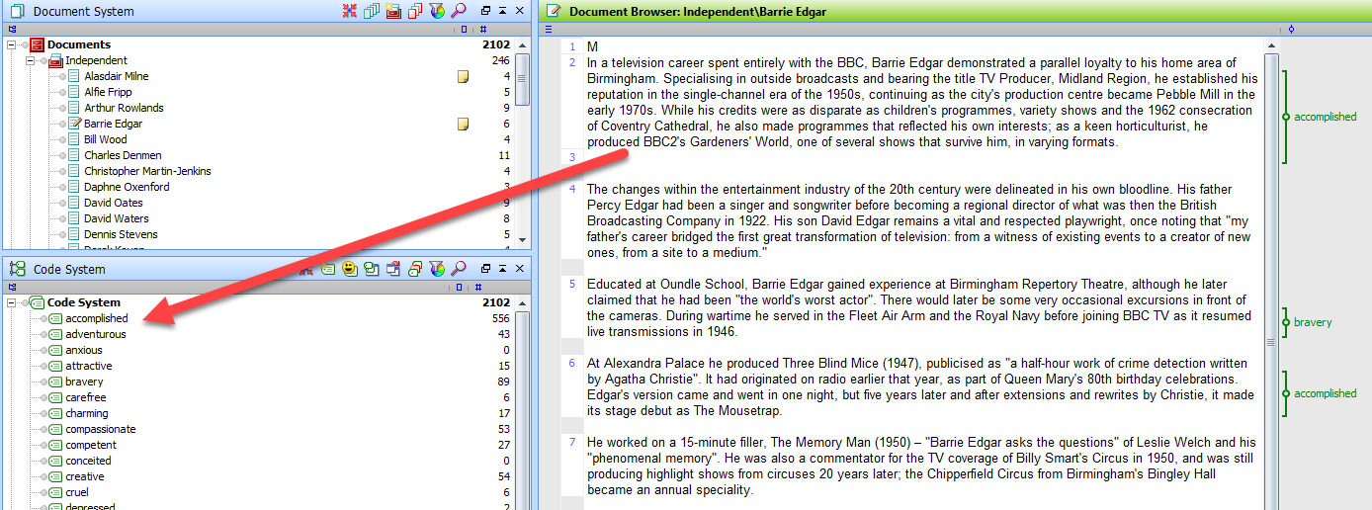
MAXQDA
Human coders:
  More accurate than machine coding
  Subject to fatigue and bias
  Take forever with big data
Classify the passage by dragging and dropping

Slide 62
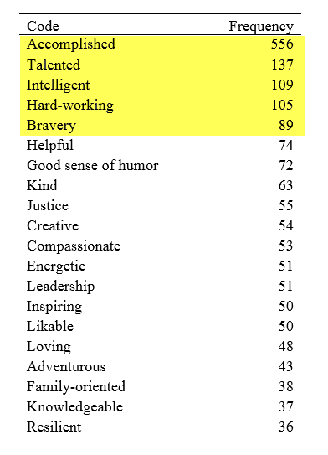
Content analysis results
The most frequent recurring traits are achievement-related.

Slide 63
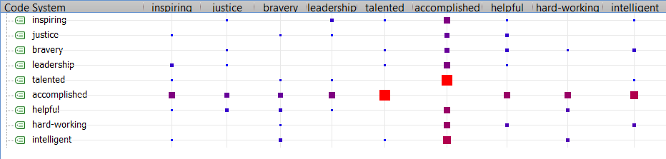
Code relation chart in MAXQDA
Symmetrical data matrix; R1=C1, R2 = C2 (as what you saw in MDS)
The frequency of co-occurrence is depicted by the size and the color of the square.
Accomplished tends to co-occur with inspiring, justice, bravery, talented, leadership, helpful, hard-working, and intelligent.

Slide 64
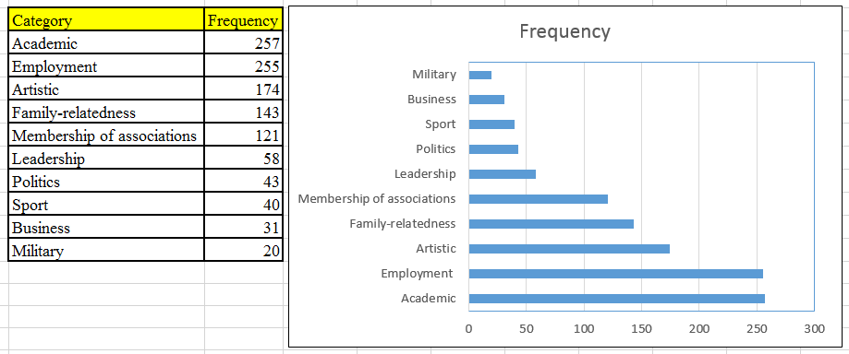
SPSS results

Slide 65
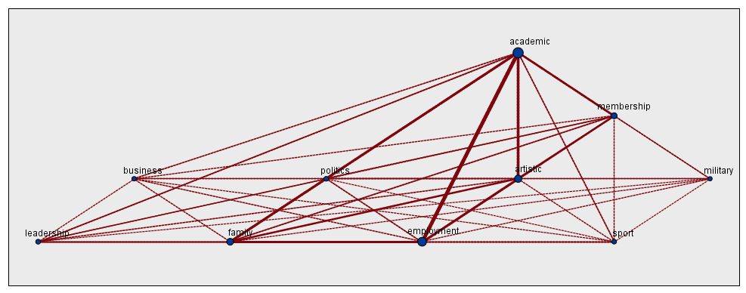
SPSS Category web
Click Display
Similar to Code relation chart in MAXQDA
Thicker line → stronger relationship (more co-occurrence)

Slide 66
Conclusion
The study is triangulated by content analysis (human coders with MAXQDA) and text mining (SPSS text mining algorithms).
In the UK sample achievement-oriented traits occurred more often than pro-social and morality-related traits. This finding suggests that the alleged perception of dead agents may be more cultural than natural.

Slide 67
Recommendations
Some authors (e.g. Bennett, Dumais, & Horvitz, 2005) suggest ensemble methods, such as using multiple text mining tools and assigning reliability index to each of the results.
Next, the research can select the best text classifier or combining all results to generate a meta-result.

Slide 68
Recommendations
The text miner should have some preconception of what they are looking for (e.g. customer satisfaction? Technical support issues? Student expectation?).
In this sense, only one set of categorization is considered proper and comparison across different text mining results may be not necessary.

Slide 69
Recommendations
Triangulation between results coded by humans and concepts extracted by text mining is good for a small project.
When there are too many documents, sample a subset for human coders for comparison or use text mining only.

